Slide 1
Chapter 4 C Program Control

Slide 2
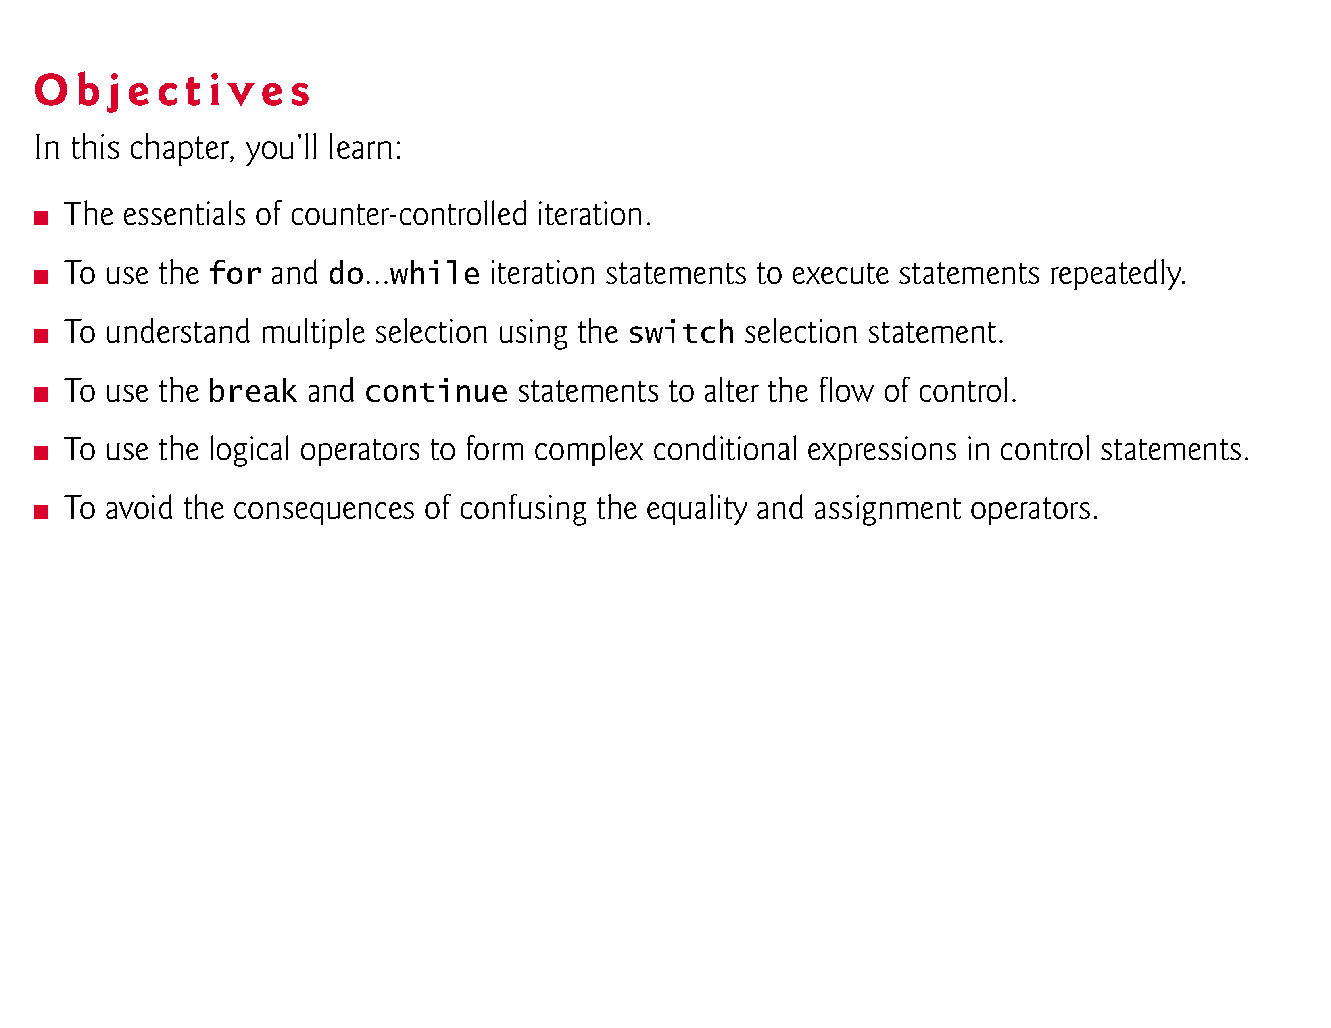

Slide 3
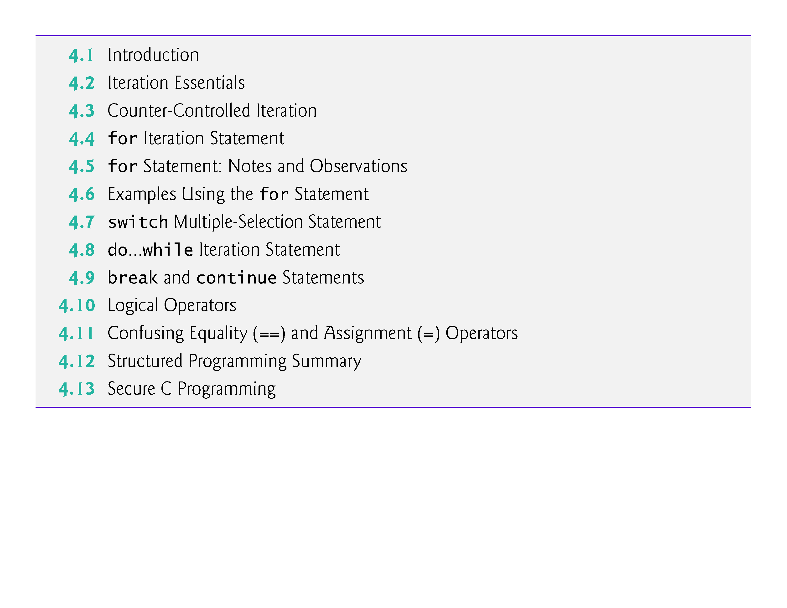

Slide 4
4.1 Introduction
In this chapter
iteration is considered in greater detail
additional iteration control statements, namely the for and the do…while
switch multiple-selection statement
break statement for exiting immediately from certain control statements
continue statement for skipping the remainder of the body of an iteration statement and proceeding with the next iteration of the loop.
Logical operators used for combining conditions
Summary of the principles of structured programming as presented in Chapter 3 and 4.

Slide 5
4.2 Iteration Essentials
A loop is a group of instructions the computer executes repeatedly while some loop-continuation condition remains true.
We’ve discussed two means of iteration:
Counter-controlled iteration
Sentinel-controlled iteration
Counter-controlled iteration is sometimes called definite iteration because we know in advance exactly how many times the loop will be executed.
Sentinel-controlled iteration is sometimes called indefinite iteration because it’s not known in advance how many times the loop will be executed.

Slide 6
4.2 Iteration Essentials (Cont.)
In counter-controlled iteration, a control variable is used to count the number of iterations.
The control variable is incremented (usually by 1) each time the group of instructions is performed.
When the value of the control variable indicates that the correct number of iterations has been performed, the loop terminates and execution continues with the statement after the iteration statement.

Slide 7
4.2 Iteration Essentials (Cont.)
Sentinel values are used to control iteration when:
The precise number of iterations isn’t known in advance, and
The loop includes statements that obtain data each time the loop is performed.
The sentinel value indicates “end of data.”
The sentinel is entered after all regular data items have been supplied to the program.
Sentinels must be distinct from regular data items.

Slide 8
4.3 Counter-Controlled Iteration
Counter-controlled iteration requires:
The name of a control variable (or loop counter).
The initial value of the control variable.
The increment (or decrement) by which the control variable is modified each time through the loop.
The condition that tests for the final value of the control variable (i.e., whether looping should continue).

Slide 9
4.3 Counter-Controlled Iteration (Cont.)
Consider the simple program shown in Fig. 4.1, which prints the numbers from 1 to 10.
The definition
unsigned int counter = 1; // initialization
names the control variable (counter), defines it to be an integer, reserves memory space for it, and sets it to an initial value of 1.
This definition is not an executable statement.

Slide 10
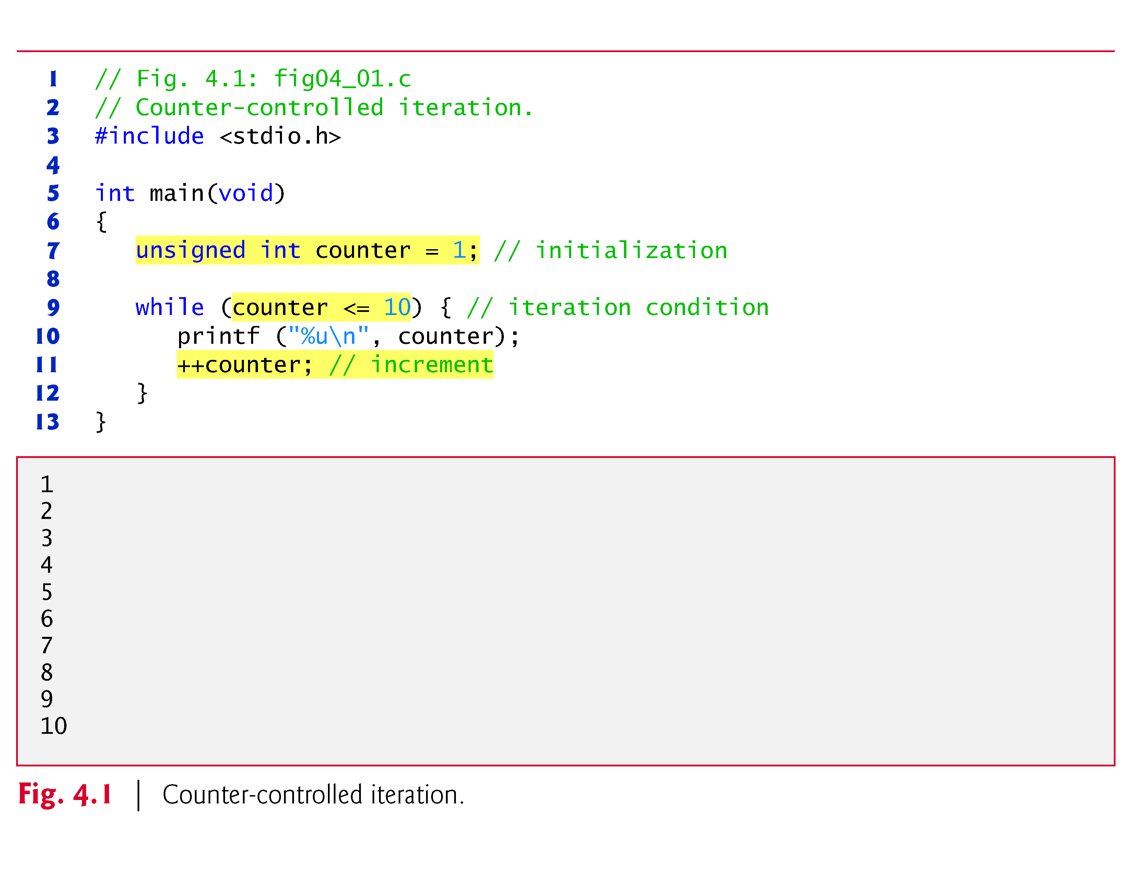

Slide 11
4.3 Counter-Controlled Iteration (Cont.)
The definition and initialization of counter could also have been written as
unsigned int counter; counter = 1;
The definition is not executable, but the assignment is.
We use both methods of setting the values of variables.
The statement
++counter; // increment
increments the loop counter by 1 each time the loop is performed.

Slide 12
4.3 Counter-Controlled Iteration (Cont.)
The loop-continuation condition in the while statement tests whether the value of the control variable is less than or equal to 10 (the last value for which the condition is true).
The body of this while is performed even when the control variable is 10.
The loop terminates when the control variable exceeds 10 (i.e., counter becomes 11).

Slide 13
4.3 Counter-Controlled Iteration (Cont.)
You could make the program in Fig. 4.1 more concise by initializing counter to 0 and by replacing the while statement with
while (++counter <= 10) printf("%u\n", counter);
This code saves a statement because the incrementing is done directly in the while condition before the condition is tested.
Also, this code eliminates the need for the braces around the body of the while because the while now contains only one statement.
Some programmers feel that this makes the code too cryptic and error prone.

Slide 14
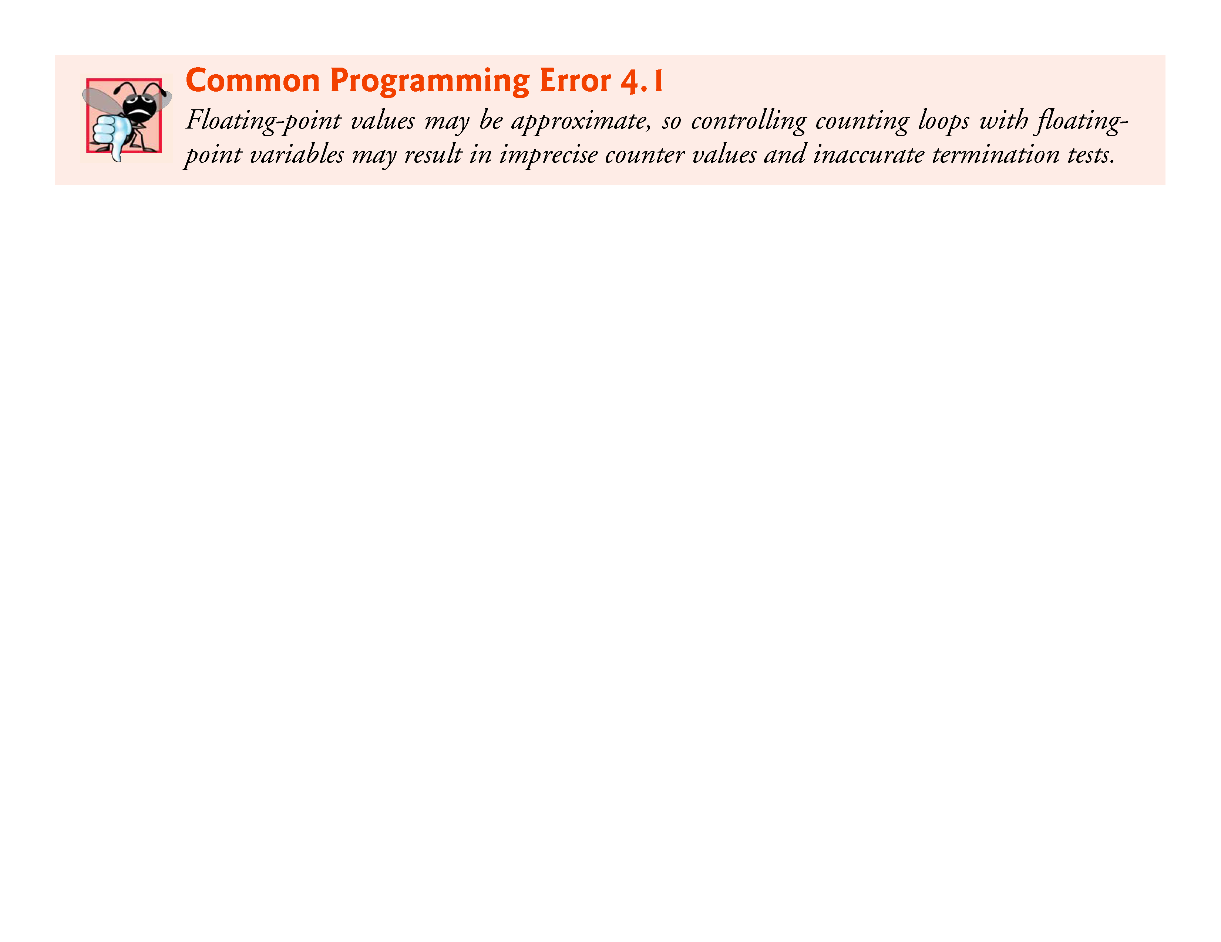

Slide 15
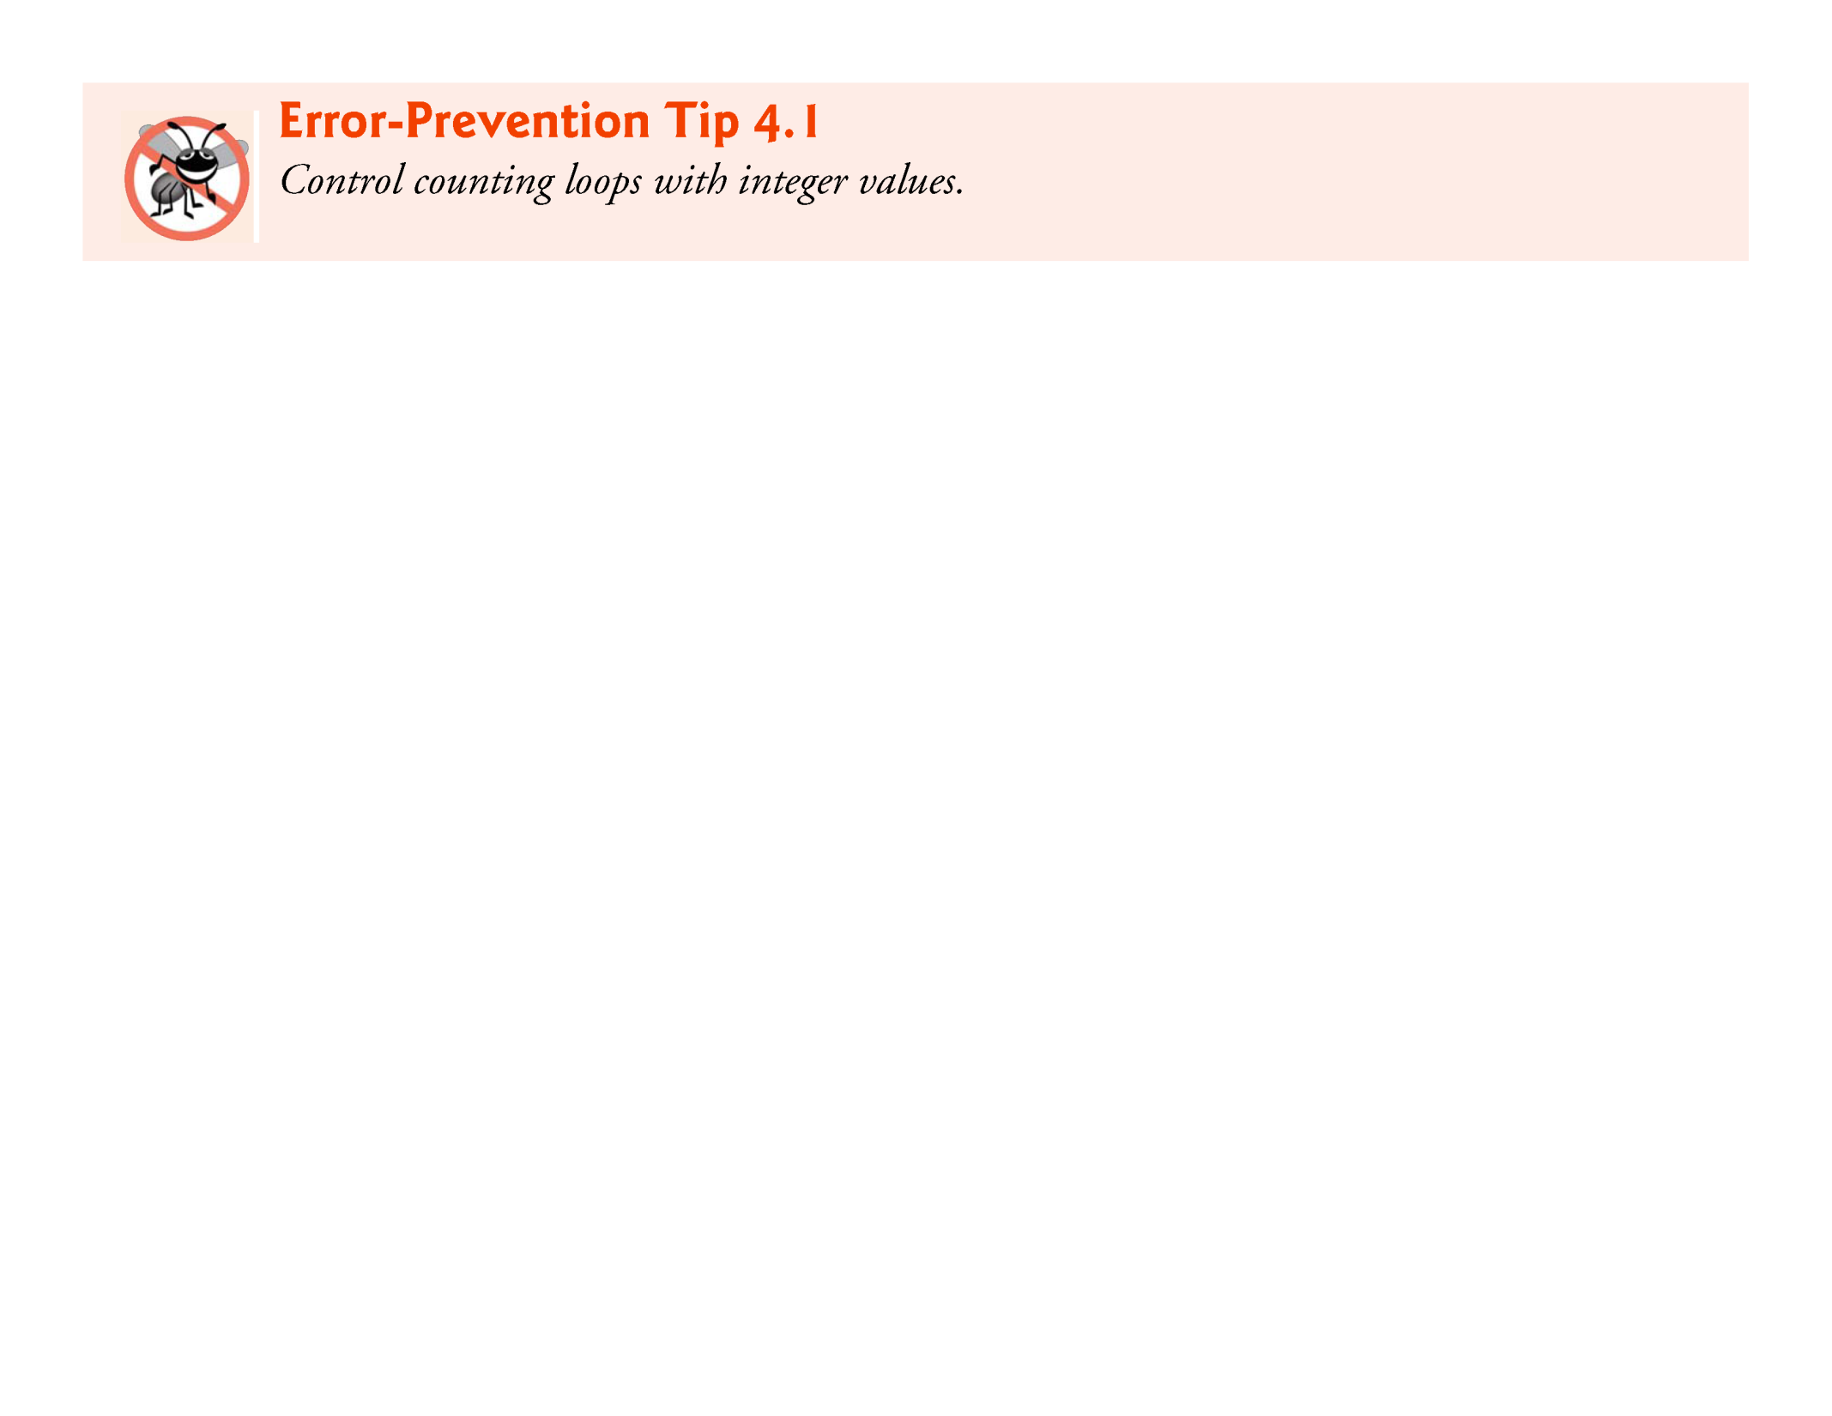

Slide 16
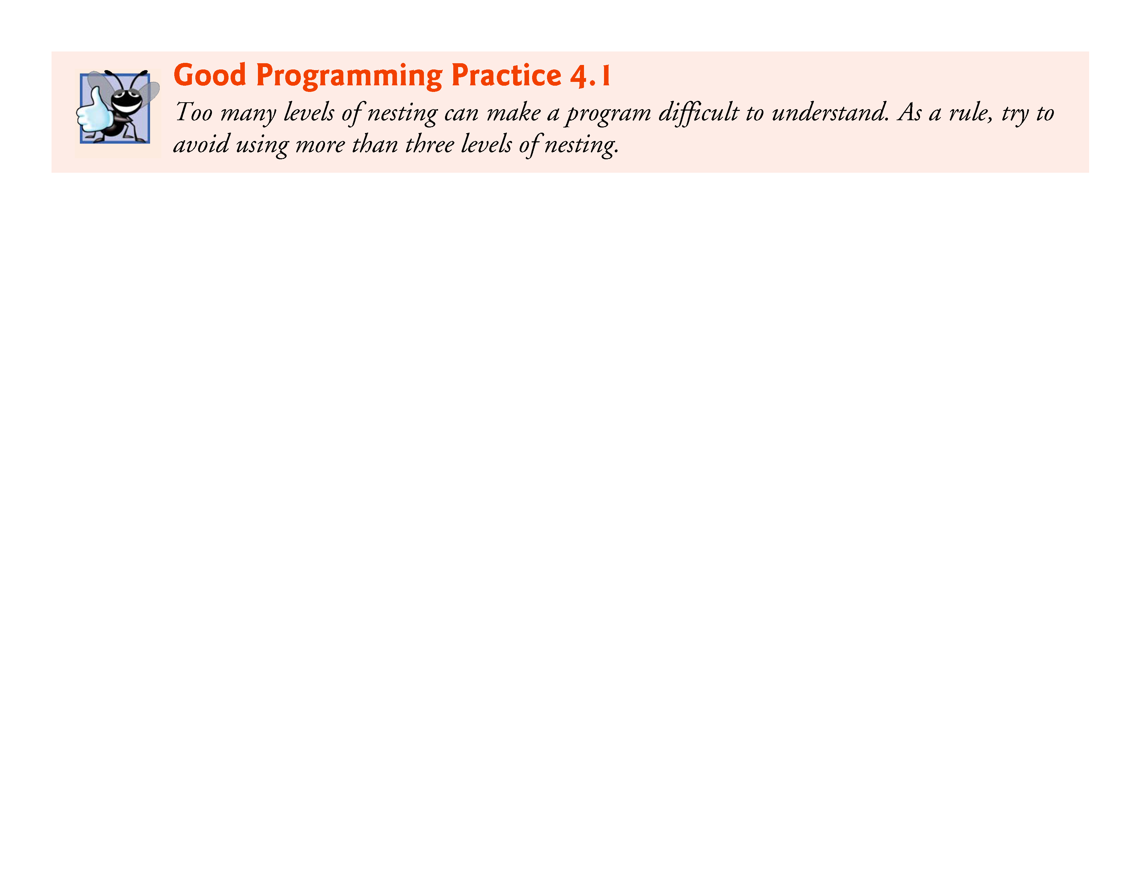

Slide 17
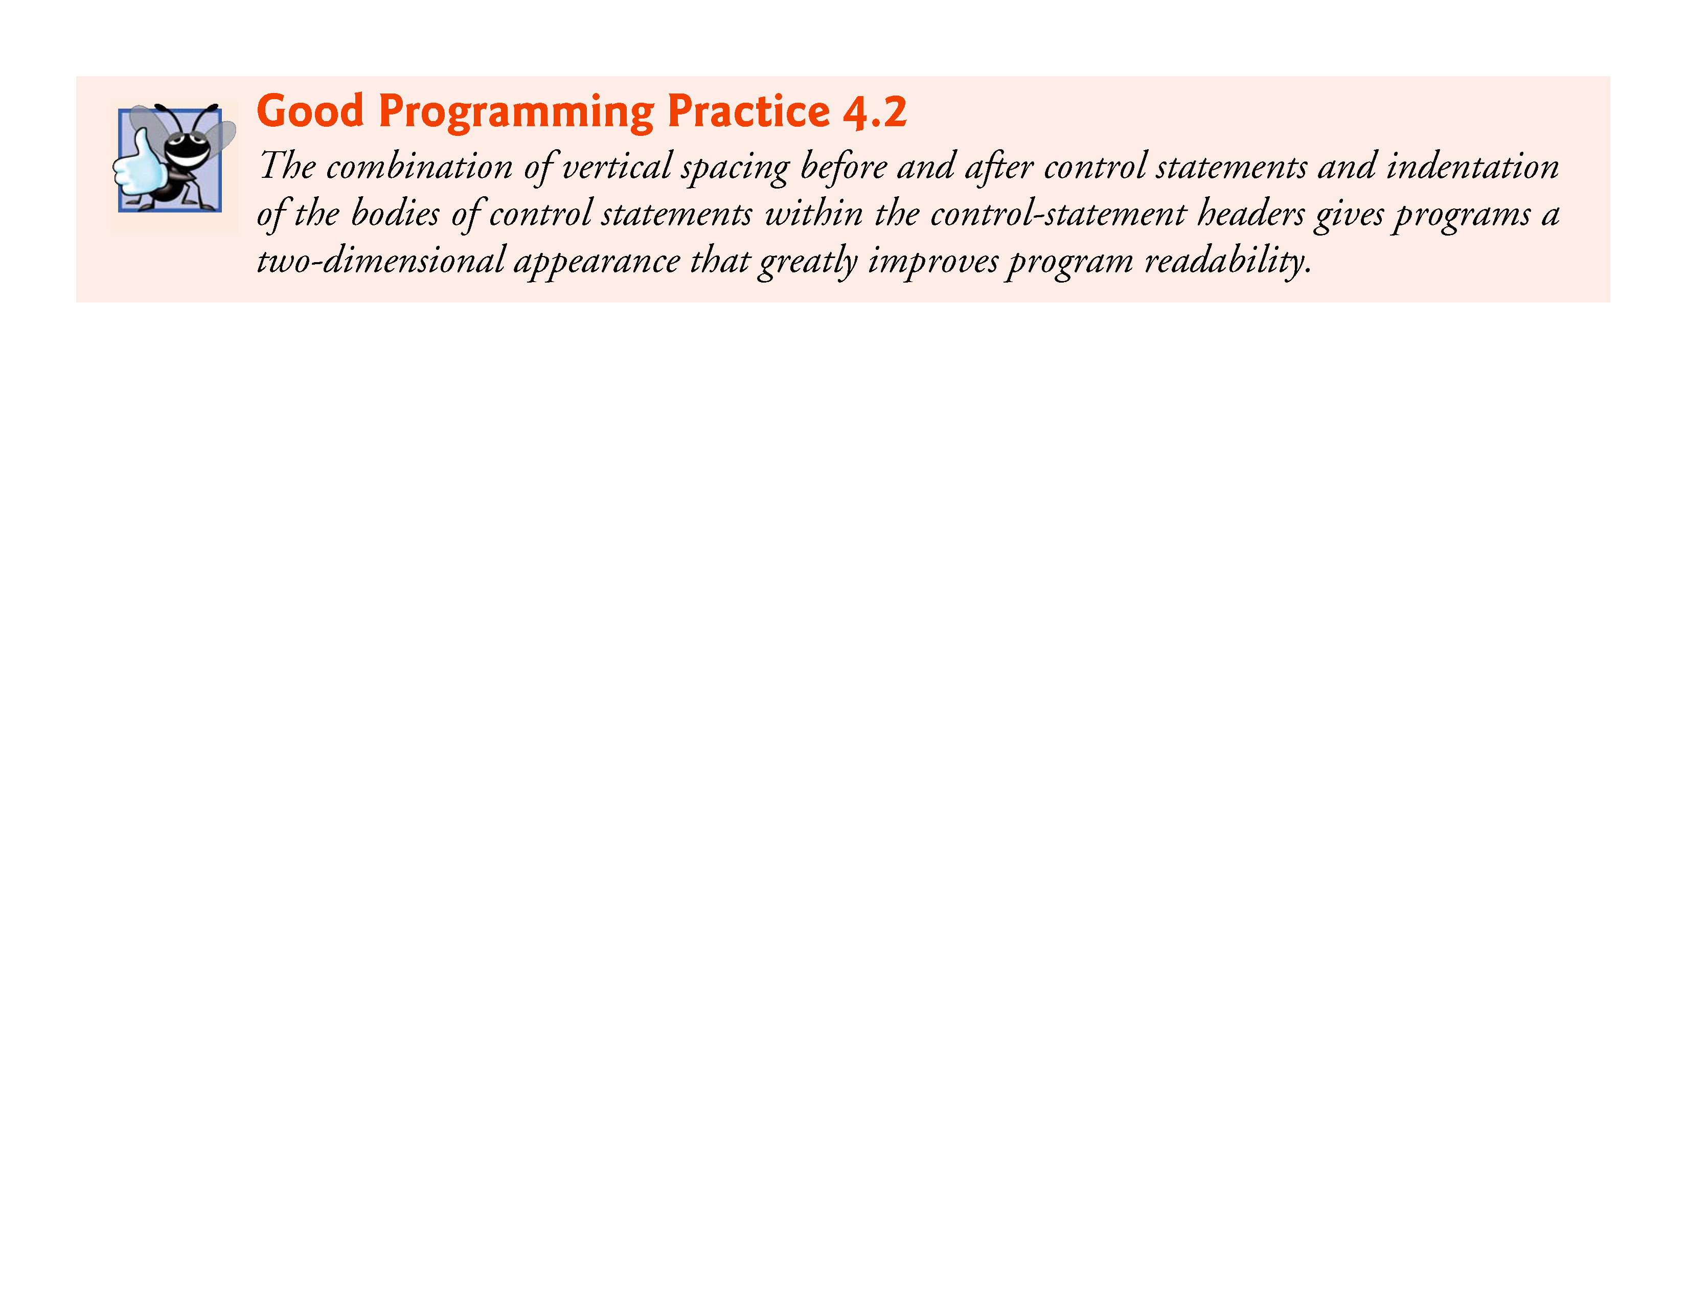

Slide 18
4.4 for Iteration Statement
The for iteration statement handles all the details of counter-controlled iteration.
To illustrate its power, let’s rewrite the program of Fig. 4.1.
The result is shown in Fig. 4.2.

Slide 19
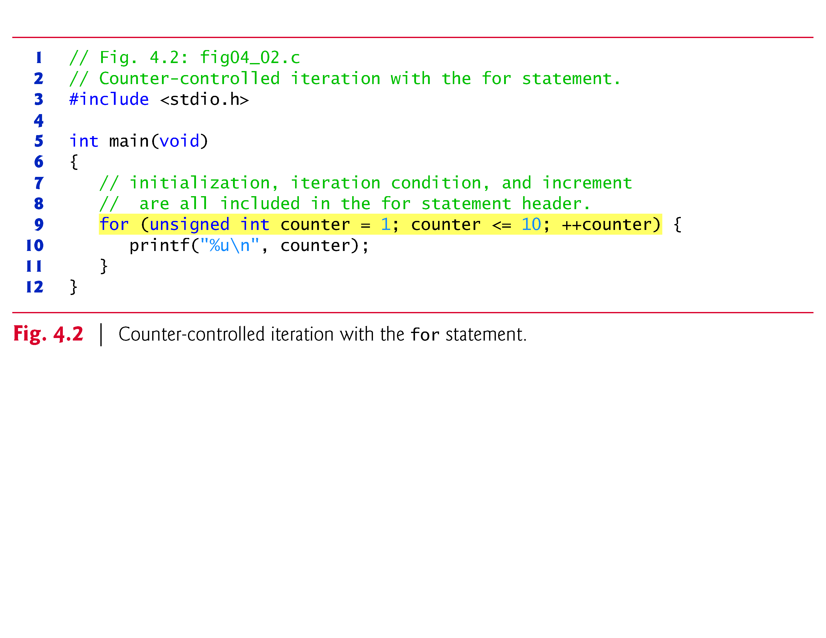

Slide 20
4.4 for Iteration Statement (Cont.)
When the for statement begins executing, the control variable counter is initialized to 1.
Then, the loop-continuation condition counter <= 10 is checked.
Because the initial value of counter is 1, the condition is satisfied, so the printf statement (line 13) prints the value of counter, namely 1.
The control variable counter is then incremented by the expression ++counter, and the loop begins again with the loop-continuation test.

Slide 21
4.4 for Iteration Statement (Cont.)
Because the control variable is now equal to 2, the final value is not exceeded, so the program performs the printf statement again.
This process continues until the control variable counter is incremented to its final value of 11—this causes the loop-continuation test to fail, and iteration terminates.
The program continues by performing the first statement after the for statement (in this case, the end of the program).

Slide 22
4.4 for Iteration Statement (Cont.)
for Statement Header Components
Figure 4.3 takes a closer look at the for statement of Fig. 4.2.
Notice that the for statement “does it all”—it specifies each of the items needed for counter-controlled iteration with a control variable.
If there’s more than one statement in the body of the for, braces are required to define the body of the loop.

Slide 23
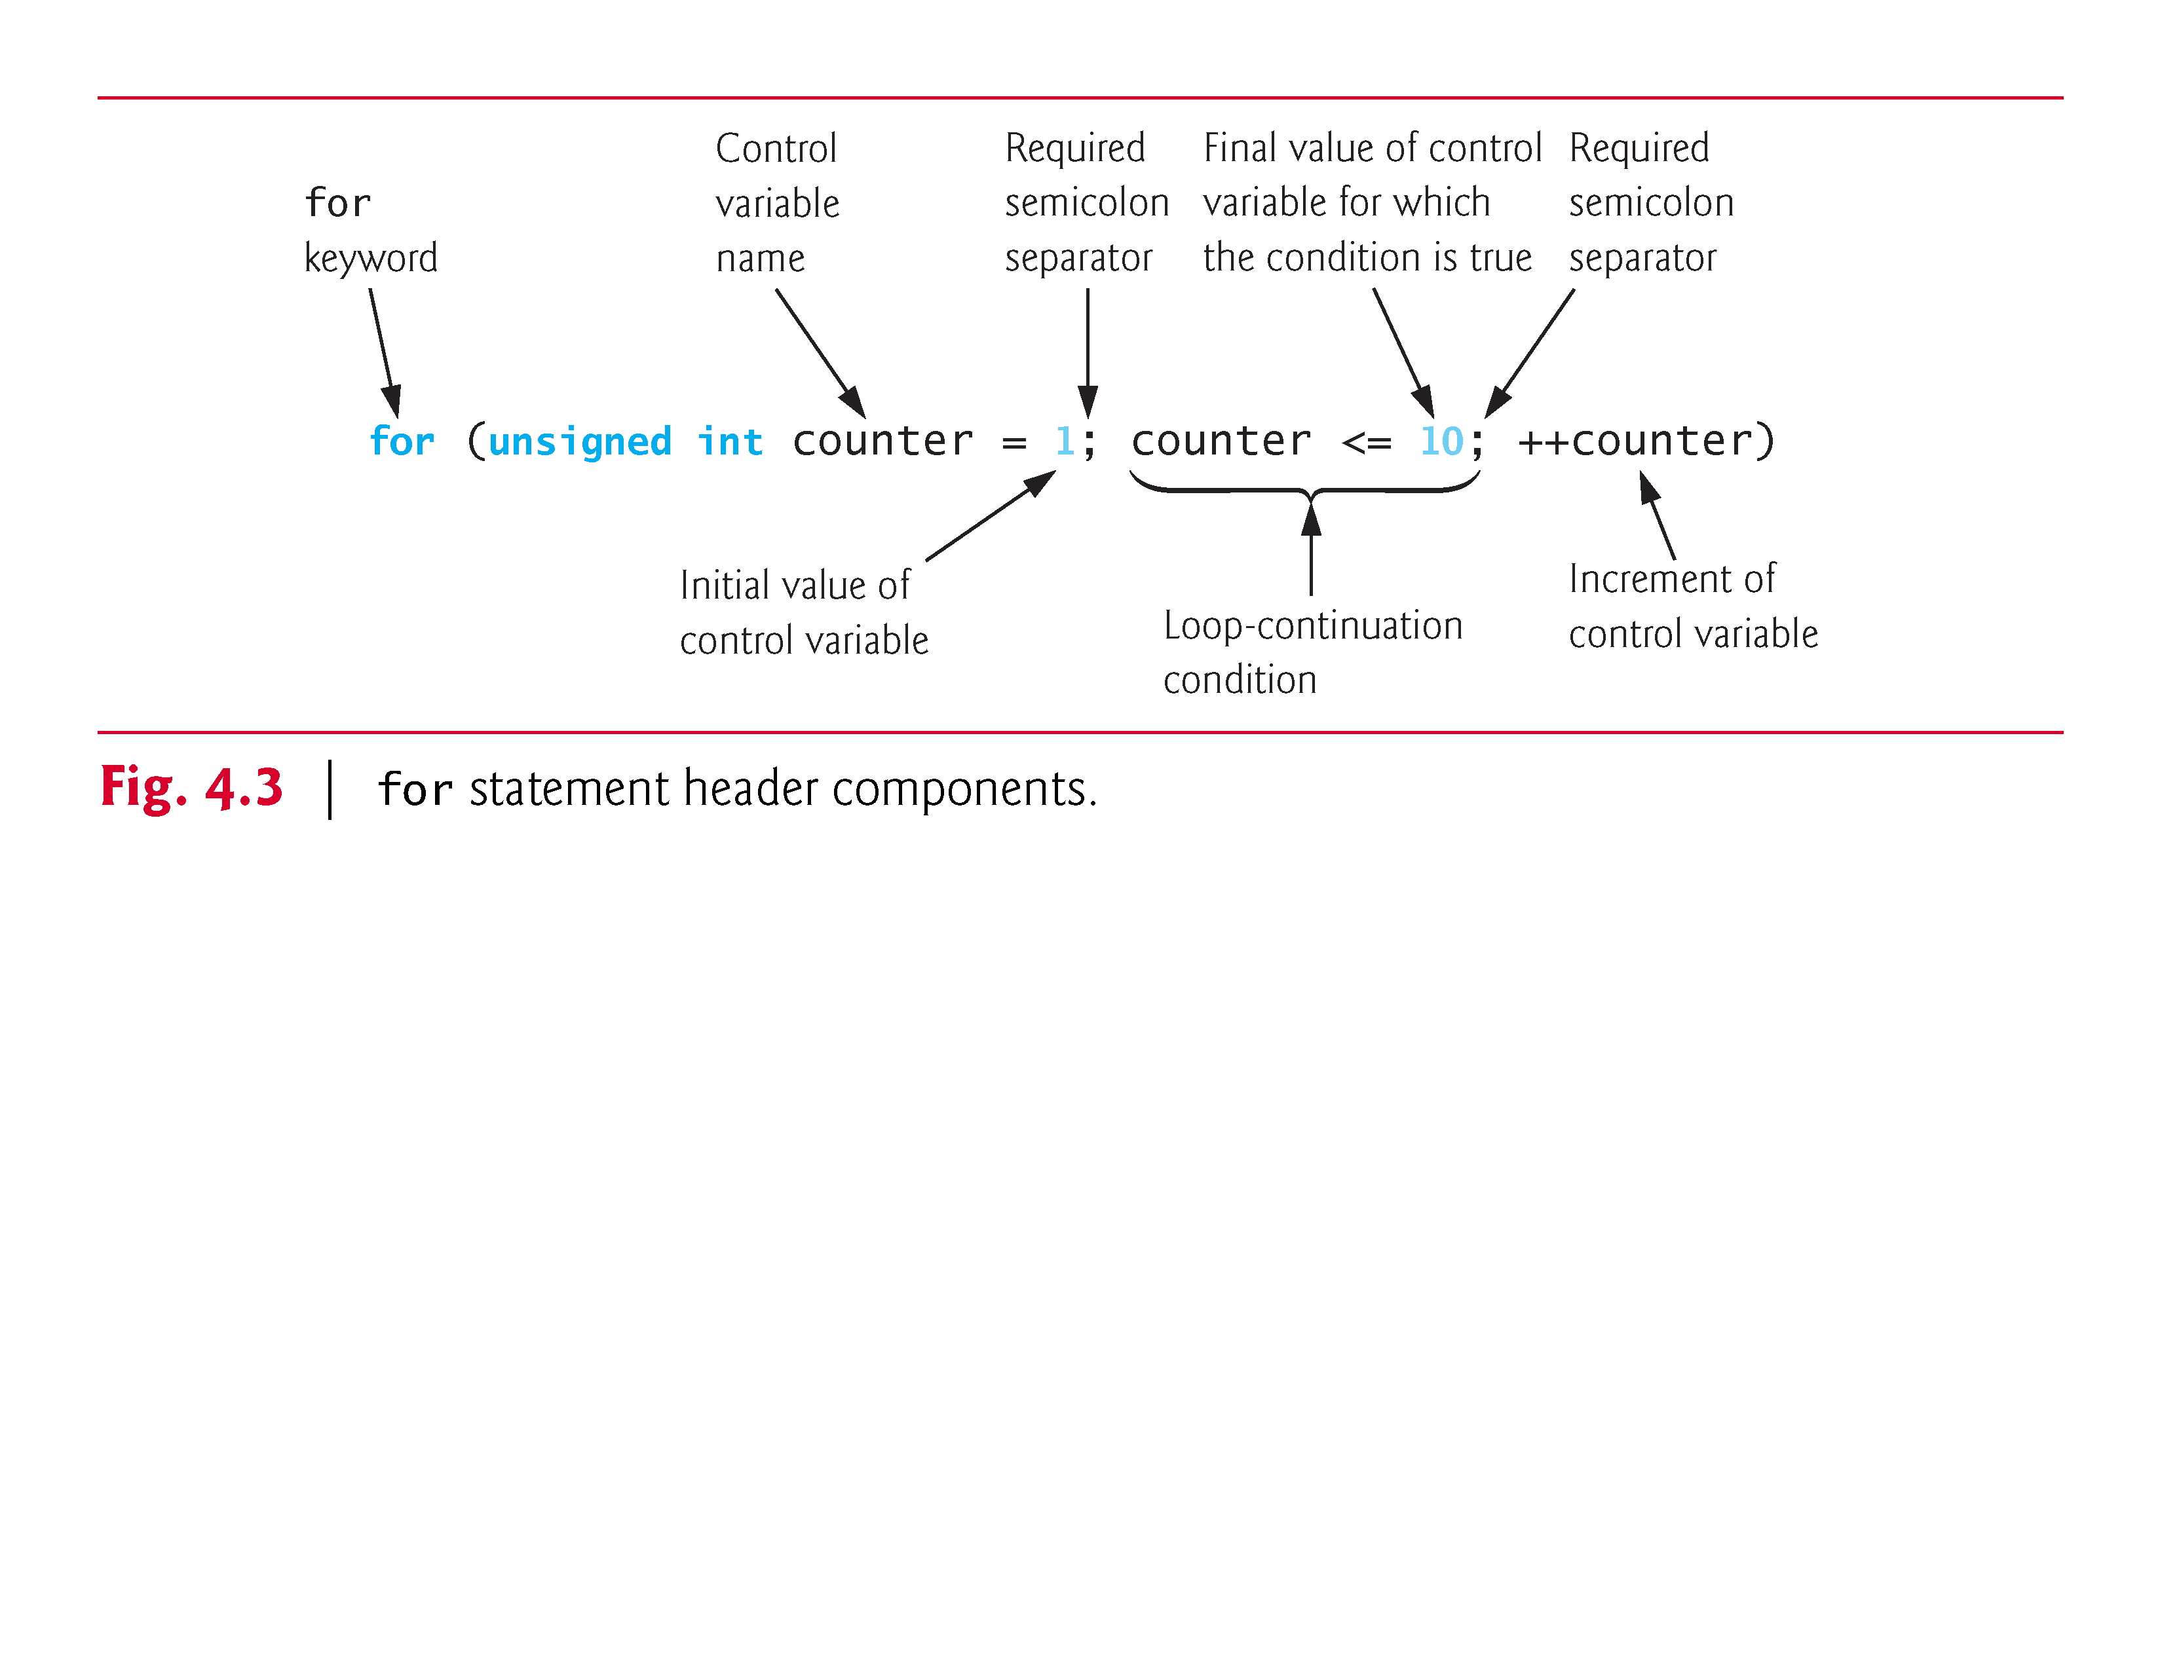

Slide 24
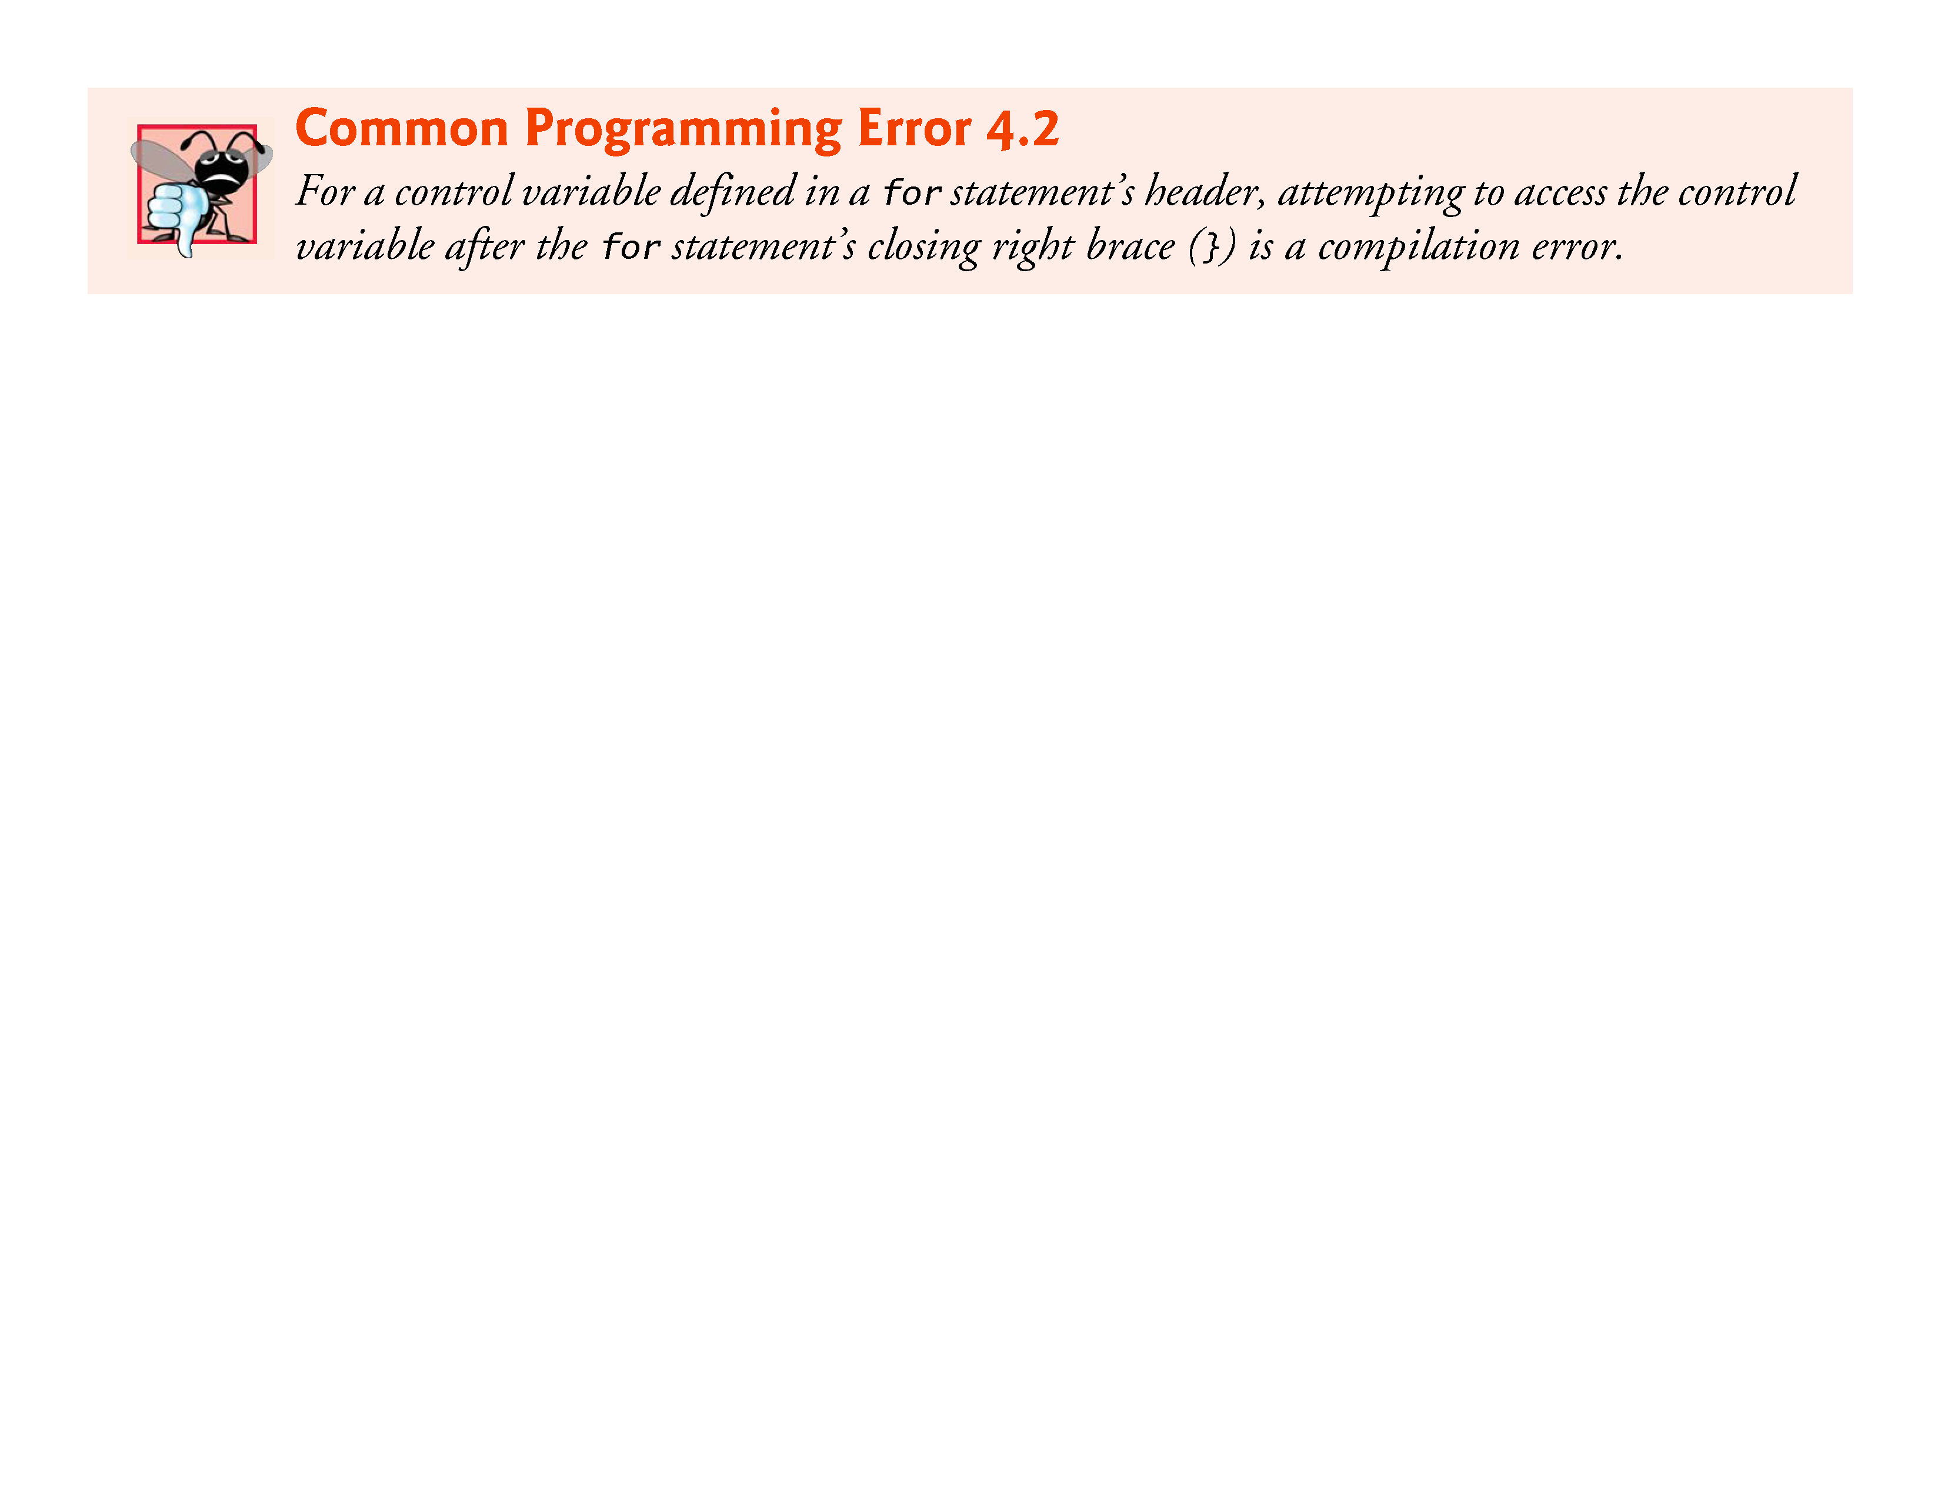

Slide 25
4.4 for Iteration Statement (Cont.)
Off-By-One Errors
Notice that Fig. 4.2 uses the loop-continuation condition counter <= 10.
If you incorrectly wrote counter < 10, then the loop would be executed only 9 times.
This is a common logic error called an off-by-one error.

Slide 26
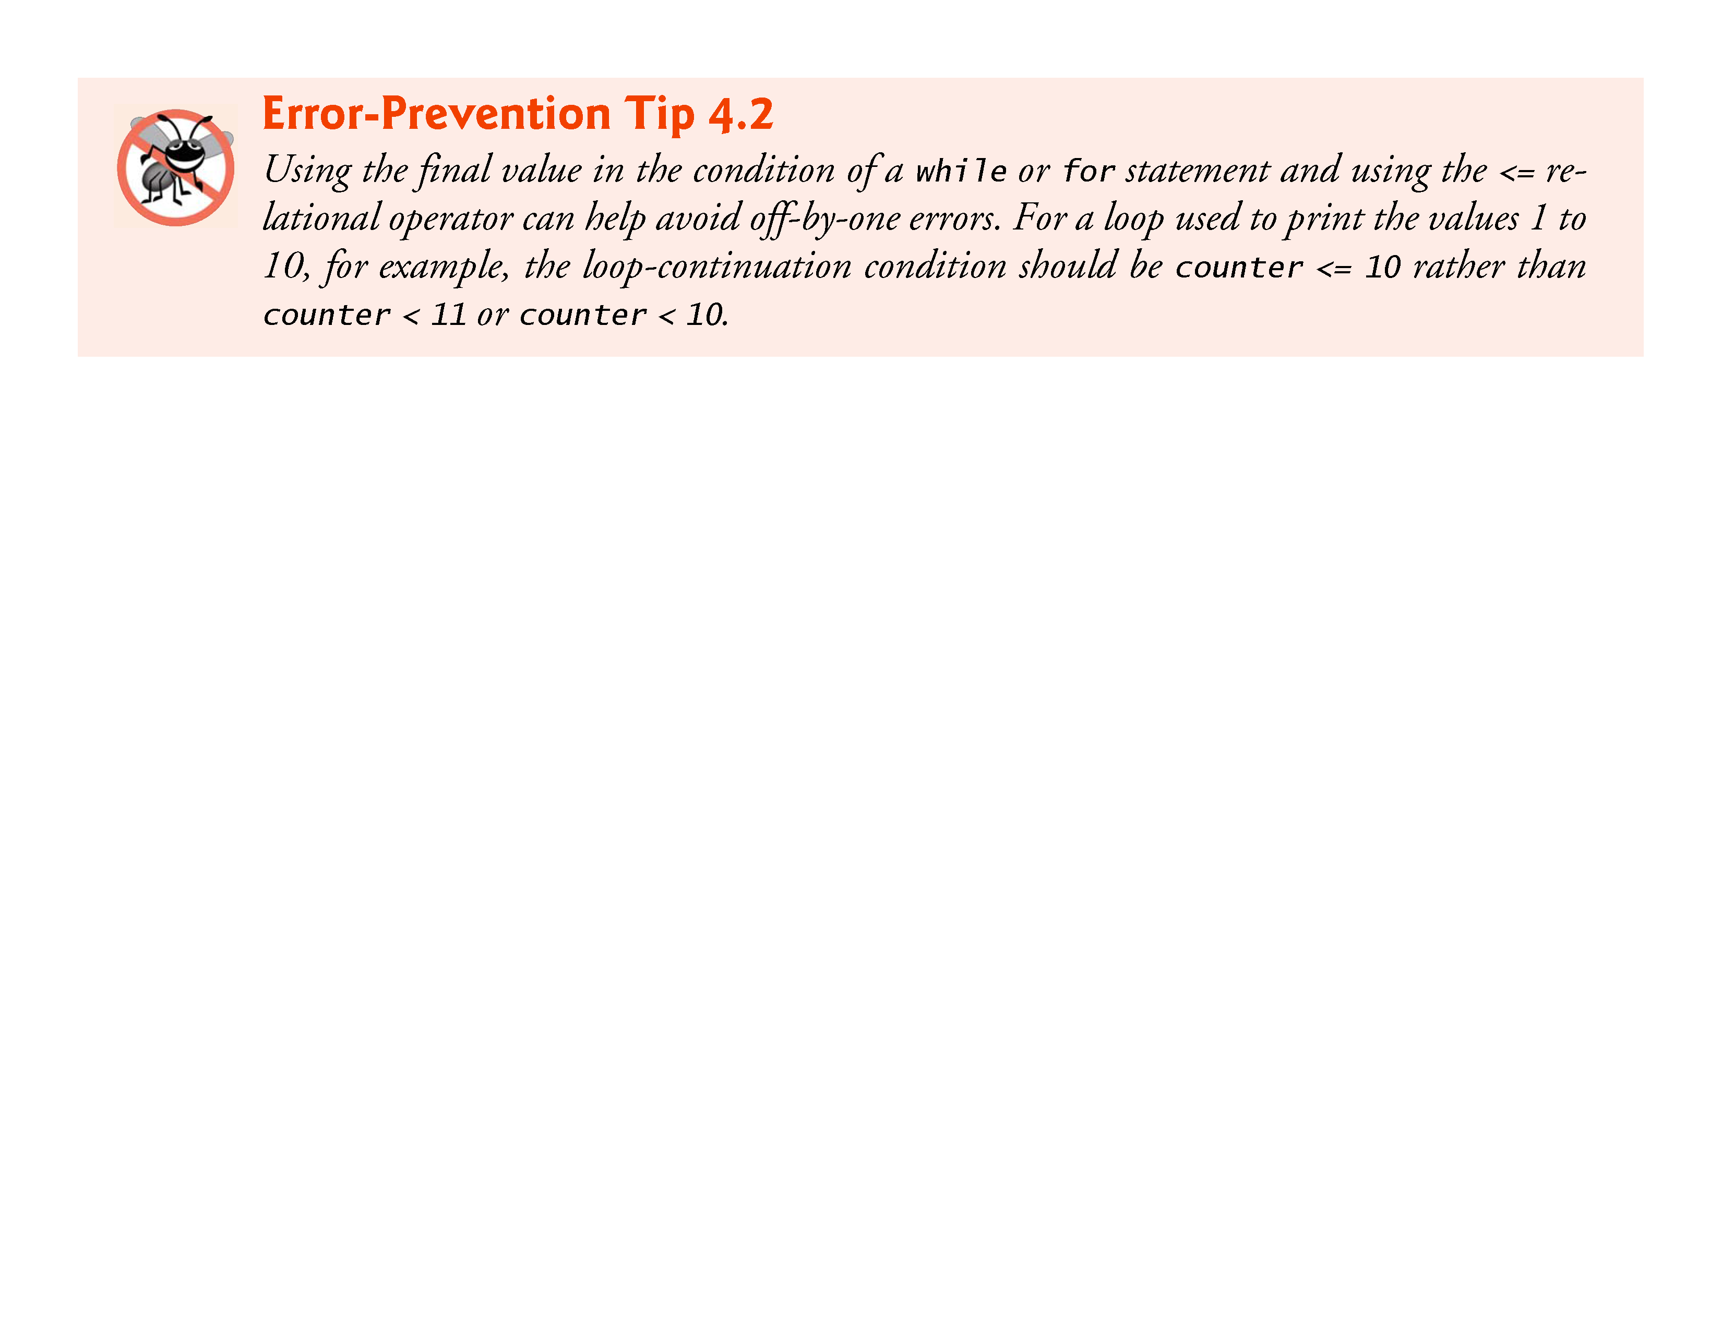

Slide 27
4.4 for Iteration Statement (Cont.)
General Format of a for Statement
The general format of the for statement is
for (initialization; condition; increment) { statement
}
where the initialization expression initializes the loop-control variable (and might define it), the condition expression is the loop-continuation condition and the increment expression increments the control variable.

Slide 28
4.4 for Iteration Statement (Cont.)
Comma-Separated Lists of Expressions
Often, the initialization and increment expressions are comma-separated lists of expressions.
The commas as used here are actually comma operators that guarantee that lists of expressions evaluate from left to right.
The value and type of a comma-separated list of expressions are the value and type of the rightmost expression in the list.

Slide 29
4.4 for Iteration Statement (Cont.)
The comma operator is most often used in the for statement.
Its primary use is to enable you to use multiple initialization and/or multiple increment expressions.
For example, there may be two control variables in a single for statement that must be initialized and incremented.

Slide 30
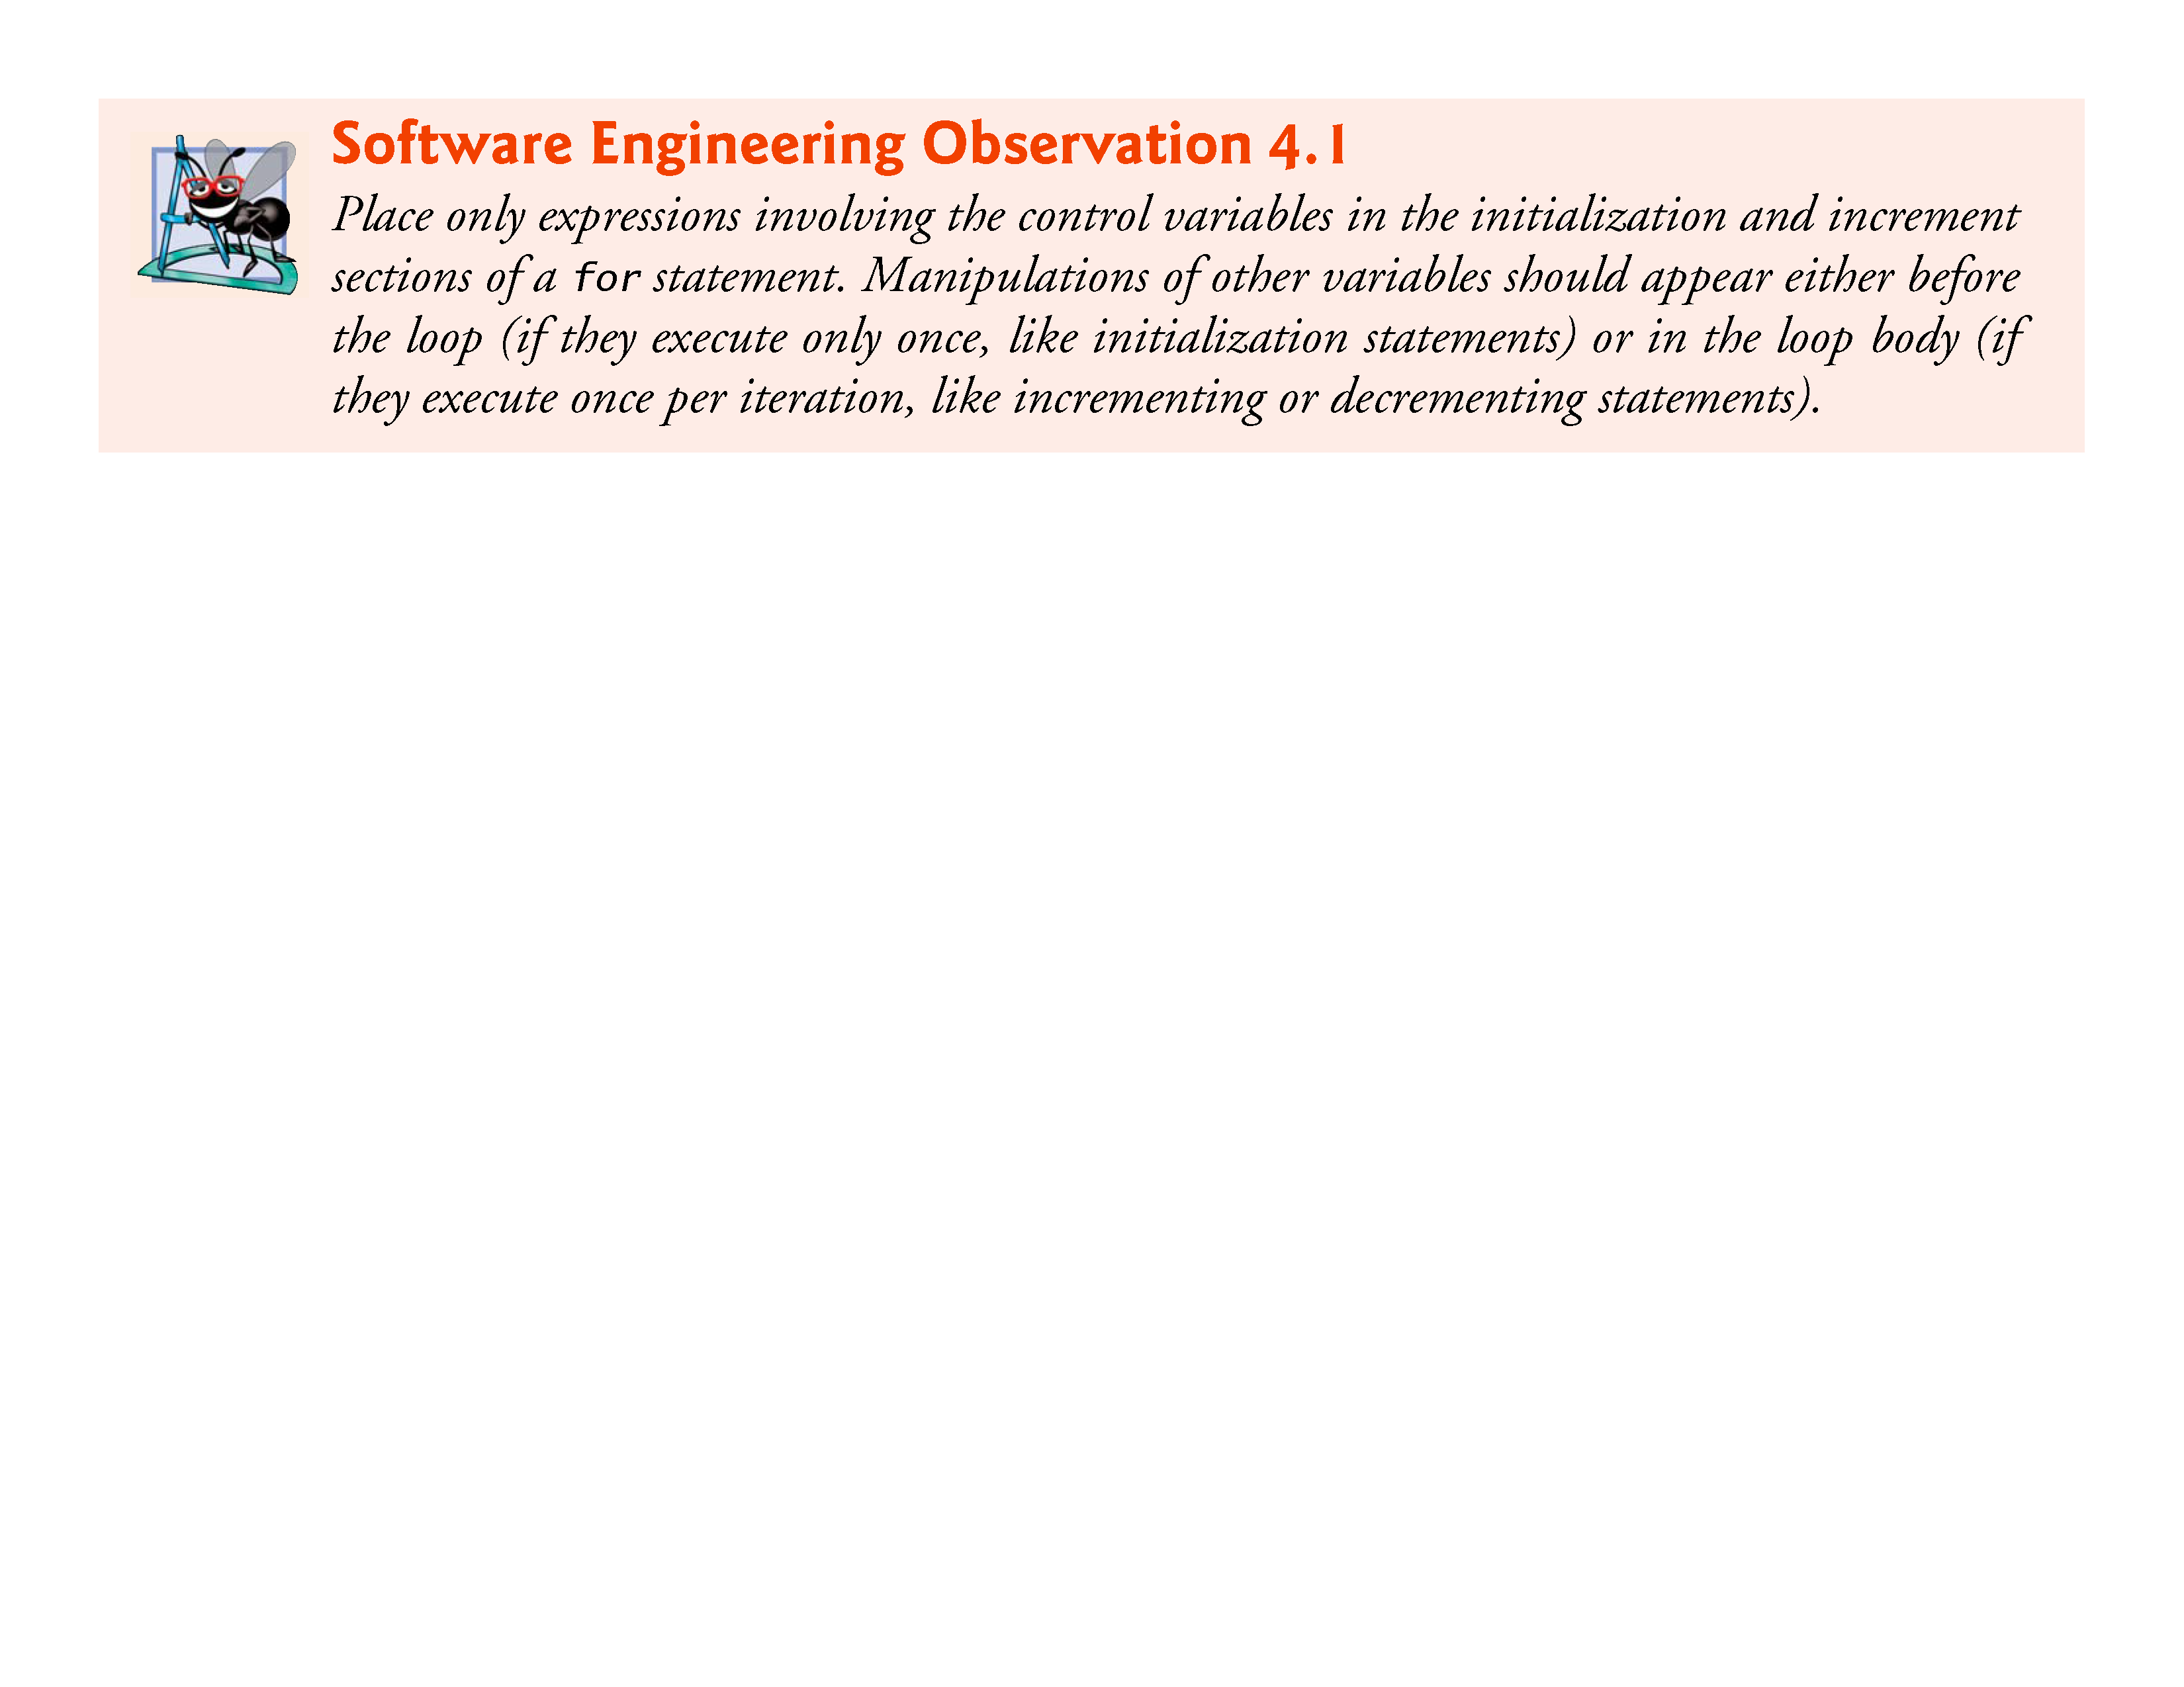

Slide 31
4.4 for Iteration Statement (Cont.)
Expressions in the for Statement’s Header Are Optional
The three expressions in the for statement are optional.
If the condition expression is omitted, C assumes that the condition is true, thus creating an infinite loop.
You may omit the initialization expression if the control variable is initialized elsewhere in the program.
The increment may be omitted if it’s calculated by statements in the body of the for statement or if no increment is needed.

Slide 32
4.4 for Iteration Statement (Cont.)
Increment Expression Acts Like a Standalone Statement
The increment expression in the for statement acts like a stand-alone C statement at the end of the body of the for.
Therefore, the expressions
counter = counter + 1 counter += 1 ++counter counter++
are all equivalent in the increment part of the for statement.
Because the variable being preincremented or postincremented here does not appear in a larger expression, both forms of incrementing have the same effect.
The two semicolons in the for statement are required.

Slide 33
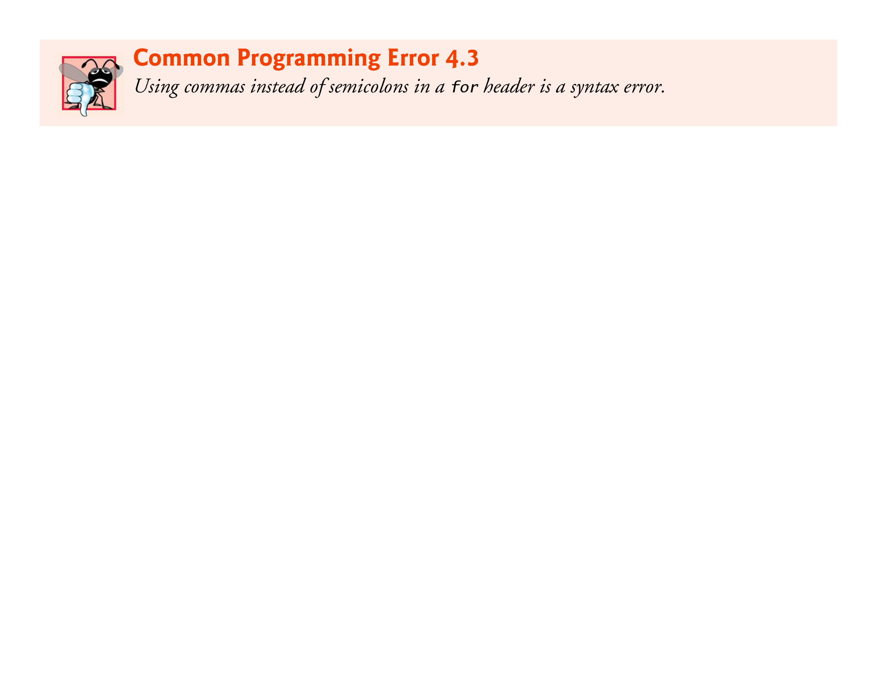

Slide 34
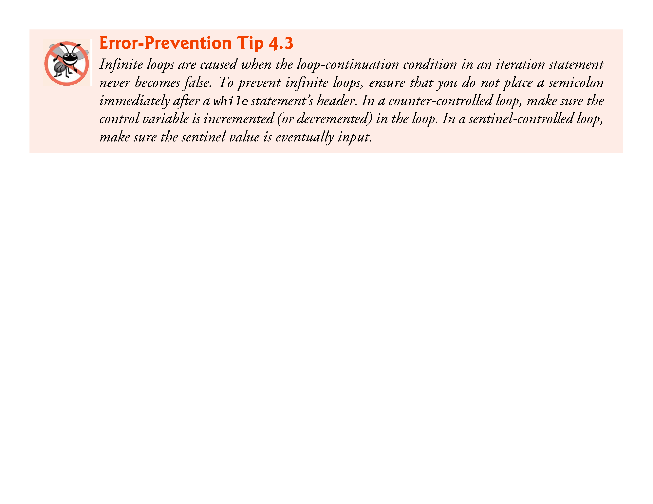

Slide 35
4.5 for Statement: Notes and Observations
The initialization, loop-continuation condition and increment can contain arithmetic expressions. For example, if x = 2 and y = 10, the statement
for (j = x; j <= 4 * x * y; j += y / x)
is equivalent to the statement
for (j = 2; j <= 80; j += 5)
The “increment” may be negative (in which case it’s really a decrement and the loop actually counts downward).
If the loop-continuation condition is initially false, the loop body does not execute. Instead, execution proceeds with the statement following the for statement.

Slide 36
4.5 for Statement: Notes and Observations (cont.)
The control variable is frequently printed or used in calculations in the body of a loop, but it need not be. It’s common to use the control variable for controlling iteration while never mentioning it in the body of the loop.
The for statement is flowcharted much like the while statement. For example, Fig. 4.4 shows the flowchart of the for statement
for (counter = 1; counter <= 10; ++counter) printf("%u", counter);
This flowchart makes it clear that the initialization occurs only once and that incrementing occurs after the body statement is performed.

Slide 37
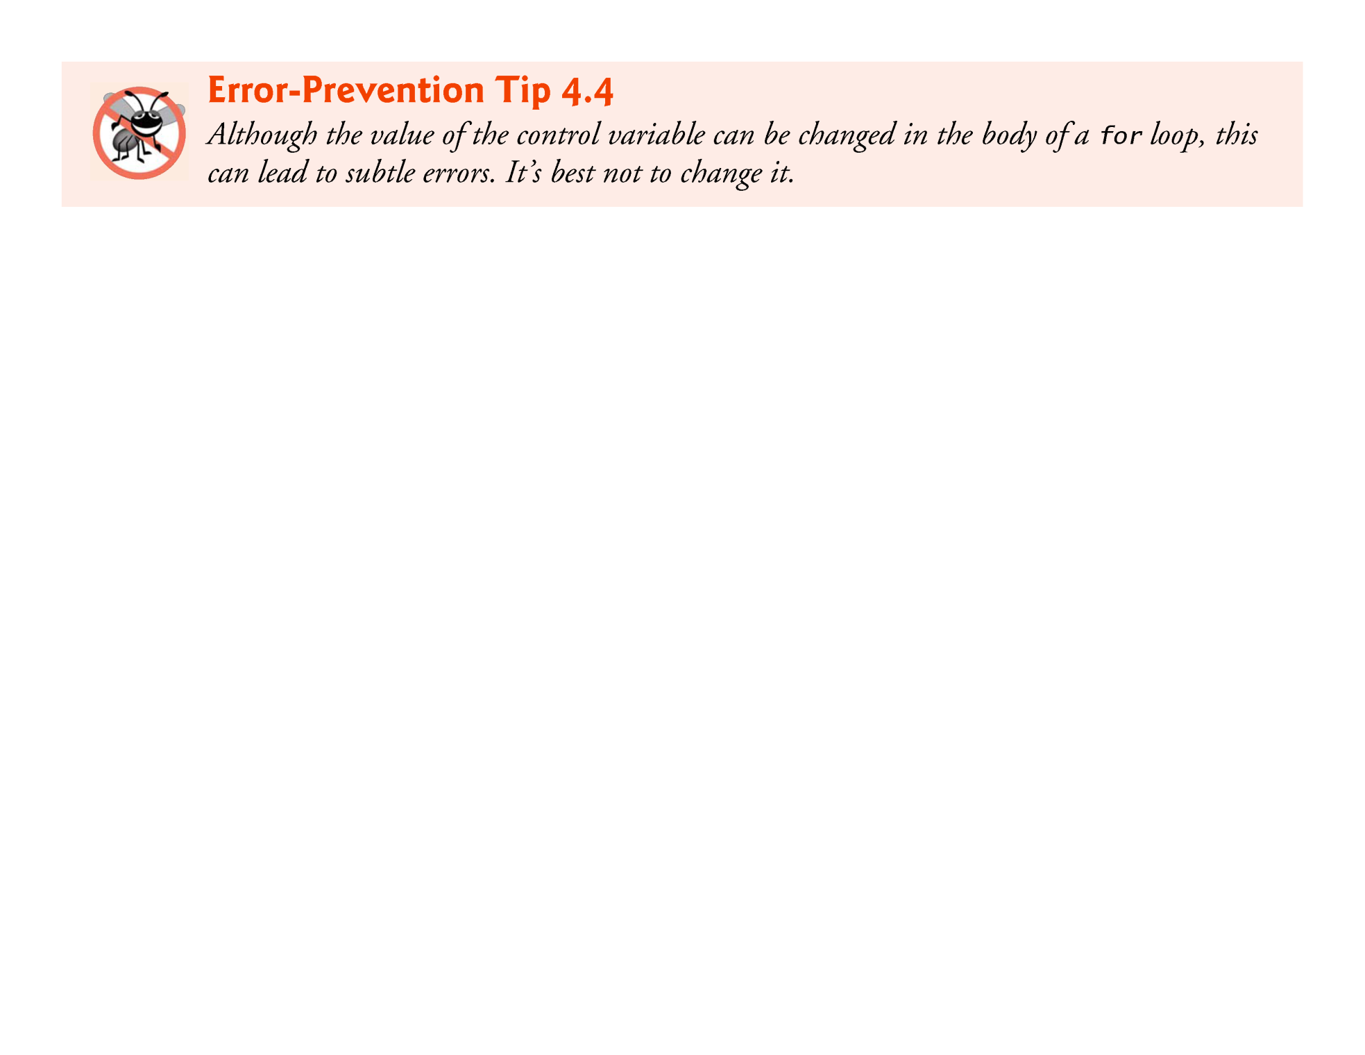

Slide 38
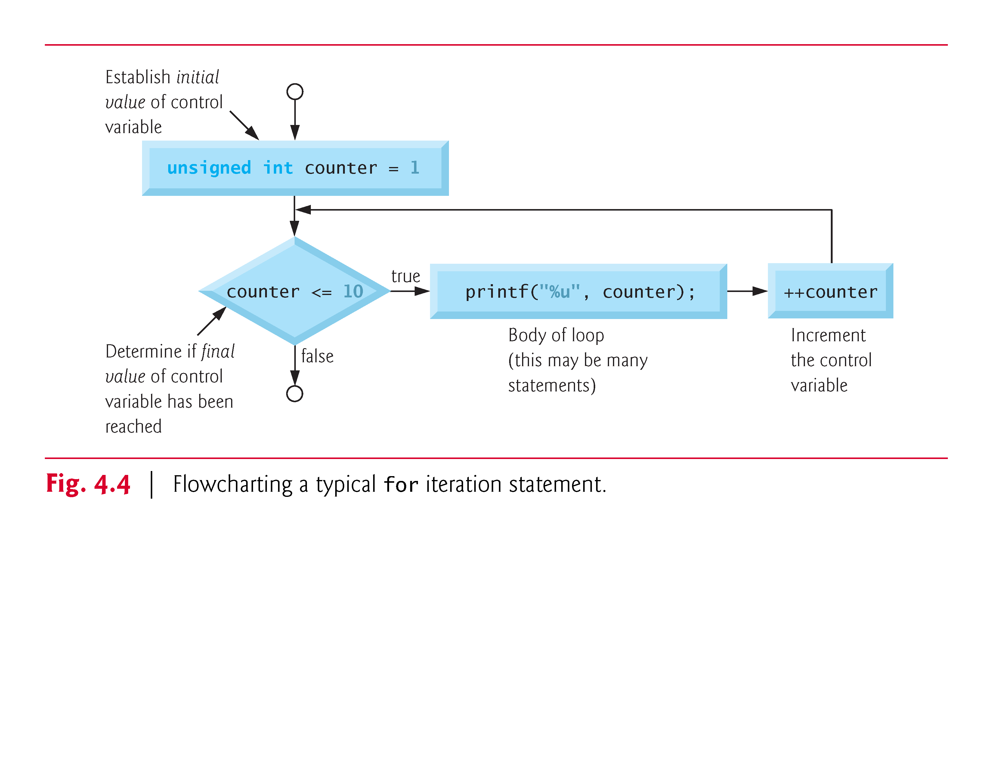

Slide 39
4.6 Examples Using the for Statement
The following examples show methods of varying the control variable in a for statement.
Vary the control variable from 1 to 100 in increments of 1.
for (i = 1; i <= 100; ++ i)
Vary the control variable from 100 to 1 in increments of -1 (decrements of 1).
for (i = 100; i >= 1; --i)
Vary the control variable from 7 to 77 in steps of 7.
for (i = 7; i <= 77; i += 7)
Vary the control variable from 20 to 2 in steps of -2.
for (i = 20; i >= 2; i -= 2)
Vary the control variable over the following sequence of values: 2, 5, 8, 11, 14, 17.
for (j = 2; j <= 17; j += 3)
Vary the control variable over the following sequence of values: 44, 33, 22, 11, 0.
for (j = 44; j >= 0; j -= 11)

Slide 40
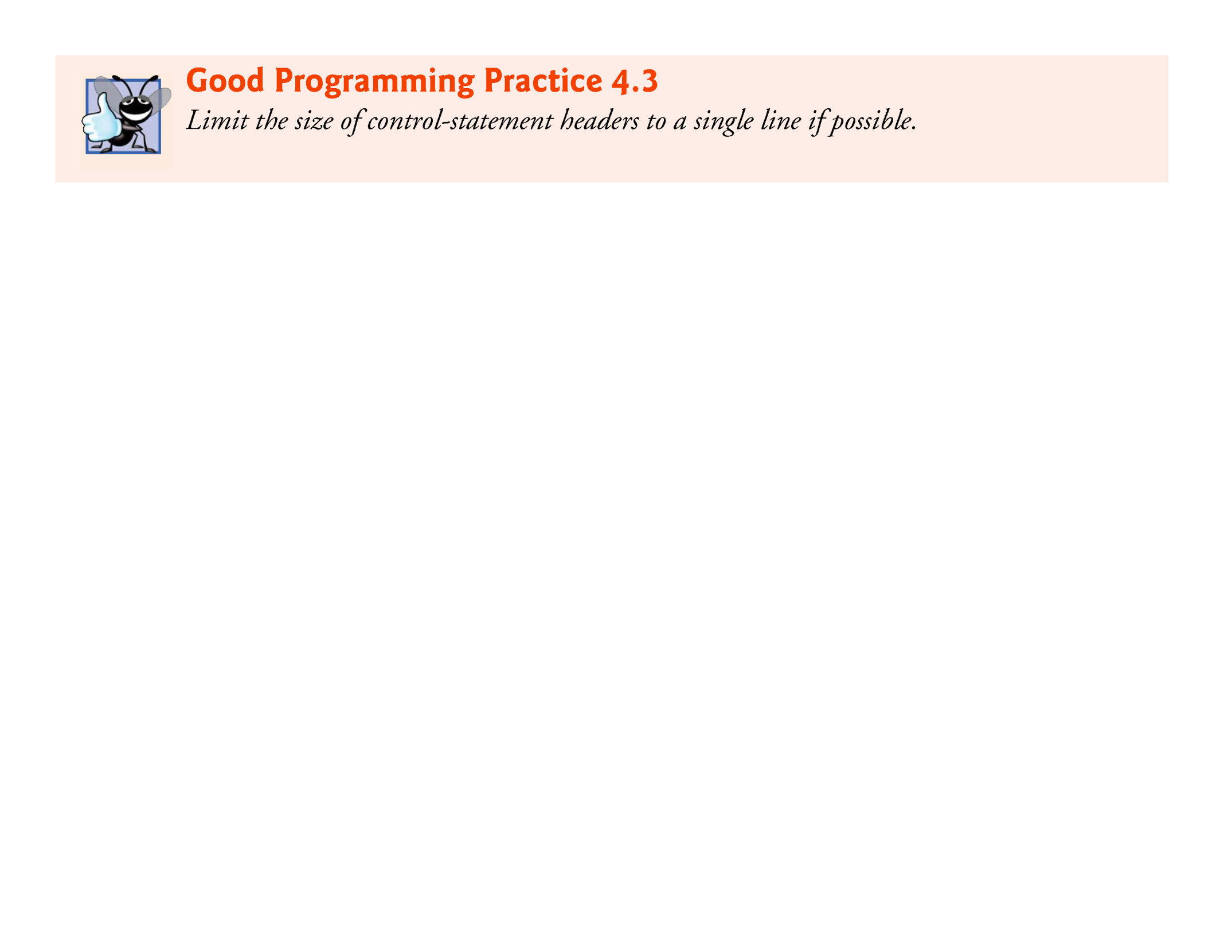

Slide 41
4.6 Examples Using the for Statement (Cont.)
Application: Summing the Even Integers from 2 to 100
Figure 4.5 uses the for statement to sum all the even integers from 2 to 100.

Slide 42
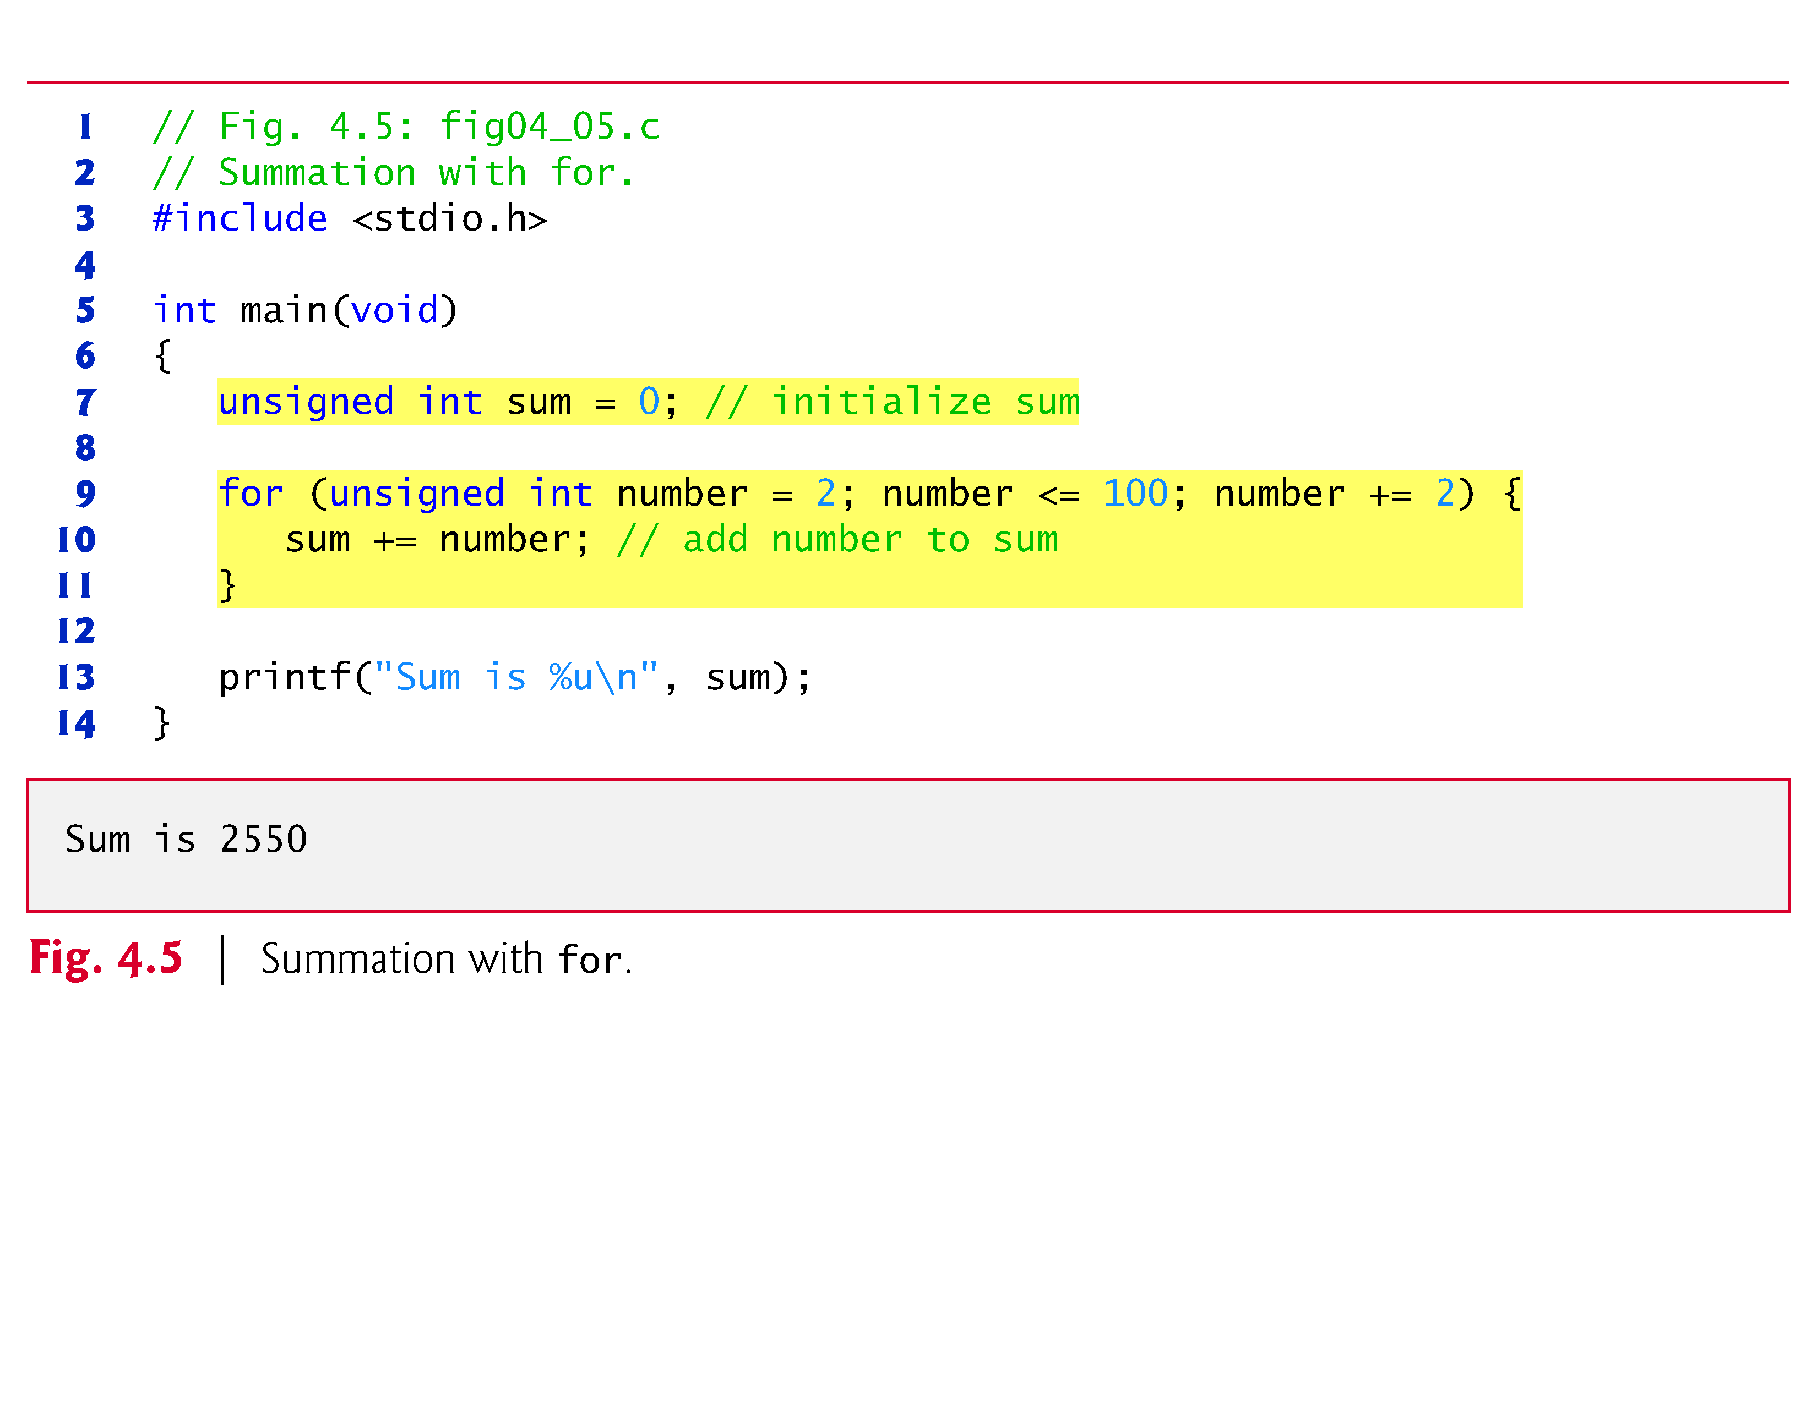

Slide 43
4.6 Examples Using the for Statement (Cont.)
The body of the for statement in Fig. 4.5 could actually be merged into the rightmost portion of the for header by using the comma operator as follows:
for (number = 2; number <= 100; sum += number, number += 2) ; // empty statement
The initialization sum = 0 could also be merged into the initialization section of the for.

Slide 44
4.6 Examples Using the for Statement (Cont.)
Application: Compound-Interest Calculations
Consider the following problem statement:
A person invests $1000.00 in a savings account yielding 5% interest. Assuming that all interest is left on deposit in the account, calculate and print the amount of money in the account at the end of each year for 10 years. Use the following formula for determining these amounts:
a = p(1 + r)^{n}
where
p is the original amount invested (i.e., the principal) r is the annual interest rate n is the number of years a is the amount on deposit at the end of the n^{th} year.
This problem involves a loop that performs the indicated calculation for each of the 10 years the money remains on deposit.
The solution is shown in Fig. 4.6.

Slide 45
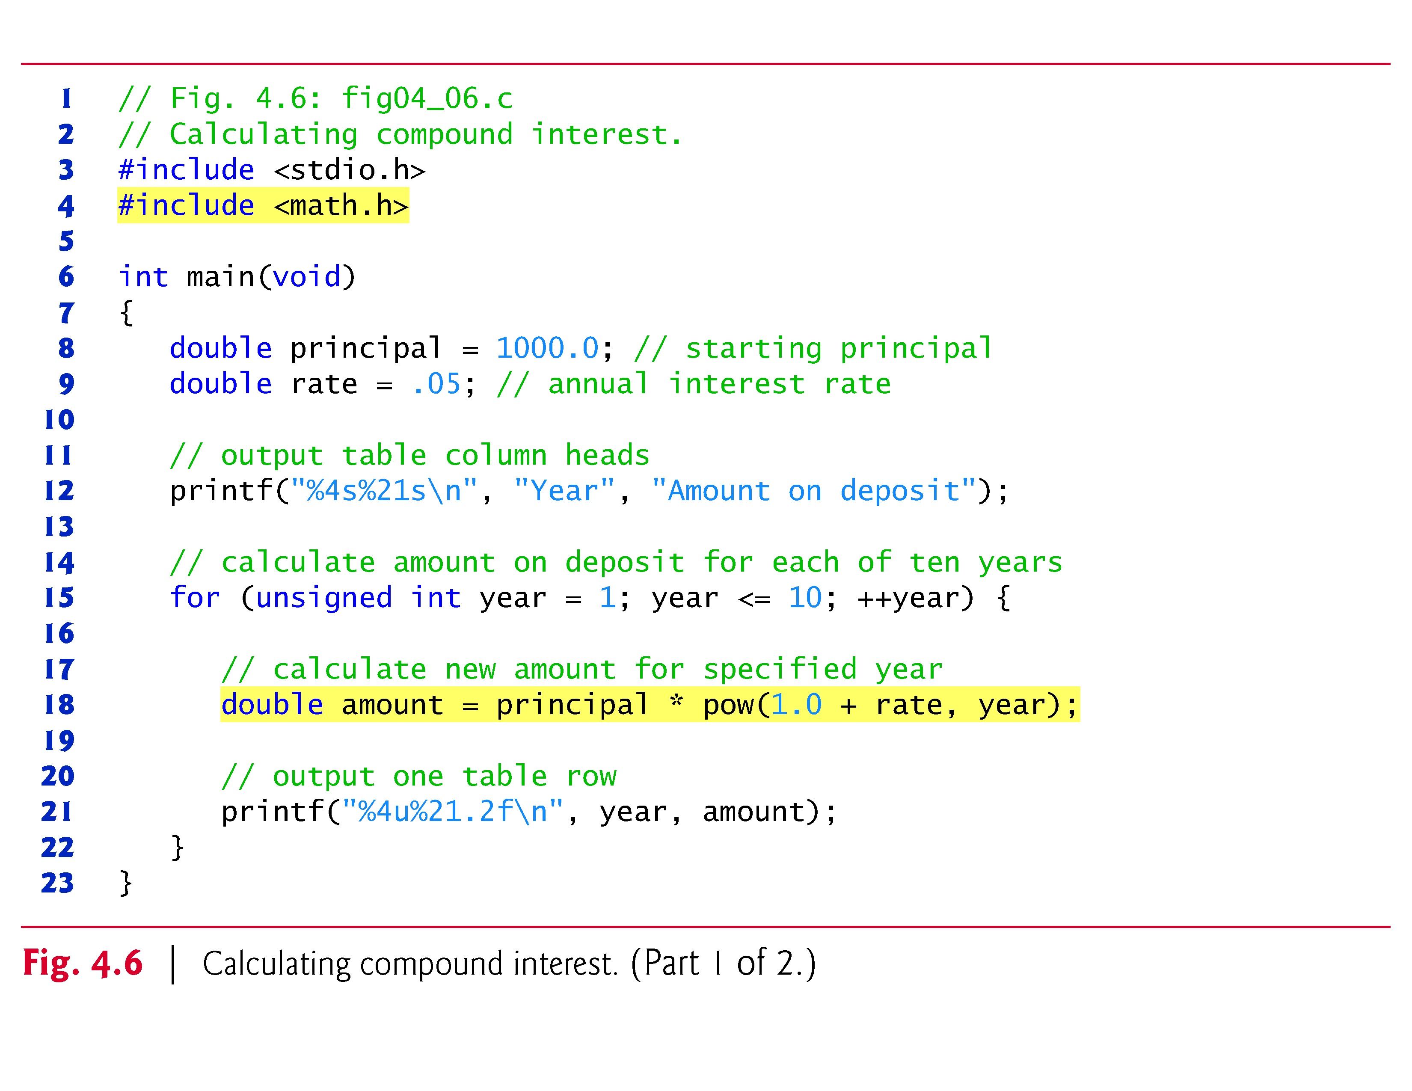

Slide 46
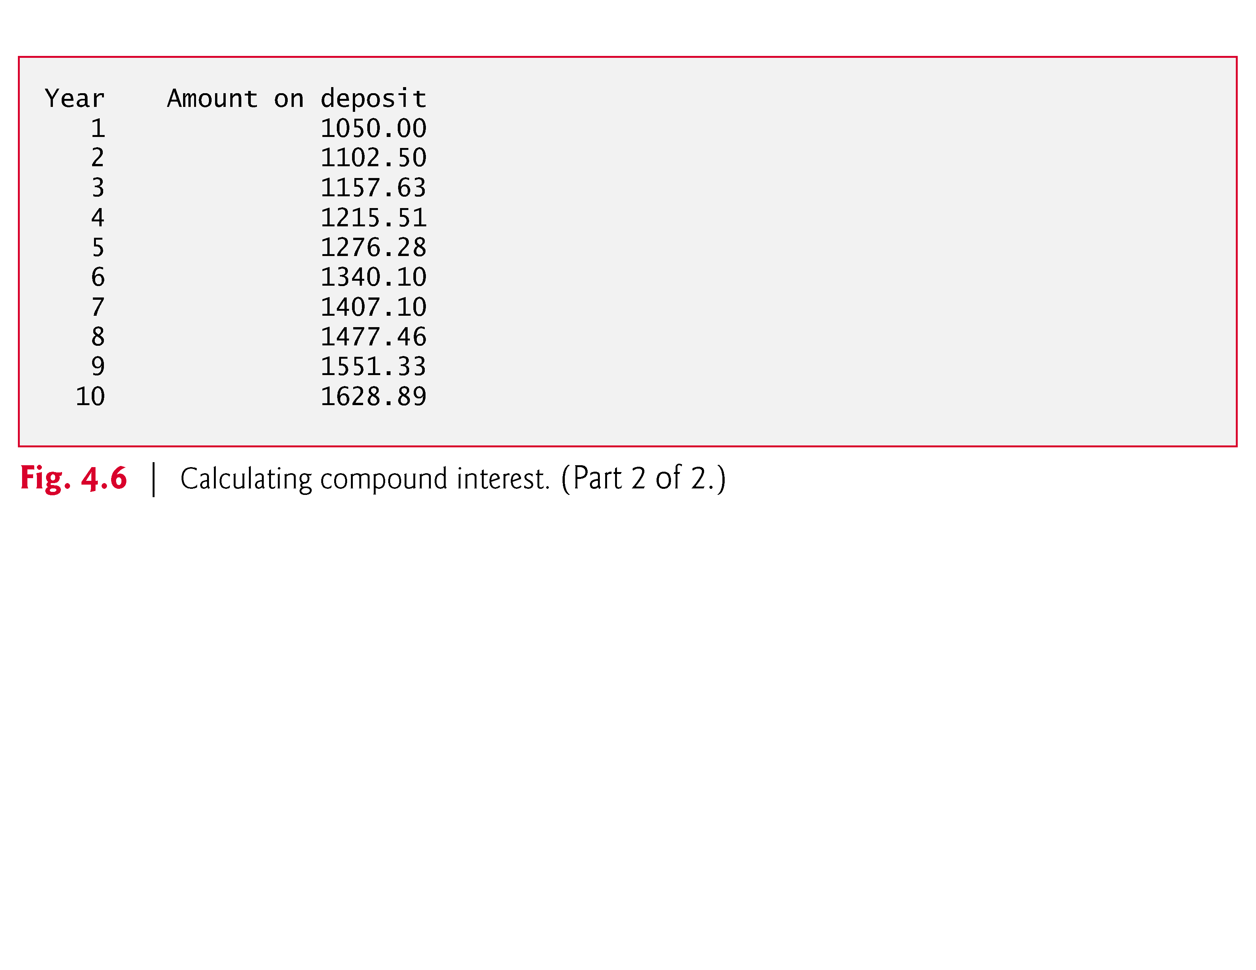

Slide 47
4.6 Examples Using the for Statement (Cont.)
The for statement executes the body of the loop 10 times, varying a control variable from 1 to 10 in increments of 1.
Although C does not include an exponentiation operator, we can use the Standard Library function pow for this purpose.
The function pow(x, y) calculates the value of x raised to the yth power.
It takes two arguments of type double and returns a double value.
Type double is a floating-point type like float, but typically a variable of type double can store a value of much greater magnitude with greater precision than float.

Slide 48
4.6 Examples Using the for Statement (Cont.)
The header <math.h> (line 4) should be included whenever a math function such as pow is used.
Actually, this program would malfunction without the inclusion of math.h, as the linker would be unable to find the pow function.
Function pow requires two double arguments, but variable year is an integer.
The math.h file includes information that tells the compiler to convert the value of year to a temporary double representation before calling the function.

Slide 49
4.6 Examples Using the for Statement (Cont.)
This information is contained in something called pow’s function prototype.
Function prototypes are explained in Chapter 5.
We also provide a summary of the pow function and other math library functions in Chapter 5.

Slide 50
4.6 Examples Using the for Statement (Cont.)
A Caution about Using Type float or double for Monetary Amounts
Notice that we defined the variables amount, principal and rate to be of type double.
We did this for simplicity because we’re dealing with fractional parts of dollars.

Slide 51
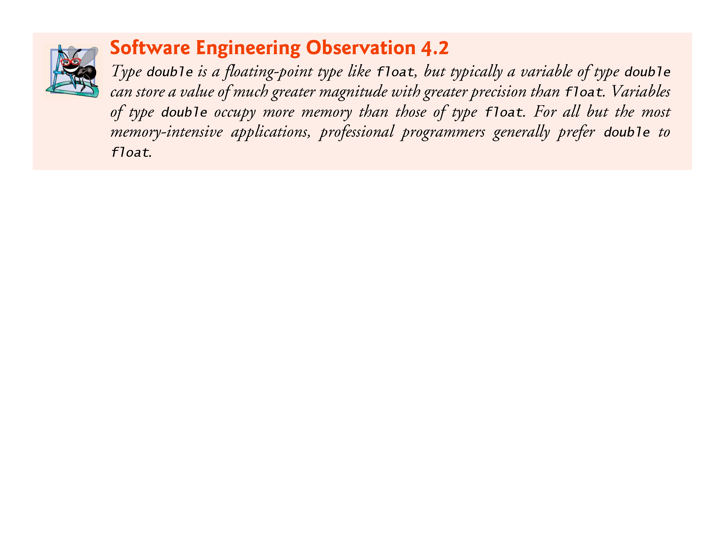

Slide 52
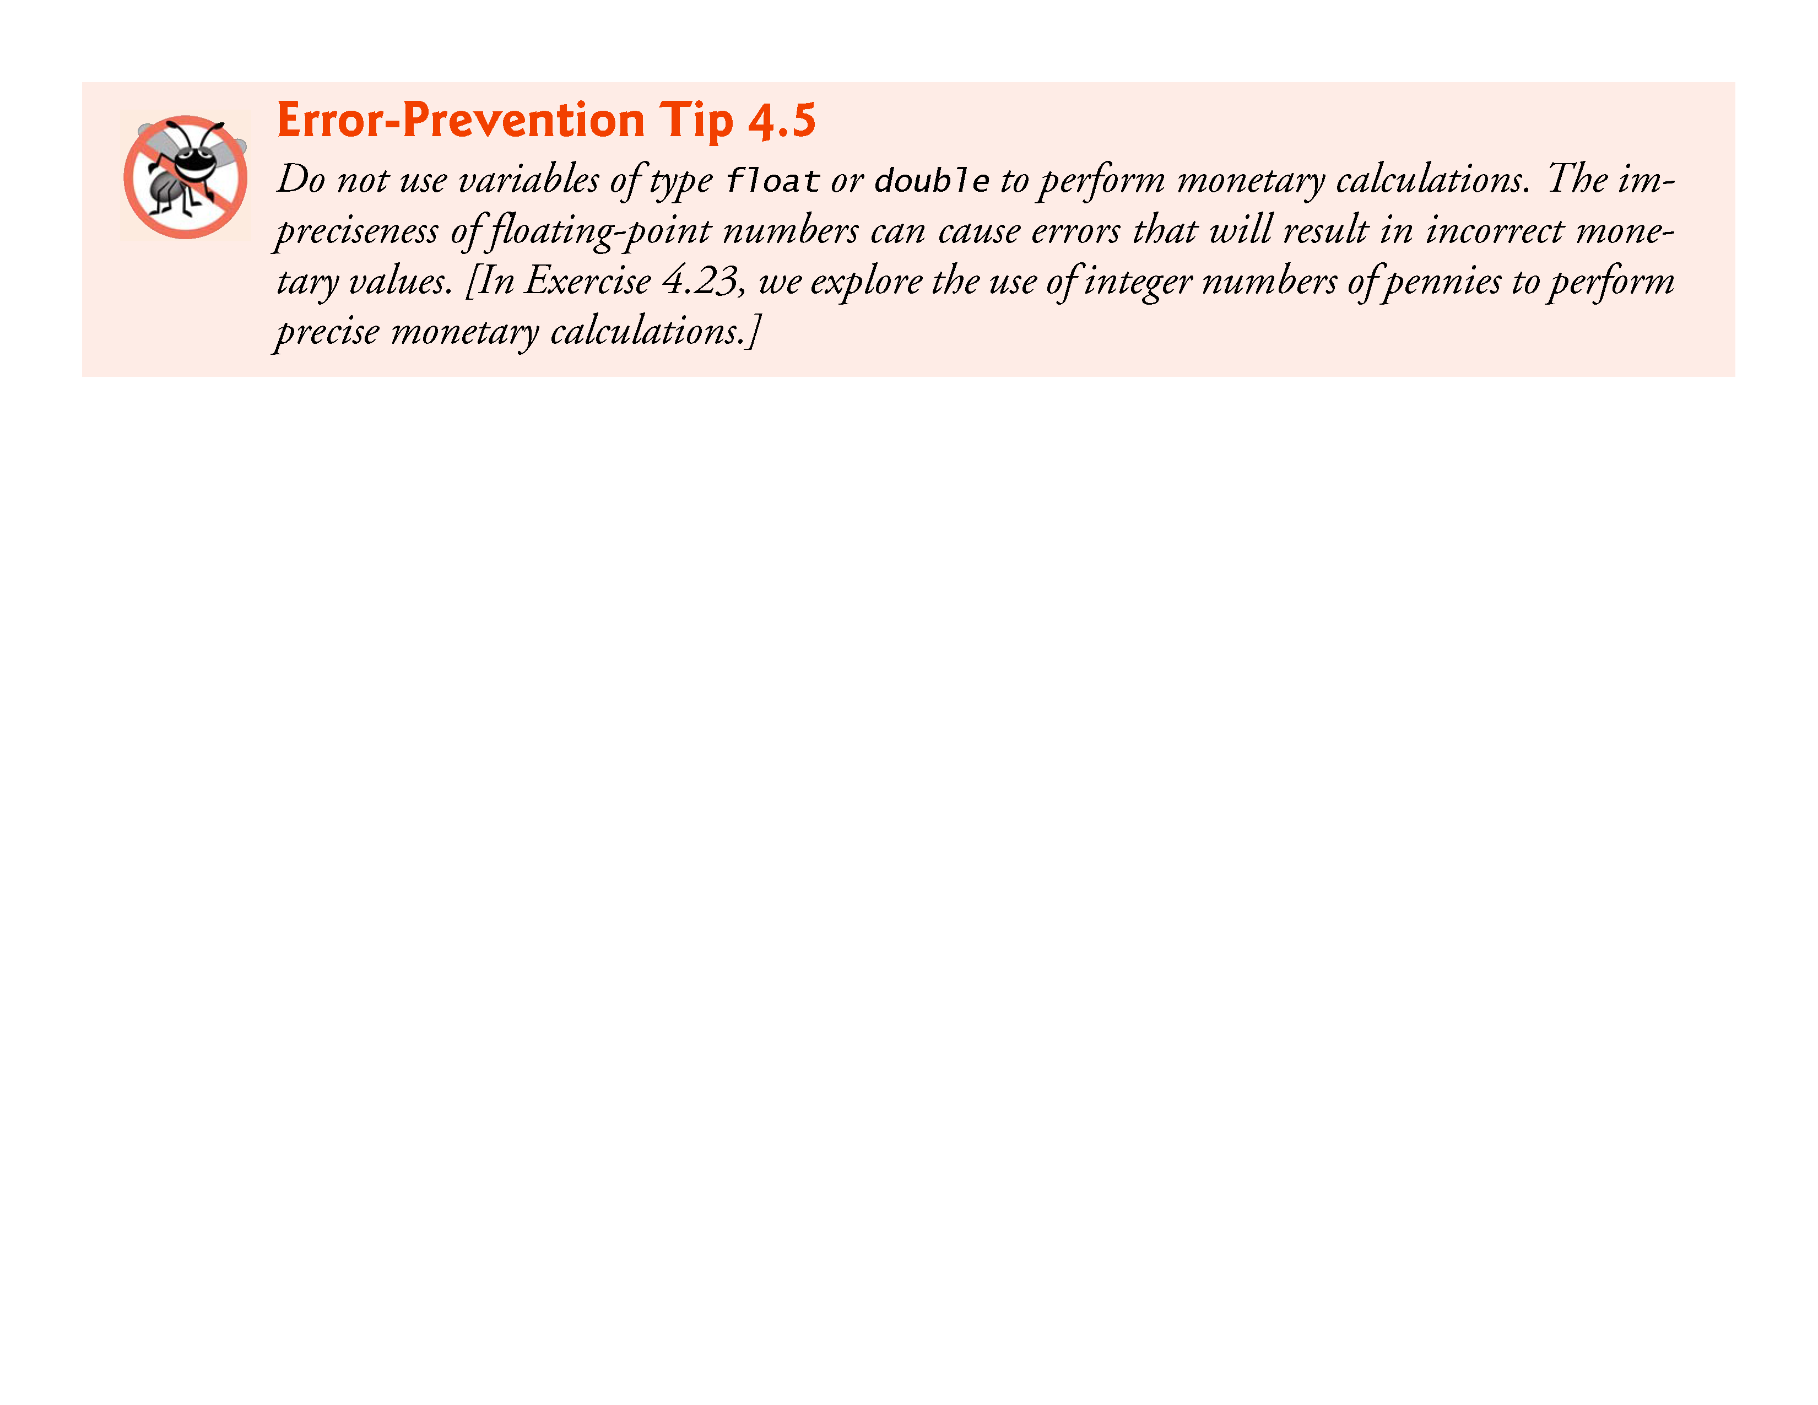

Slide 53
4.6 Examples Using the for Statement (Cont.)
Here is a simple explanation of what can go wrong when using float or double to represent dollar amounts.
Two float dollar amounts stored in the machine could be 14.234 (which with %.2f prints as 14.23) and 18.673 (which with %.2f prints as 18.67).
When these amounts are added, they produce the sum 32.907, which with %.2f prints as 32.91.

Slide 54
4.6 Examples Using the for Statement (Cont.)
Thus your printout could appear as
14.23 + 18.67 _______ 32.91
Clearly the sum of the individual numbers as printed should be 32.90! You’ve been warned!

Slide 55
4.6 Examples Using the for Statement (Cont.)
Formatting Numeric Output
The conversion specifier %21.2f is used to print the value of the variable amount in the program.
The 21 in the conversion specifier denotes the field width in which the value will be printed.
A field width of 21 specifies that the value printed will appear in 21 print positions.
The 2 specifies the precision (i.e., the number of decimal positions).

Slide 56
4.6 Examples Using the for Statement (Cont.)
If the number of characters displayed is less than the field width, then the value will automatically be right justified in the field.
This is particularly useful for aligning floating-point values with the same precision (so that their decimal points align vertically).
To left justify a value in a field, place a - (minus sign) between the % and the field width.
The minus sign may also be used to left justify integers (such as in %-6d) and character strings (such as in %-8s).

Slide 57
4.7 switch Multiple-Selection Statement
Occasionally, an algorithm will contain a series of decisions in which a variable or expression is tested separately for each of the constant integral values it may assume, and different actions are taken.
This is called multiple selection.
C provides the switch multiple-selection statement to handle such decision making.
The switch statement consists of a series of case labels, an optional default case and statements to execute for each case.
Figure 4.7 uses switch to count the number of each different letter grade students earned on an exam.

Slide 58
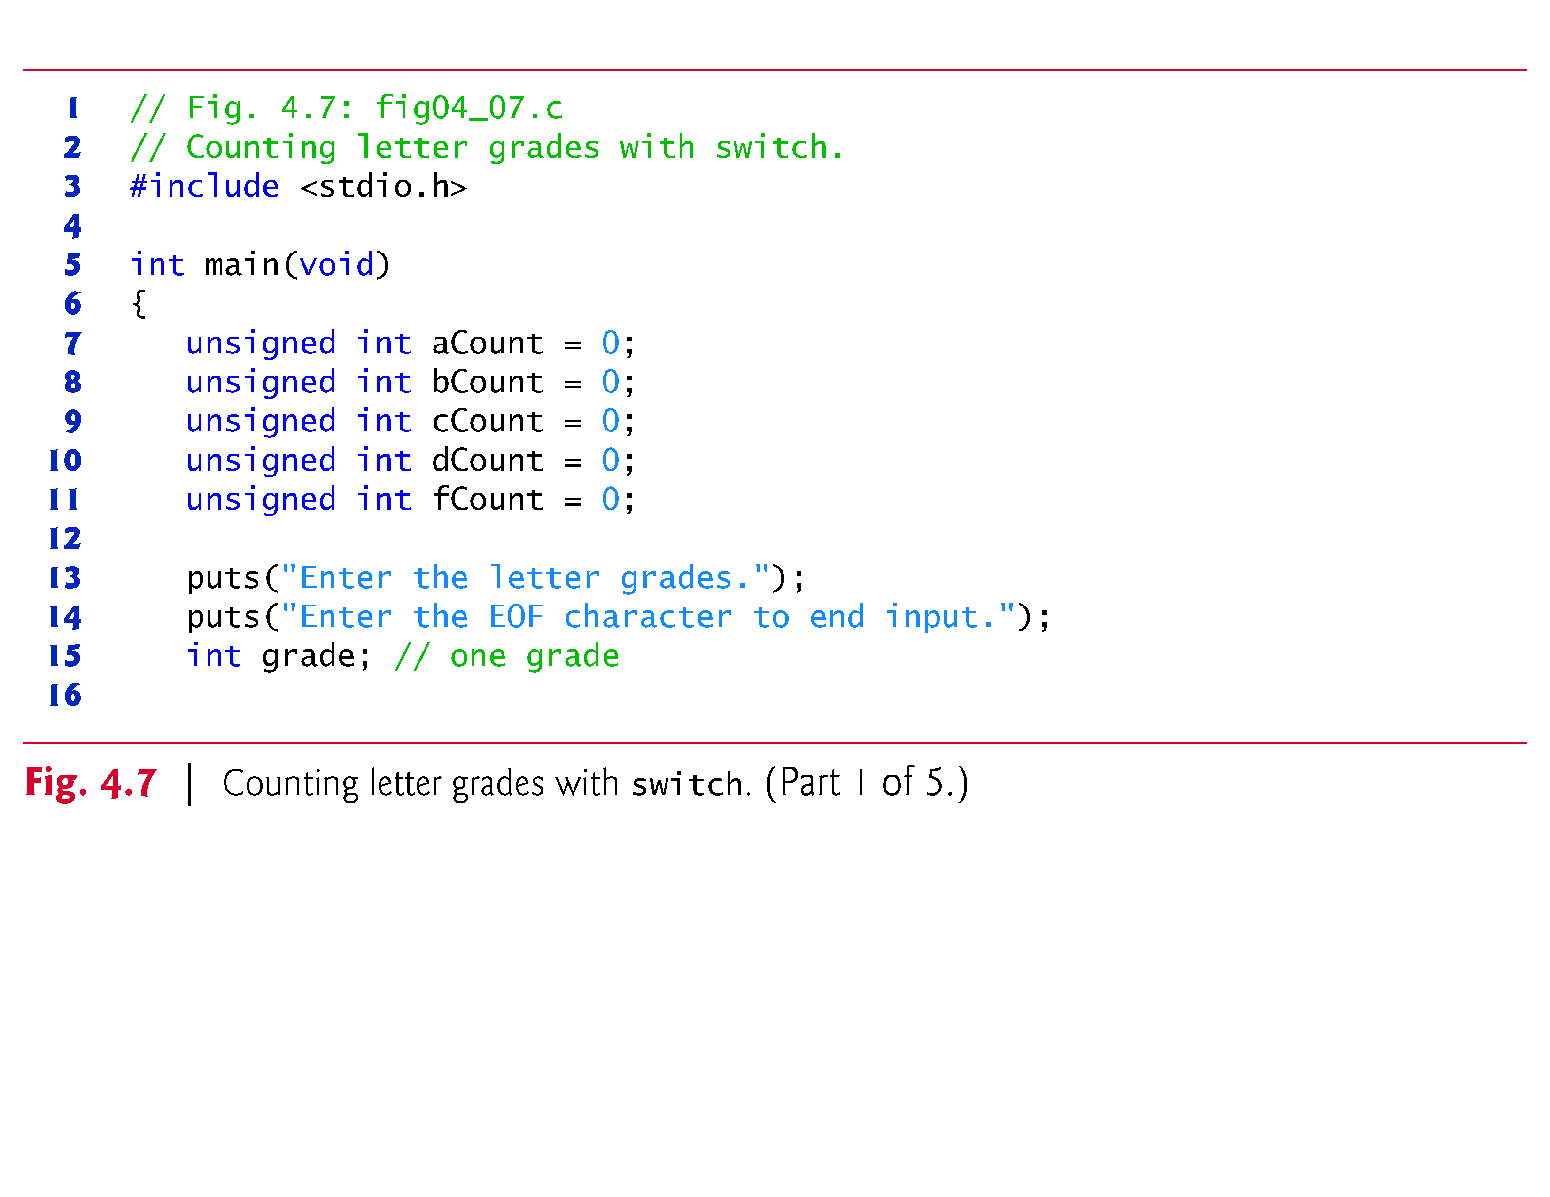

Slide 59
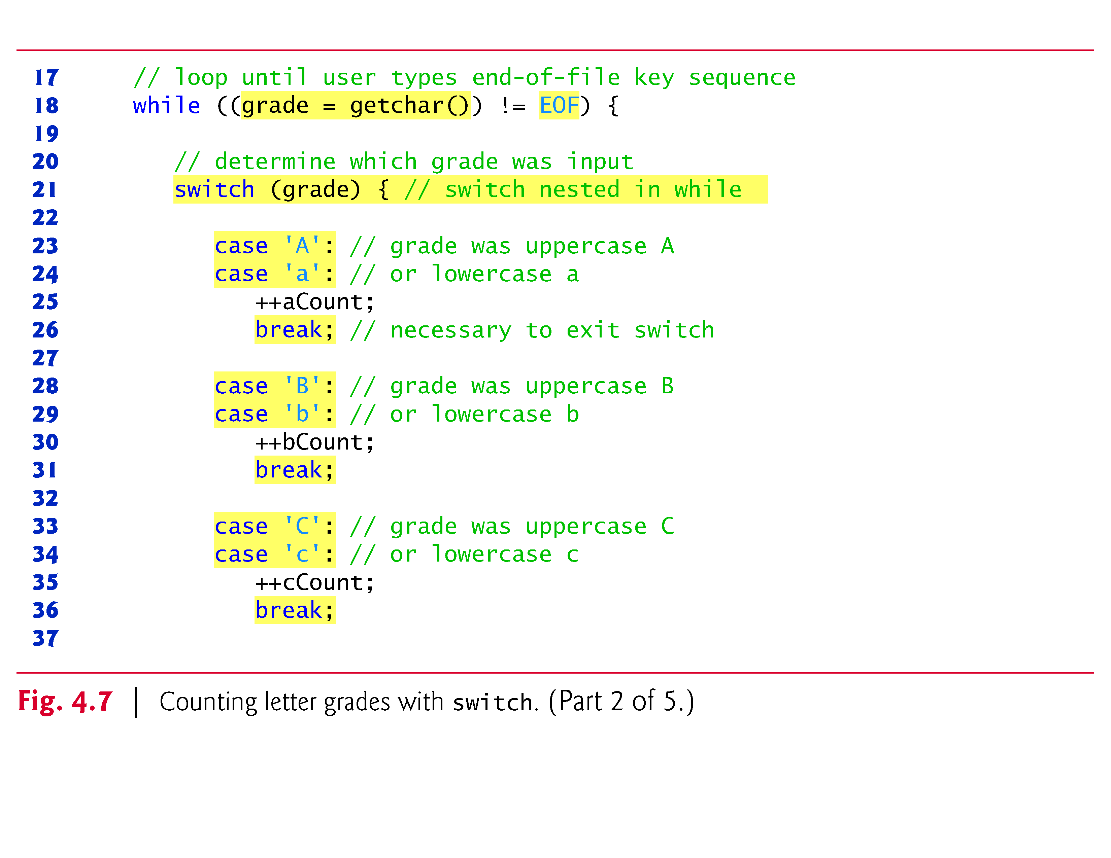

Slide 60
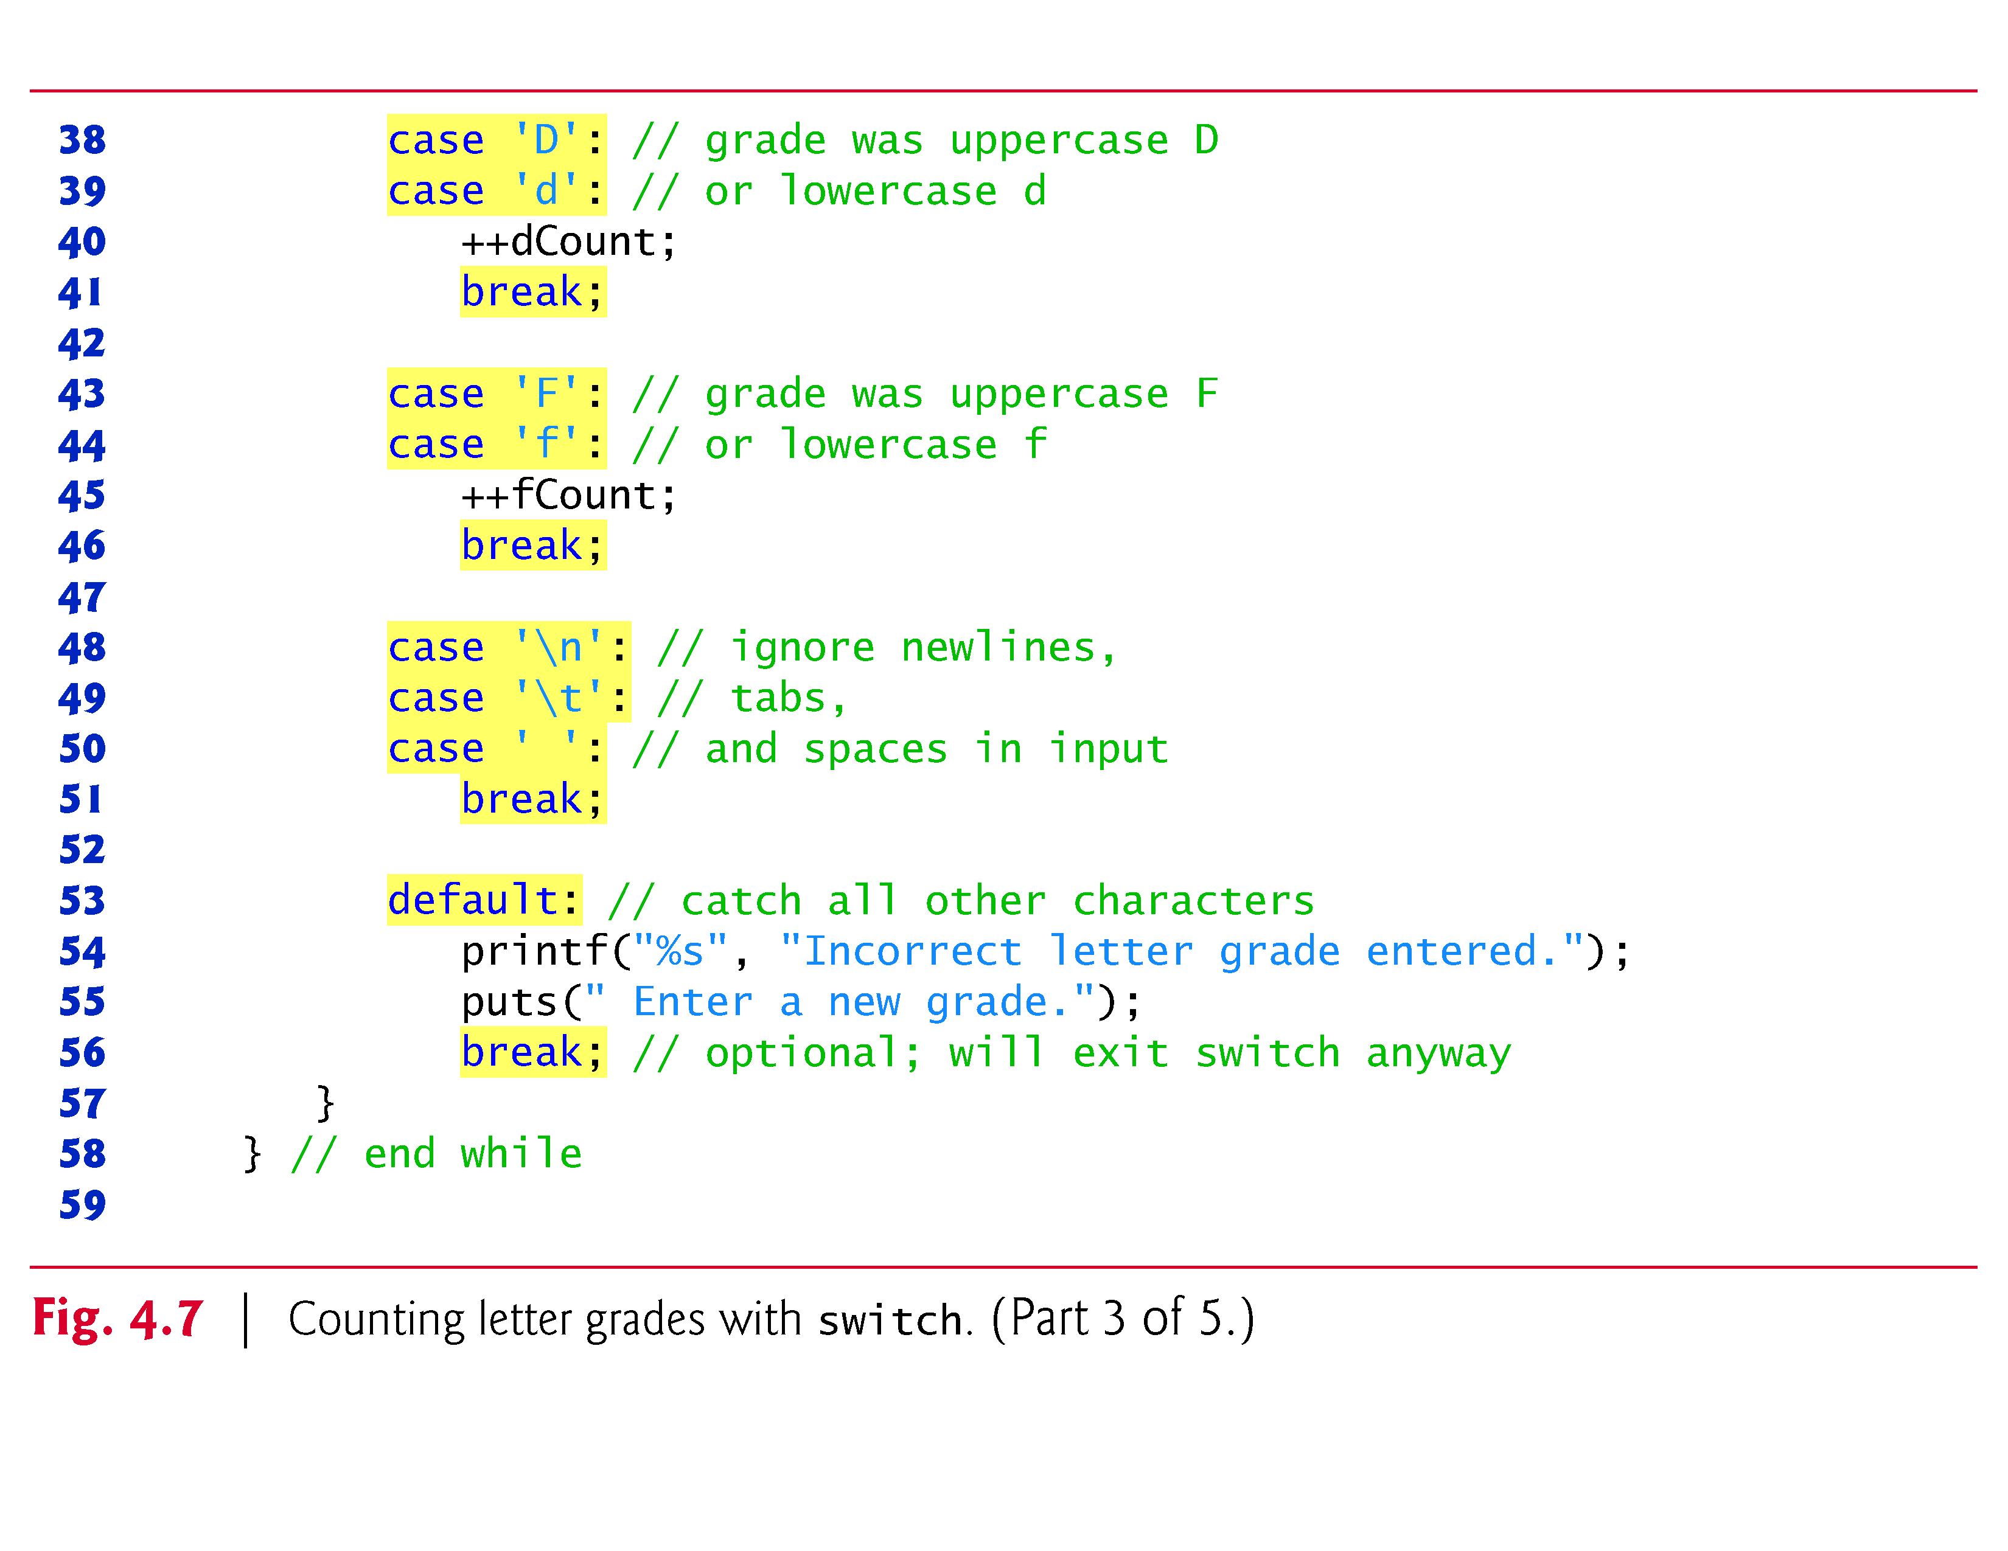

Slide 61
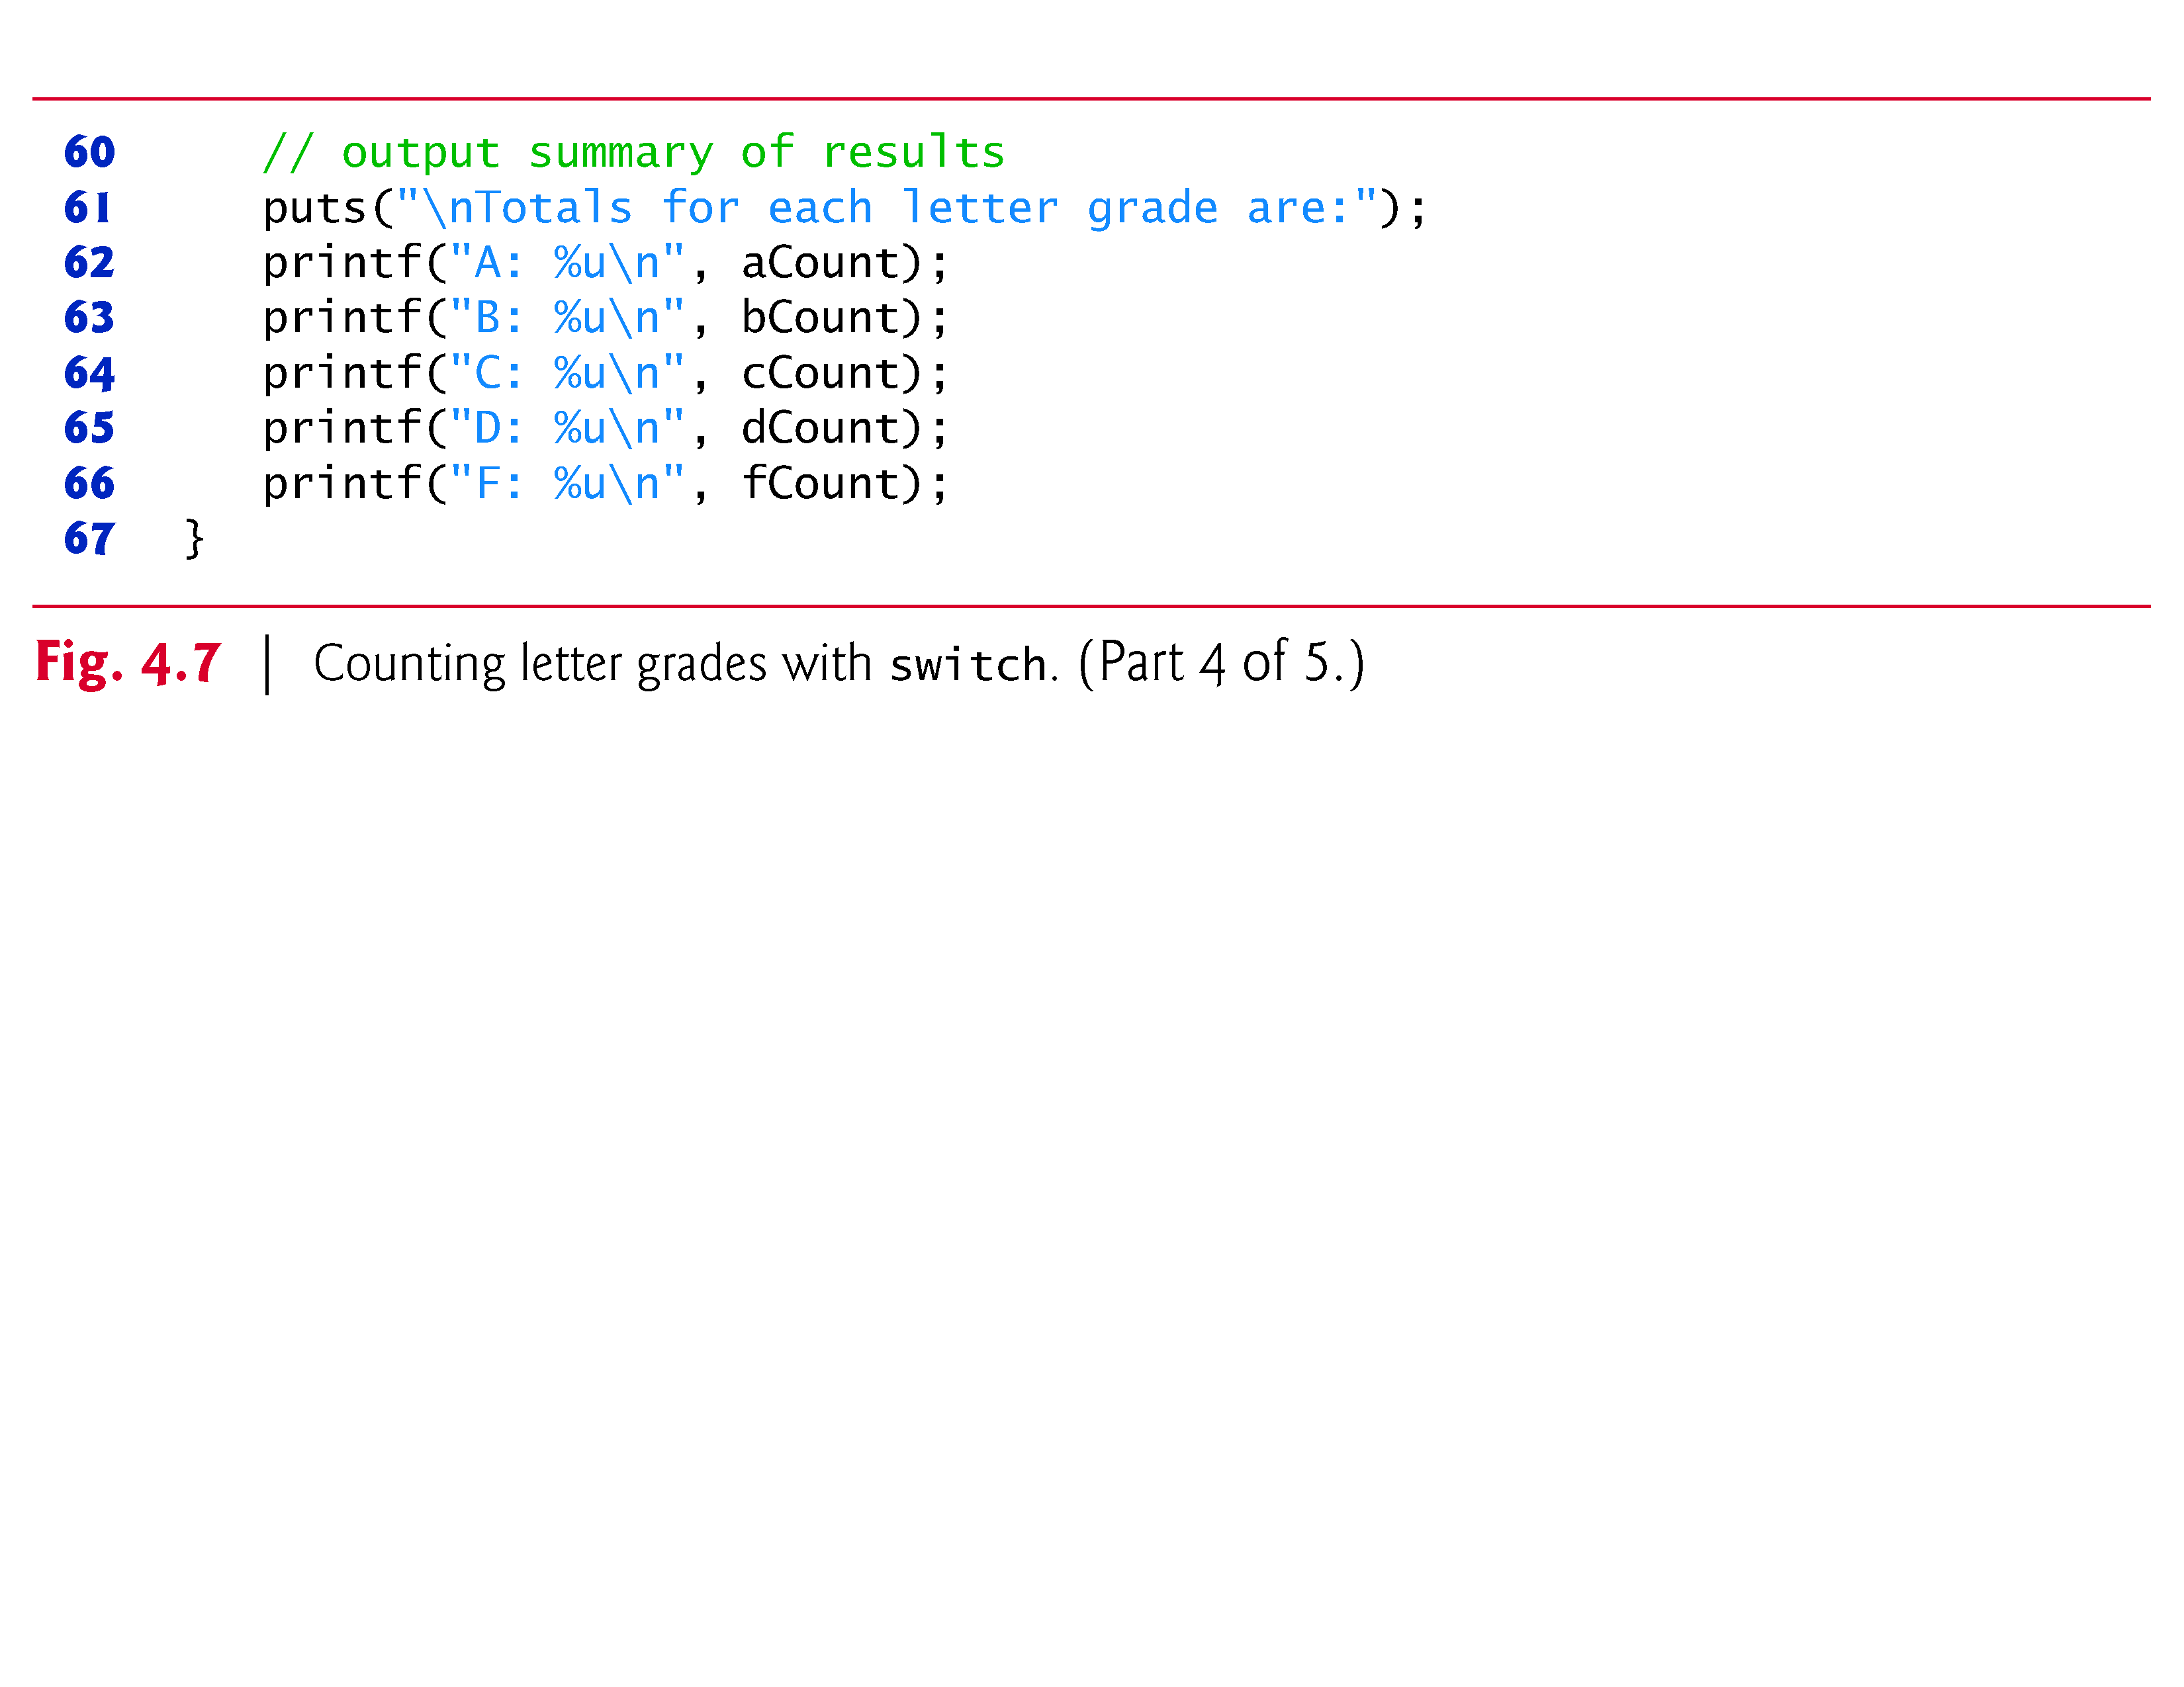

Slide 62
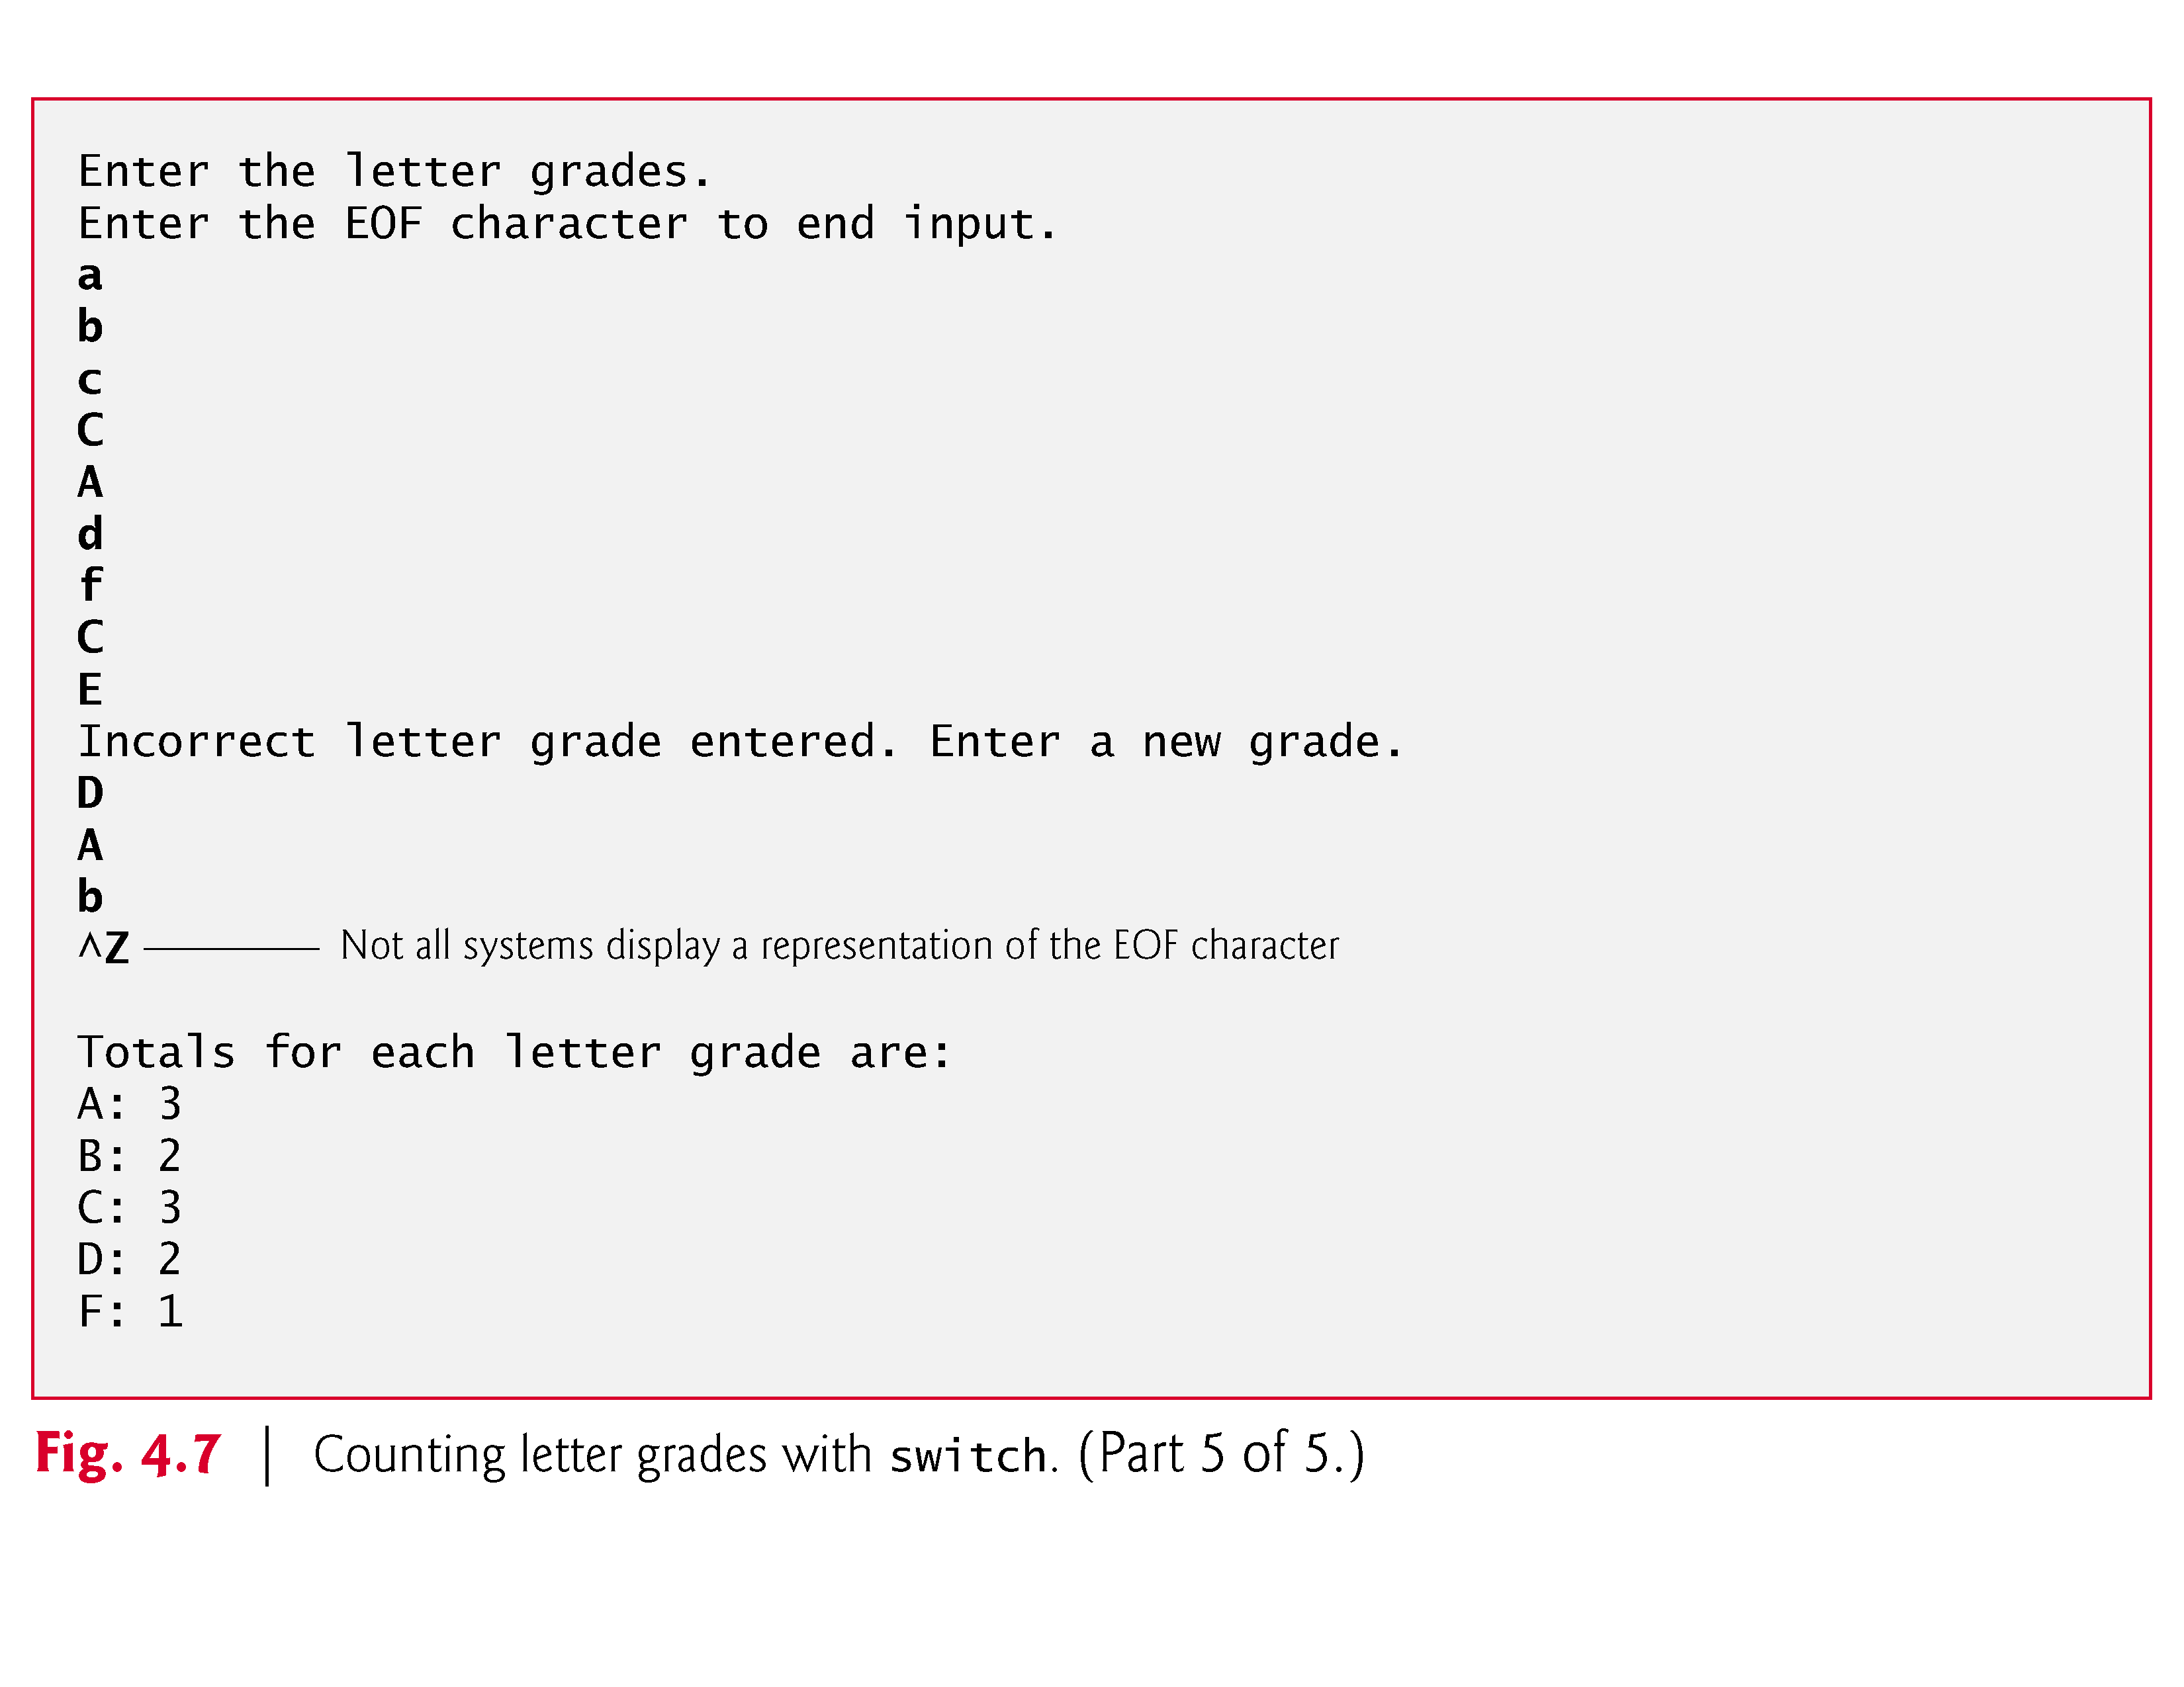

Slide 63
4.7 switch Multiple-Selection Statement (Cont.)
Reading Character Input
In the program, the user enters letter grades for a class.
In the while header (line 19),
while ((grade = getchar()) != EOF)
the parenthesized assignment (grade = getchar()) executes first.
The getchar function (from <stdio.h>) reads one character from the keyboard and returns as an int the character that the user entered.
Characters are normally stored in variables of type char.
However, an important feature of C is that characters can be stored in any integer data type because they’re usually represented as one-byte integers in the computer.

Slide 64
4.7 switch Multiple-Selection Statement (Cont.)
Thus, we can treat a character as either an integer or a character, depending on its use.
For example, the statement
printf("The character (%c) has the value %d.\n", 'a', 'a');
uses the conversion specifiers %c and %d to print the character a and its integer value, respectively.
The result is
The character (a) has the value 97.
The integer 97 is the character’s numerical representation in the computer.

Slide 65
4.7 switch Multiple-Selection Statement (Cont.)
Many computers today use the ASCII (American Standard Code for Information Interchange) character set in which 97 represents the lowercase letter 'a'.
A list of the ASCII characters and their decimal values is presented in Appendix B.
Characters can be read with scanf by using the conversion specifier %c.
Assignments as a whole actually have a value.
This value is assigned to the variable on the left side of =.
The value of the assignment expression grade = getchar() is the character that’s returned by getchar and assigned to the variable grade.

Slide 66
4.7 switch Multiple-Selection Statement (Cont.)
The fact that assignments have values can be useful for setting several variables to the same value.
For example,
a = b = c = 0;
first evaluates the assignment c = 0 (because the = operator associates from right to left).
The variable b is then assigned the value of the assignment c = 0 (which is 0).
Then, the variable a is assigned the value of the assignment b = (c = 0) (which is also 0).
In the program, the value of the assignment grade = getchar() is compared with the value of EOF (a symbol whose acronym stands for “end of file”).

Slide 67
4.7 switch Multiple-Selection Statement (Cont.)
We use EOF (which normally has the value -1) as the sentinel value.
The user types a system-dependent keystroke combination to mean “end of file”—i.e., “I have no more data to enter.” EOF is a symbolic integer constant defined in the <stdio.h> header (we’ll see in Chapter 6 how symbolic constants are defined).
If the value assigned to grade is equal to EOF, the program terminates.
We’ve chosen to represent characters in this program as ints because EOF has an integer value (normally -1).

Slide 68
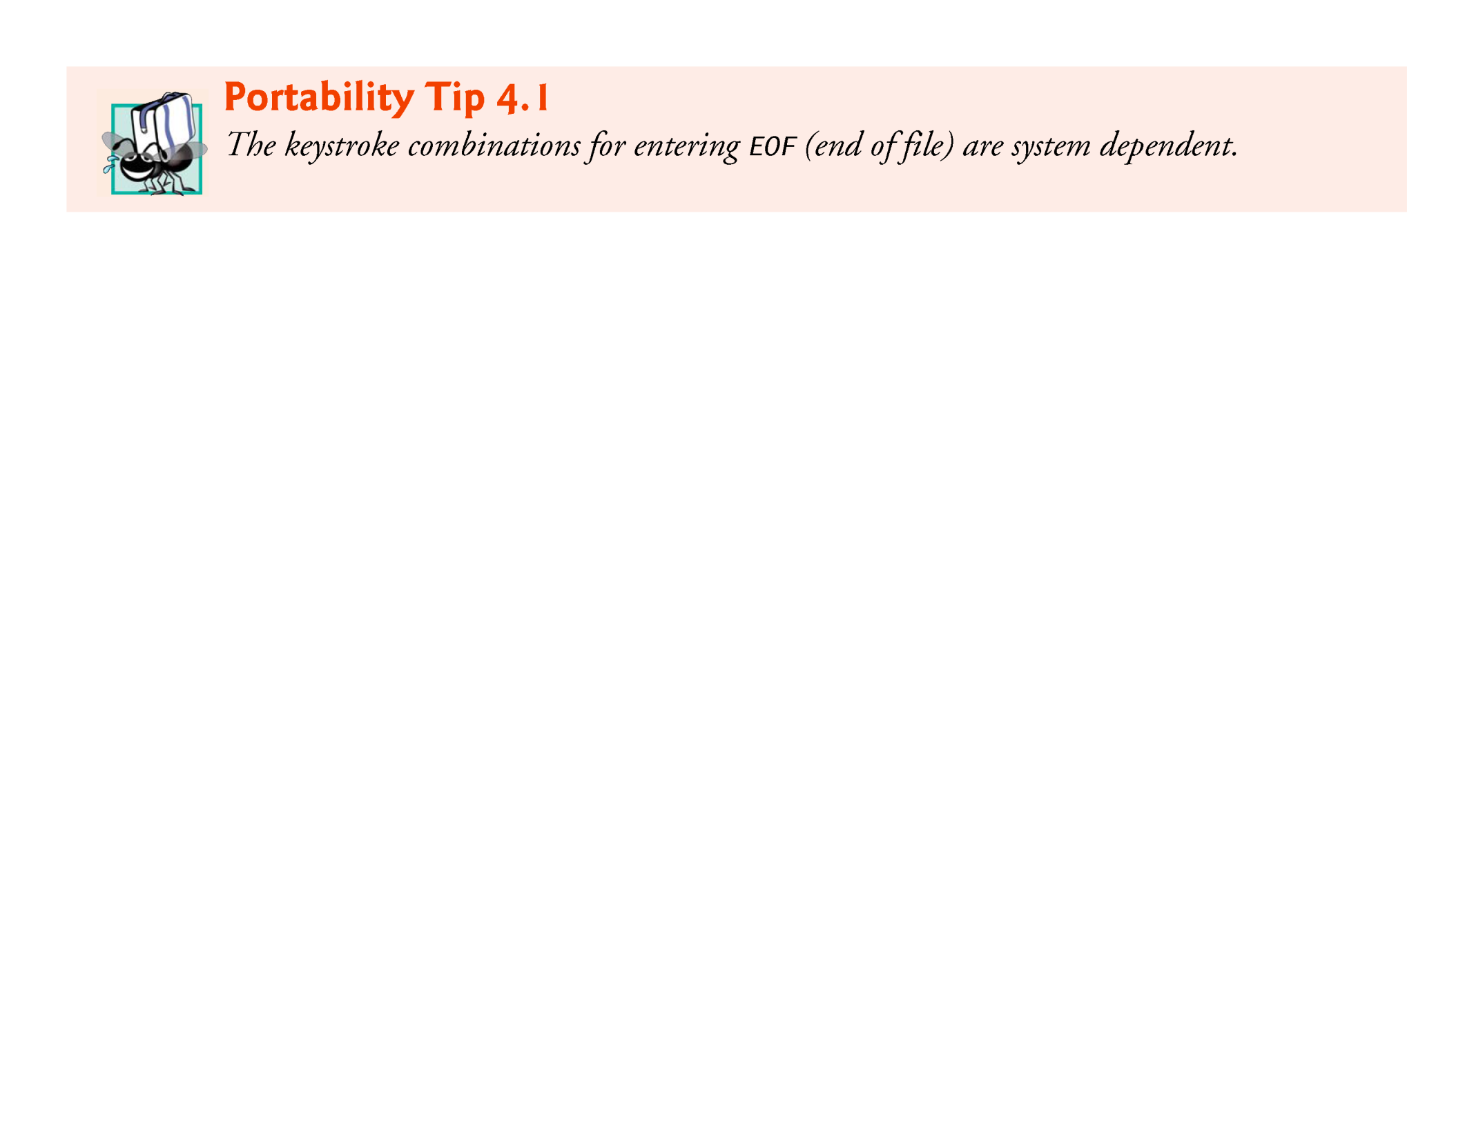

Slide 69
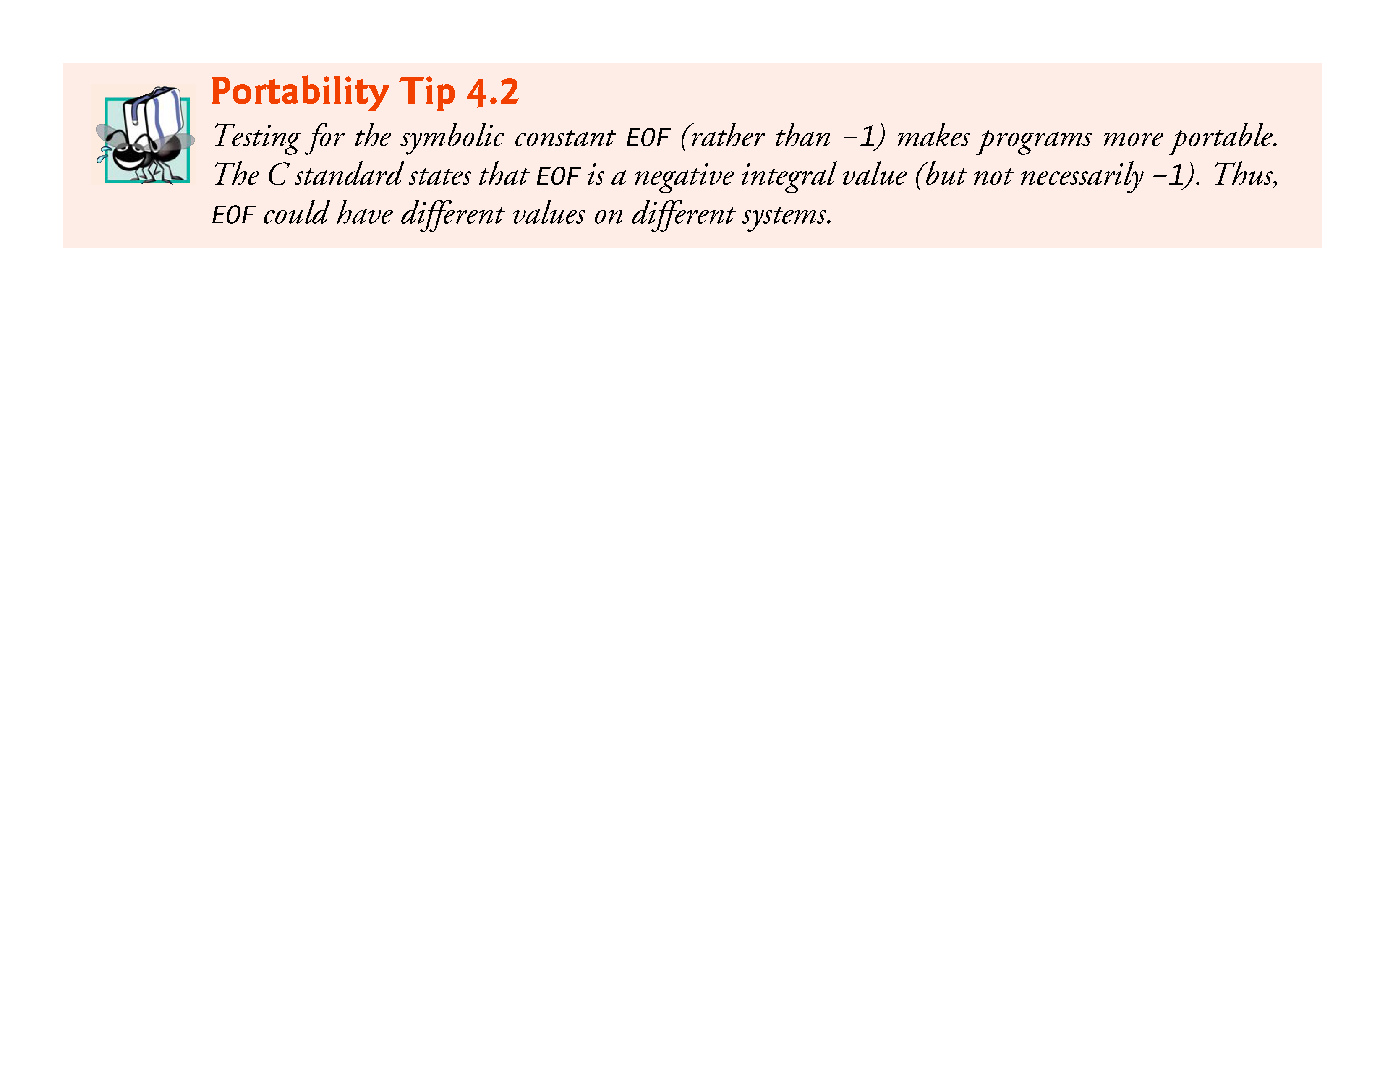

Slide 70
4.7 switch Multiple-Selection Statement (Cont.)
Entering the EOF Indicator
On Linux/UNIX/Mac OS X systems, the EOF indicator is entered by typing
<Ctrl> d
on a line by itself.
This notation <Ctrl> d means to press the Enter key then simultaneously press both Ctrl and d.
On other systems, such as Microsoft Windows, the EOF indicator can be entered by typing
<Ctrl> z
You may also need to press Enter on Windows.

Slide 71
4.7 switch Multiple-Selection Statement (Cont.)
The user enters grades at the keyboard.
When the Enter key is pressed, the characters are read by function getchar one character at a time.
If the character entered is not equal to EOF, the switch statement (line 22) is entered.

Slide 72
4.7 switch Multiple-Selection Statement (Cont.)
switch Statement Details
Keyword switch is followed by the variable name grade in parentheses.
This is called the controlling expression.
The value of this expression is compared with each of the case labels.
Assume the user has entered the letter C as a grade.
C is automatically compared to each case in the switch.
If a match occurs (case 'C':), the statements for that case are executed.

Slide 73
4.7 switch Multiple-Selection Statement (Cont.)
In the case of the letter C, cCount is incremented by 1 (line 36), and the switch statement is exited immediately with the break statement.
The break statement causes program control to continue with the first statement after the switch statement.
The break statement is used because the cases in a switch statement would otherwise run together.

Slide 74
4.7 switch Multiple-Selection Statement (Cont.)
If break is not used anywhere in a switch statement, then each time a match occurs in the statement, the statements for all the remaining cases will be executed—called fallthrough.
If no match occurs, the default case is executed, and an error message is printed.

Slide 75
4.7 switch Multiple-Selection Statement (Cont.)
switch Statement Flowchart
Each case can have one or more actions.
The switch statement is different from all other control statements in that braces are not required around multiple actions in a case of a switch.
The general switch multiple-selection statement (using a break in each case) is flowcharted in Fig. 4.8.
The flowchart makes it clear that each break statement at the end of a case causes control to immediately exit the switch statement.

Slide 76
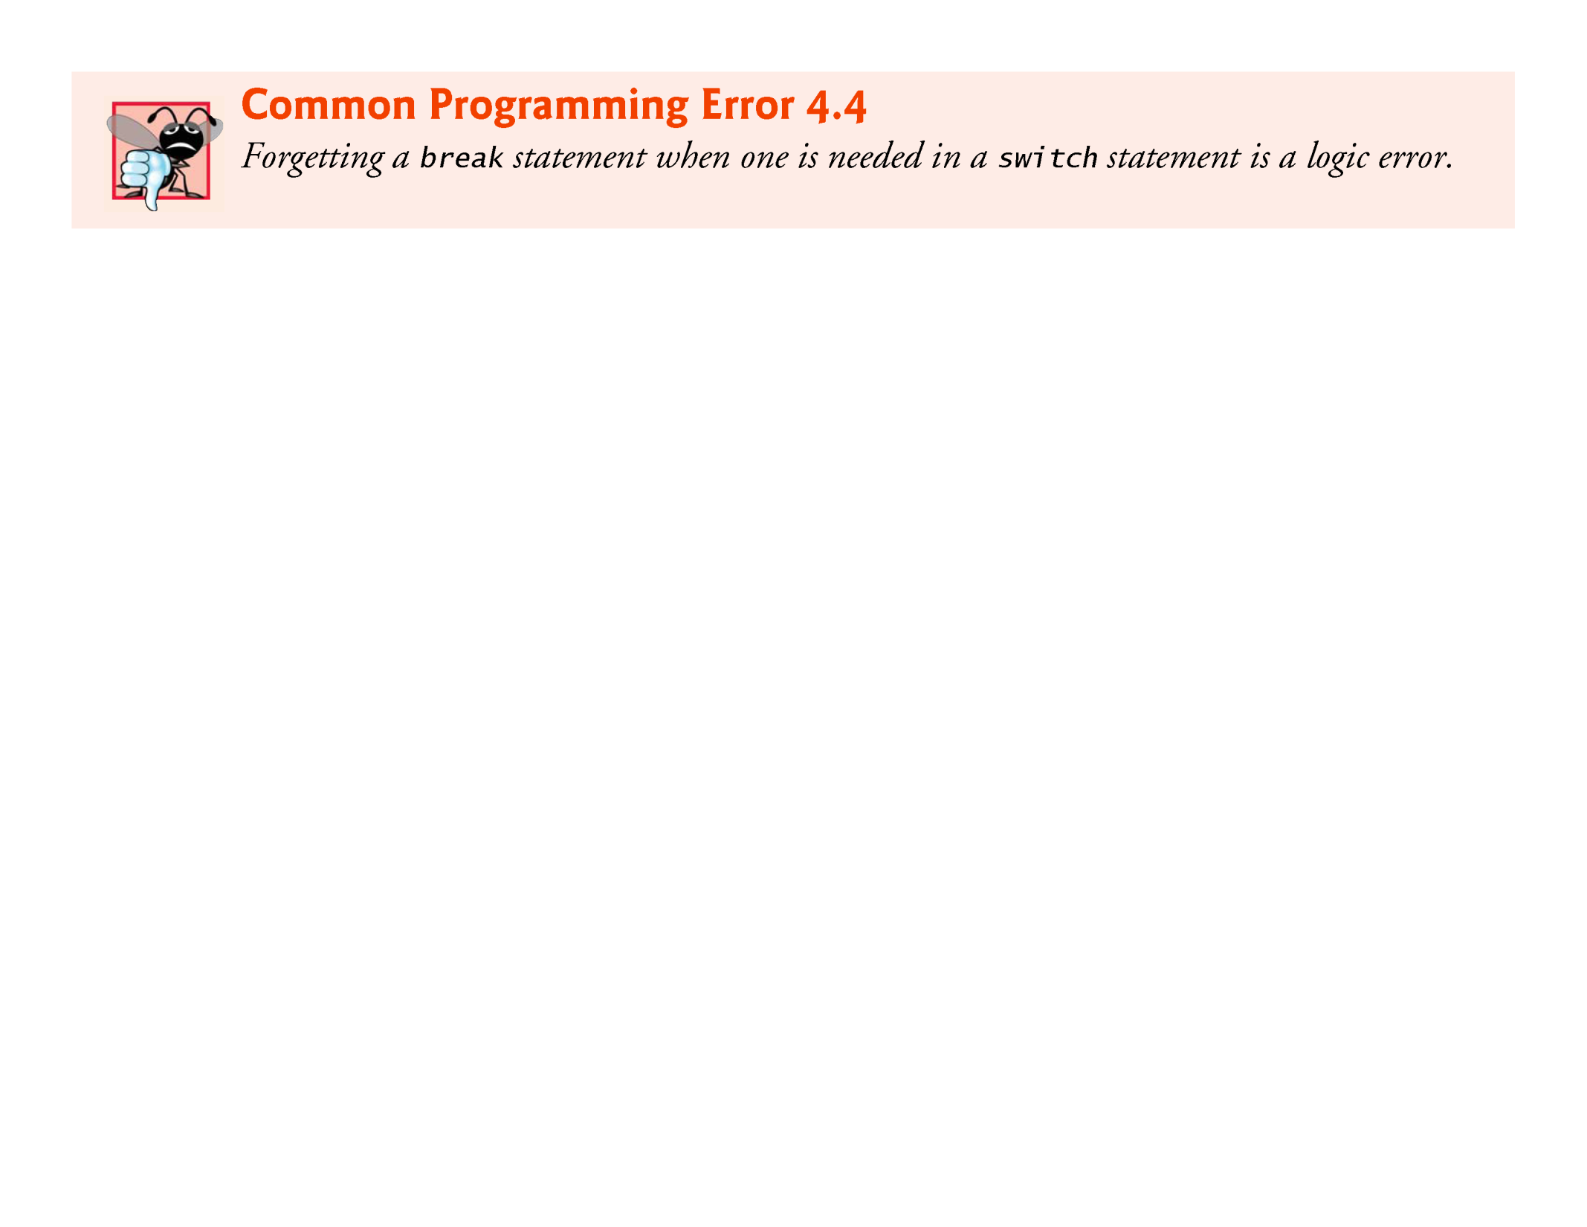

Slide 77
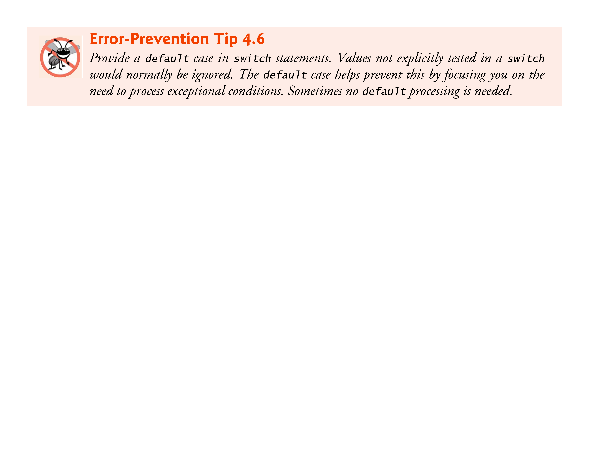

Slide 78
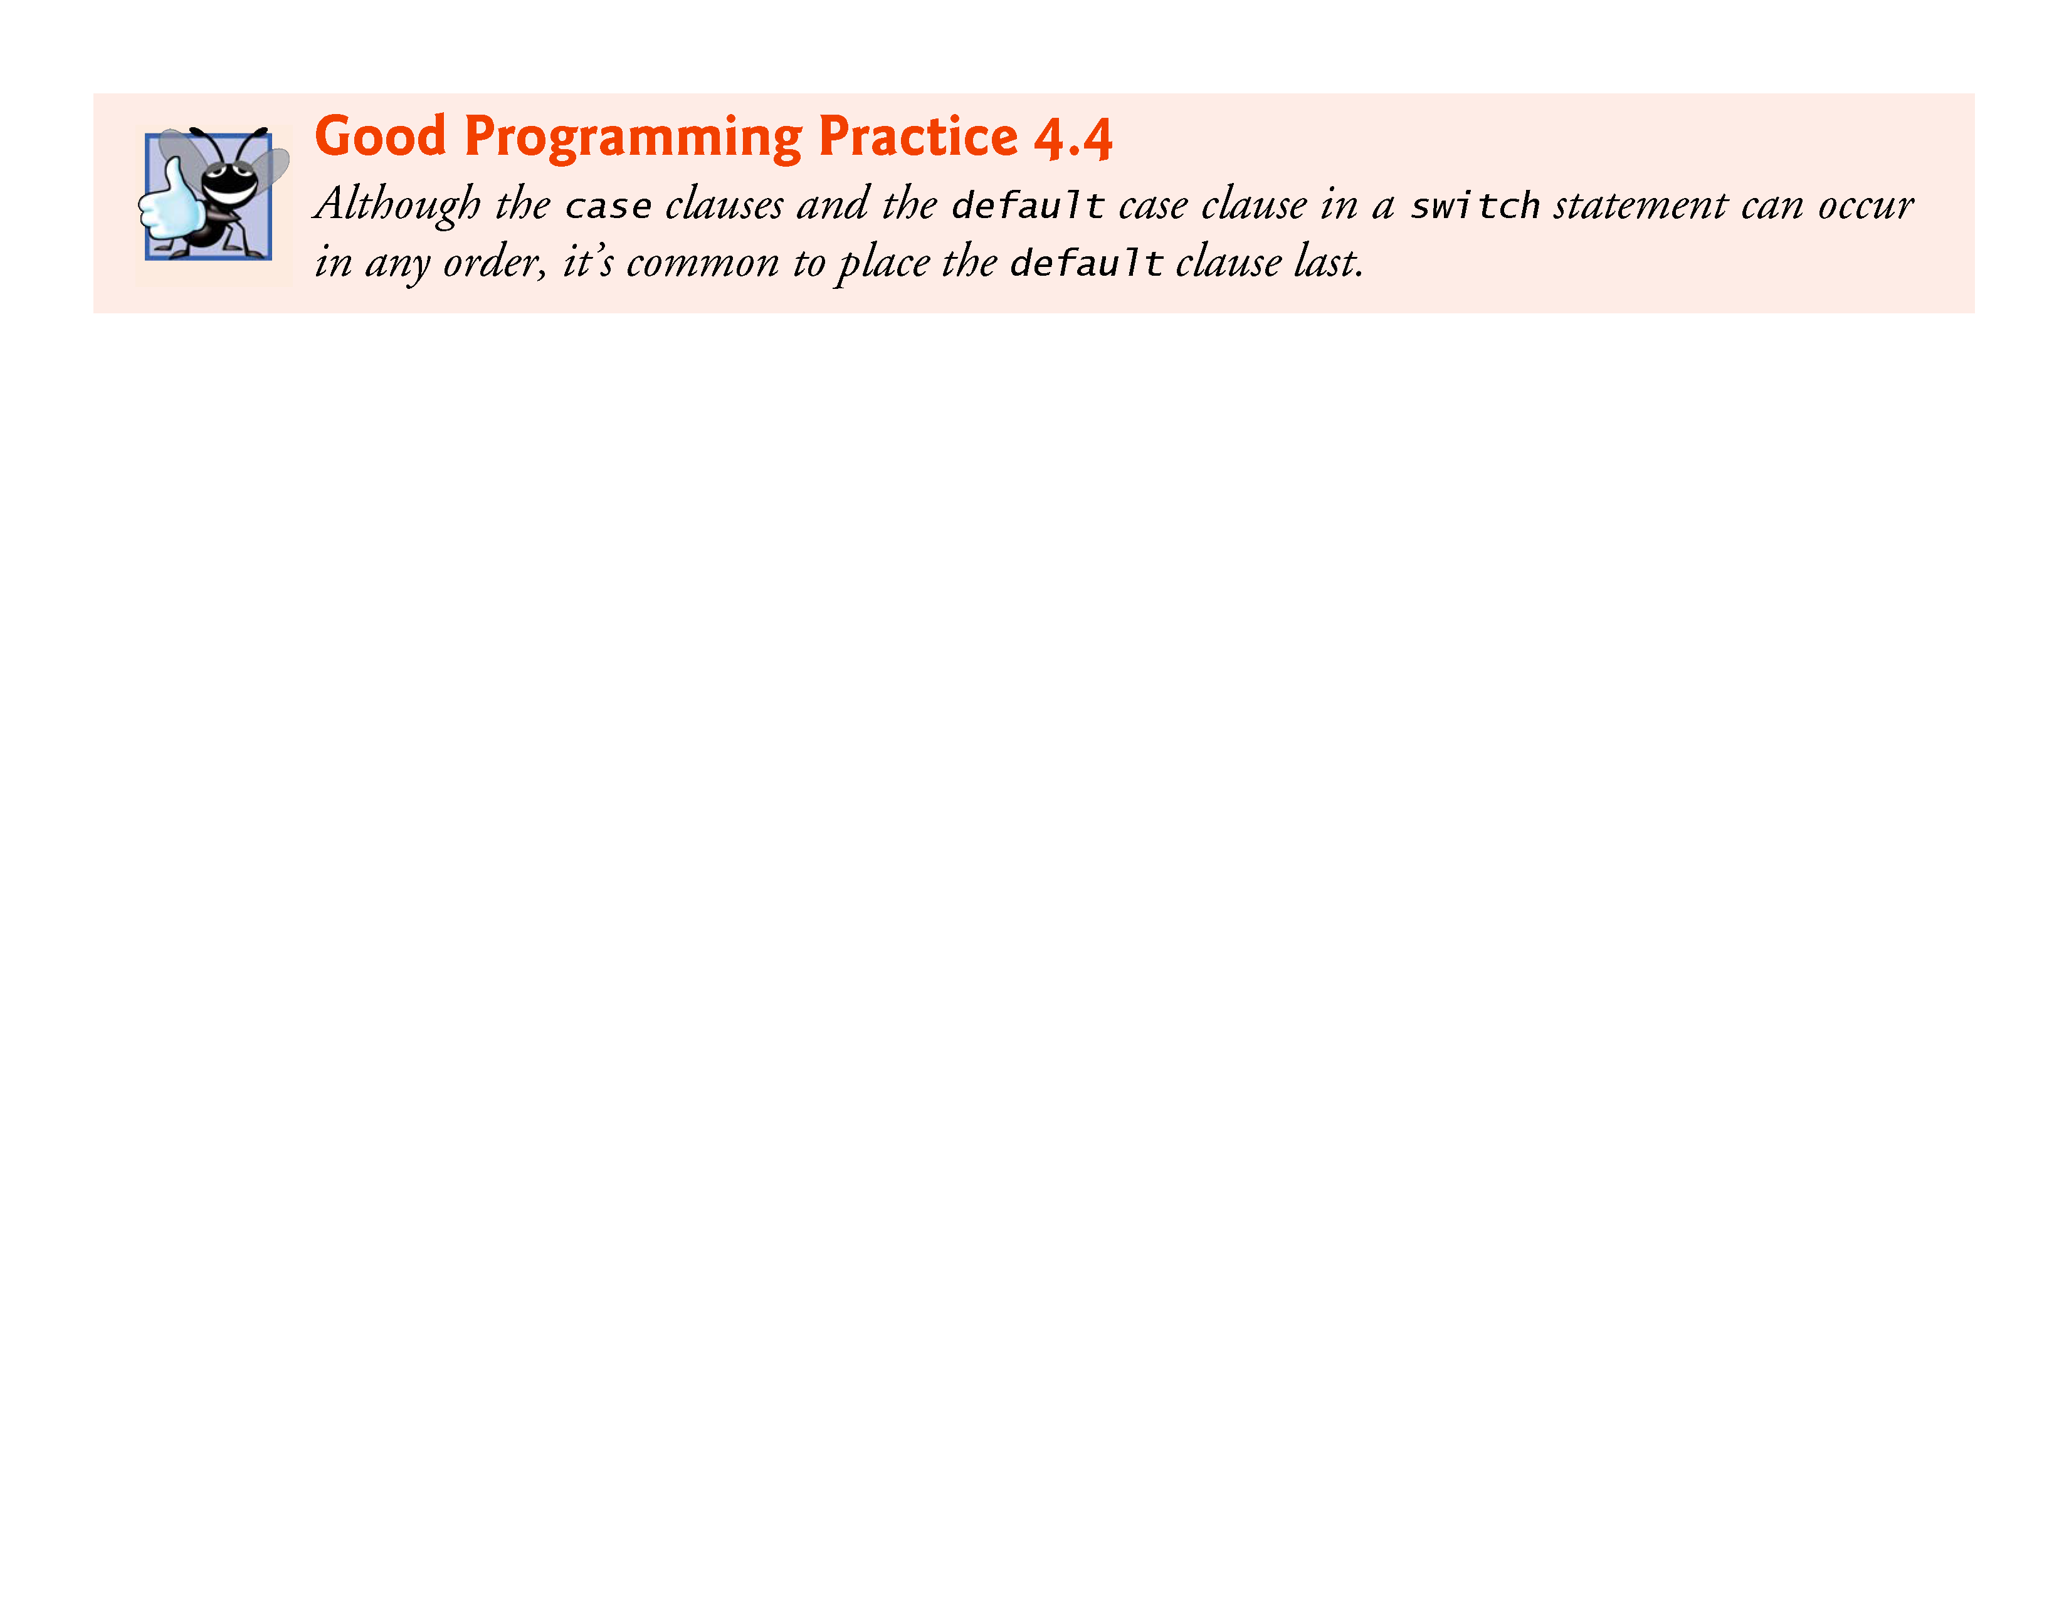

Slide 79


Slide 80
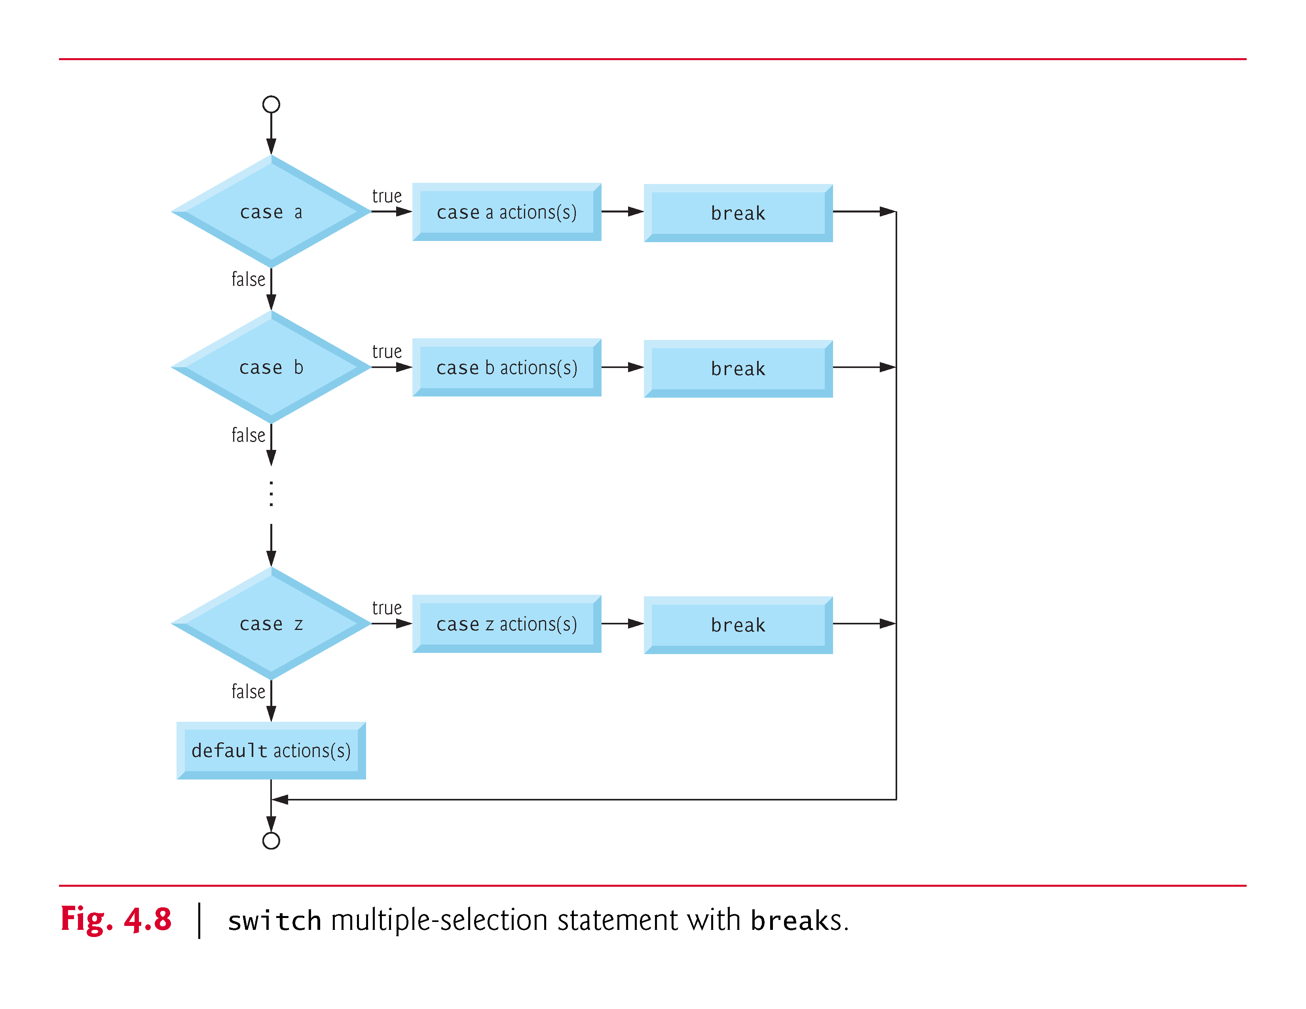

Slide 81
4.7 switch Multiple-Selection Statement (Cont.)
Ignoring Newline, Tab and Blank Characters in Input
In the switch statement of Fig. 4.7, the lines
case '\n': // ignore newlines, case '\t': // tabs, case ' ': // and spaces in input break; // exit switch
cause the program to skip newline, tab and blank characters.
Reading characters one at a time can cause some problems.
To have the program read the characters, you must send to the computer by pressing the Enter key.
This causes the newline character to be placed in the input after the character we wish to process.

Slide 82
4.7 switch Multiple-Selection Statement (Cont.)
Often, this newline character must be specially processed to make the program work correctly.
By including the preceding cases in our switch statement, we prevent the error message in the default case from being printed each time a newline, tab or space is encountered in the input.
So each input causes two iterations of the loop—the first for the letter grade and the second for '\n'.

Slide 83
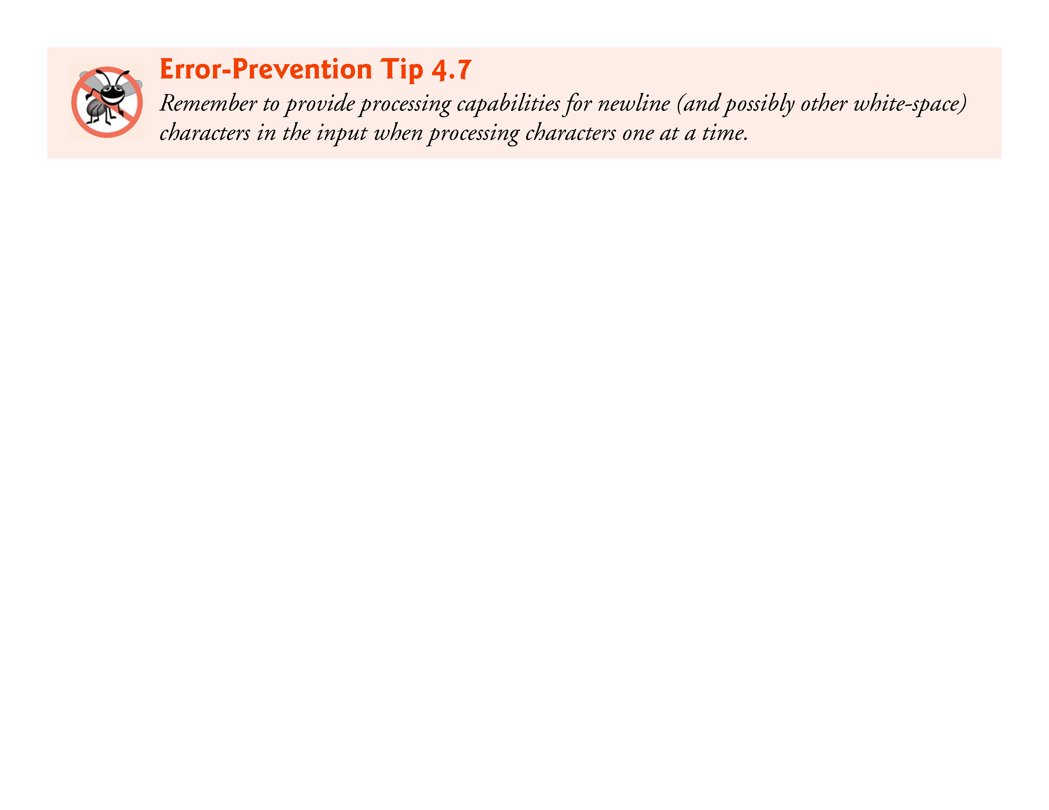

Slide 84
4.7 switch Multiple-Selection Statement (Cont.)
Listing several case labels together (such as case 'D': case 'd':) simply means that the same set of actions is to occur for either of these cases.

Slide 85
4.7 switch Multiple-Selection Statement (Cont.)
Constant Integral Expressions
When using the switch statement, remember that each individual case can test only a constant integral expression—i.e., any combination of character constants and integer constants that evaluates to a constant integer value.
A character constant can be represented as the specific character in single quotes, such as 'A'.

Slide 86
4.7 switch Multiple-Selection Statement (Cont.)
Characters must be enclosed within single quotes to be recognized as character constants—characters in double quotes are recognized as strings.
Integer constants are simply integer values.
In our example, we have used character constants.
Remember that characters are represented as small integer values.

Slide 87
4.7 switch Multiple-Selection Statement (Cont.)
Notes on Integral Types
Portable languages like C must have flexible data type sizes.
Different applications may need integers of different sizes.
C provides several data types to represent integers.
In addition to int and char, C provides types short int (which can be abbreviated as short) and long int (which can be abbreviated as long), as well as unsigned variations of all the integral types.
The C standard specifies the minimum range of values for each integer type, but the actual range may be greater and depends on the implementation.
For short ints the minimum range is –32767 to +32767.
For most integer calculations, long ints are sufficient.

Slide 88
4.7 switch Multiple-Selection Statement (Cont.)
The minimum range of values for long ints is –2147483647 to +2147483647.
The range of values for an int greater than or equal to that of a short int and less than or equal to that of a long int.
The data type signed char can be used to represent integers in the range –127 to +127 or any of the characters in the computer’s character set.

Slide 89
4.8 do…while Iteration Statement
The do…while iteration statement is similar to the while statement.
In the while statement, the loop-continuation condition is tested at the beginning of the loop before the body of the loop is performed.
The do…while statement tests the loop-continuation condition after the loop body is performed.
Therefore, the loop body will be executed at least once.
When a do…while terminates, execution continues with the statement after the while clause.

Slide 90
4.8 do…while Iteration Statement (Cont.)
It’s not necessary to use braces in the do…while statement if there’s only one statement in the body.
However, the braces are usually included to avoid confusion between the while and do…while statements.
For example,
while (condition)
is normally regarded as the header to a while statement.

Slide 91
4.8 do…while Iteration Statement (Cont.)
A do…while with no braces around the single-statement body appears as
do statement while (condition);
which can be confusing.
The last line—while(condition);—may be misinterpreted as a while statement containing an empty statement.
Thus, to avoid confusion, the do…while with one statement is often written as follows:

Slide 92
4.8 do…while Iteration Statement (Cont.)
Figure 4.9 uses a do…while statement to print the numbers from 1 to 10.
The control variable counter is preincremented in the loop-continuation test.

Slide 93
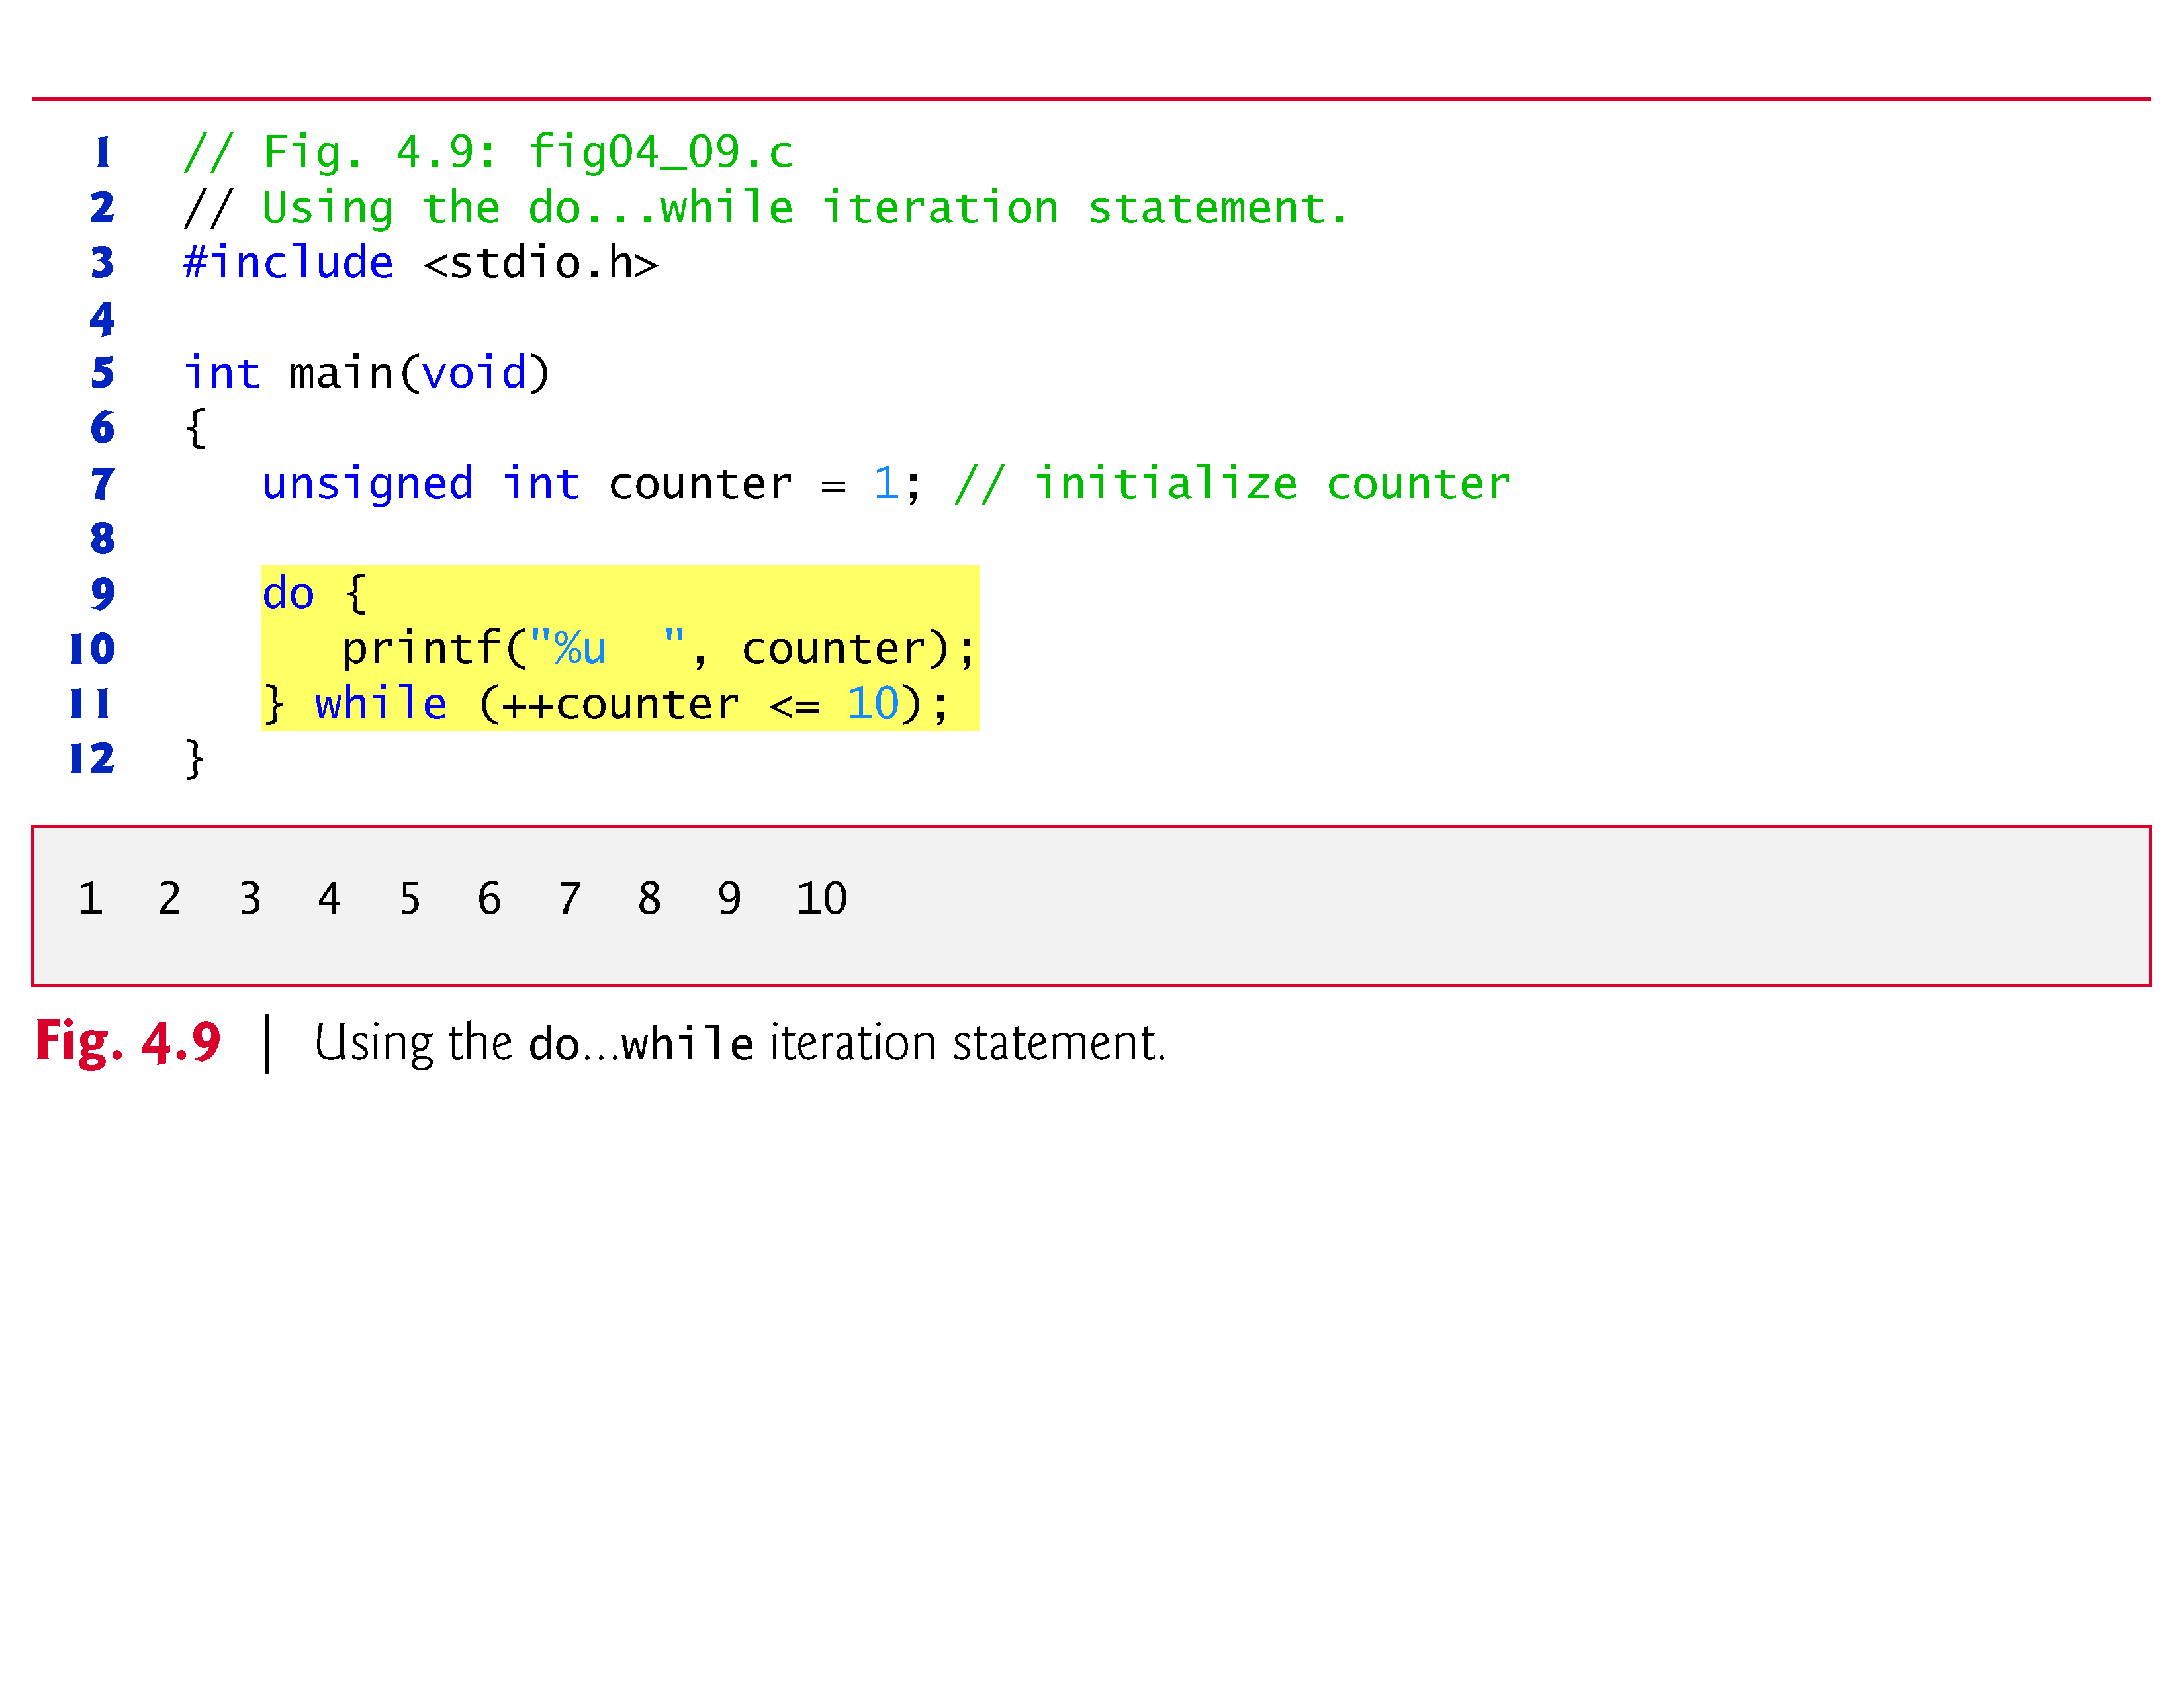

Slide 94
4.8 do…while Iteration Statement (Cont.)
do…while Statement Flowchart
Figure 4.10 shows the do…while statement flowchart, which makes it clear that the loop-continuation condition does not execute until after the action is performed at least once.

Slide 95
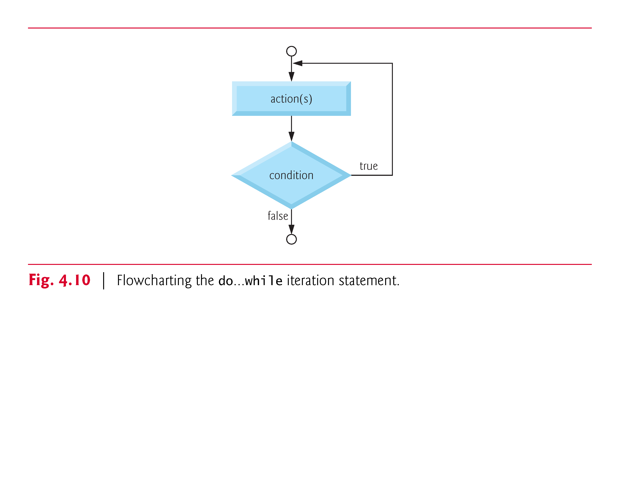

Slide 96
4.9 break and continue Statements
The break and continue statements are used to alter the flow of control.
break Statement
The break statement, when executed in a while, for, do…while or switch statement, causes an immediate exit from that statement.
Program execution continues with the next statement.
Common uses of the break statement are to escape early from a loop or to skip the remainder of a switch statement (as in Fig. 4.7).

Slide 97
4.9 break and continue Statements (Cont.)
Figure 4.11 demonstrates the break statement in a for iteration statement.
When the if statement detects that x has become 5, break is executed.
This terminates the for statement, and the program continues with the printf after the for.
The loop fully executes only four times.

Slide 98
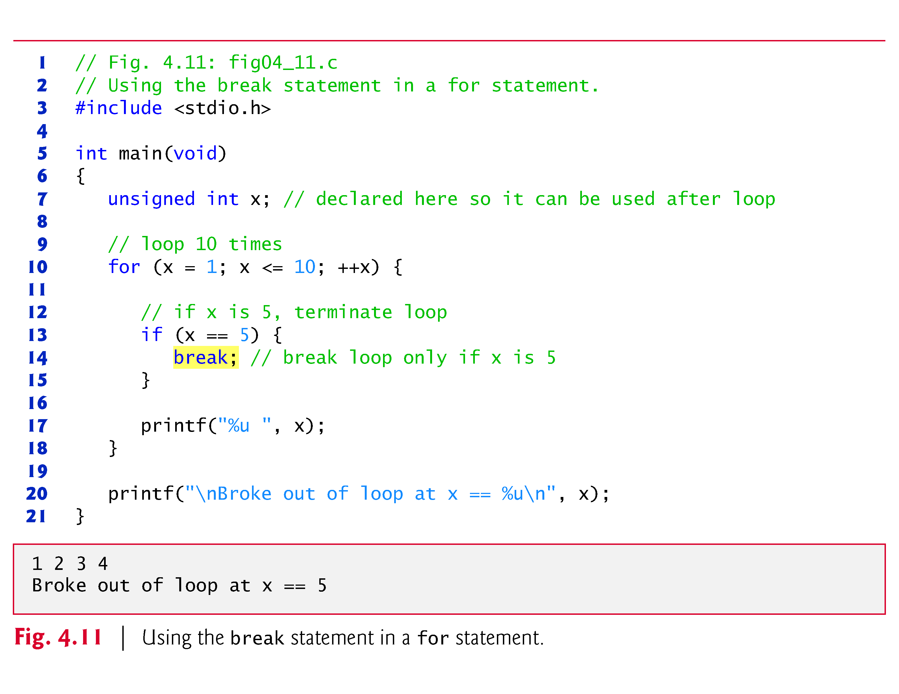

Slide 99
4.9 break and continue Statements (Cont.)
continue Statement
The continue statement, when executed in a while, for or do…while statement, skips the remaining statements in the body of that control statement and performs the next iteration of the loop.
In while and do…while statements, the loop-continuation test is evaluated immediately after the continue statement is executed.
In the for statement, the increment expression is executed, then the loop-continuation test is evaluated.
Figure 4.12 uses the continue statement in a for statement to skip the printf statement and begin the next iteration of the loop.

Slide 100
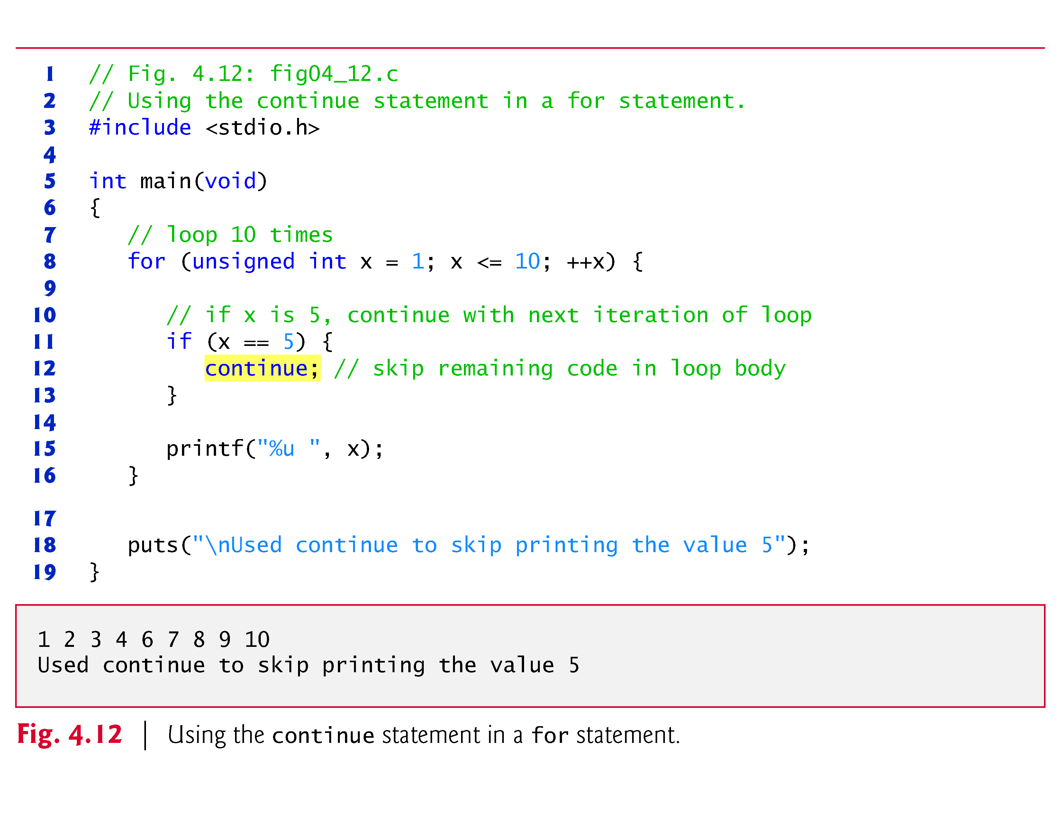

Slide 101
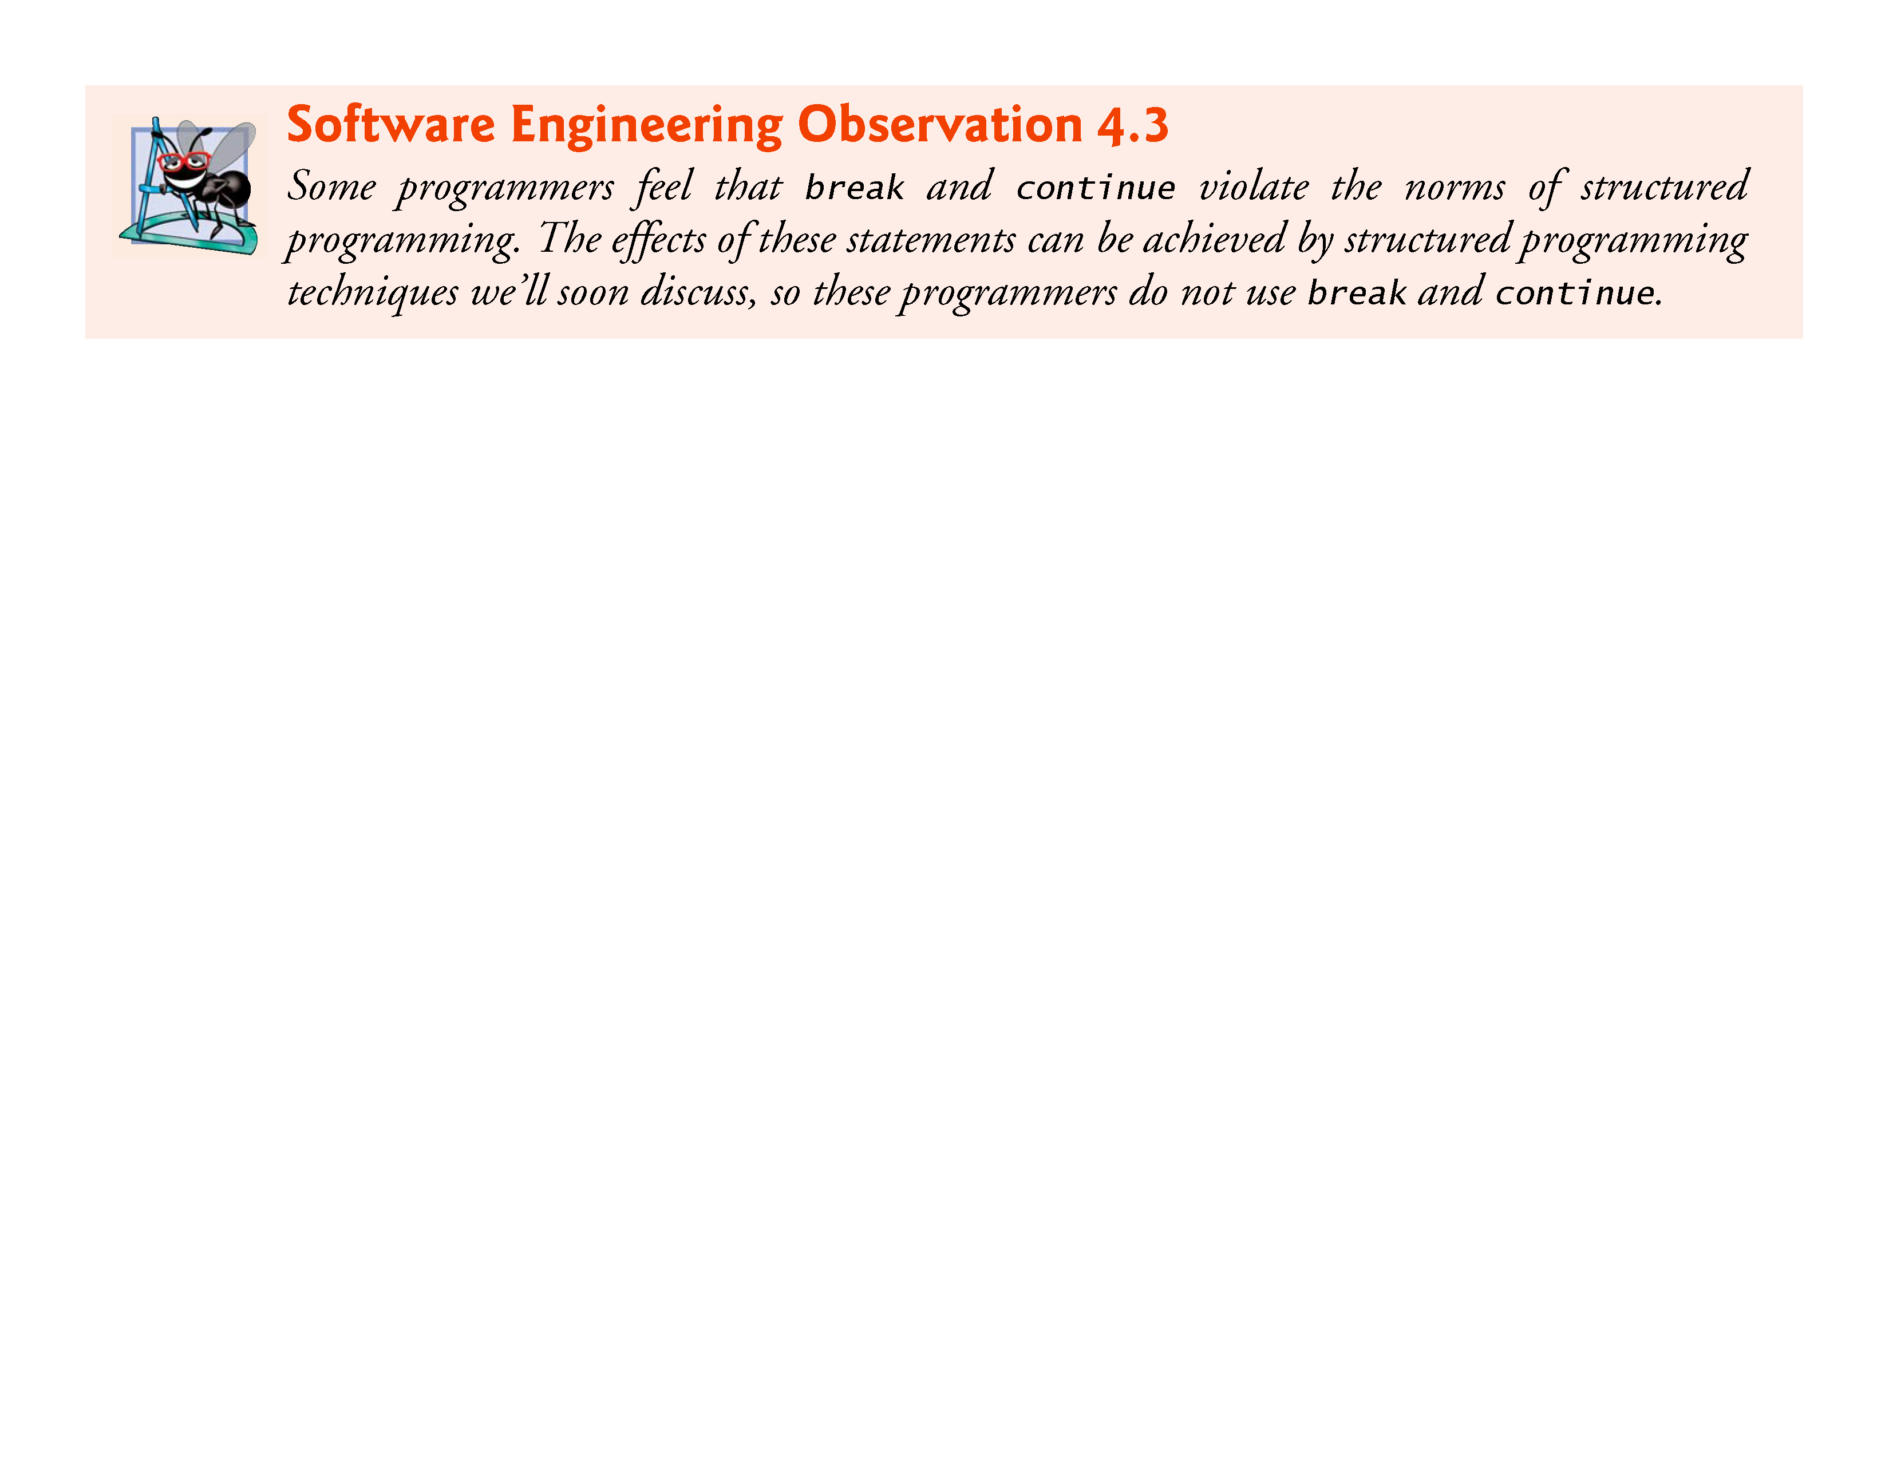

Slide 102
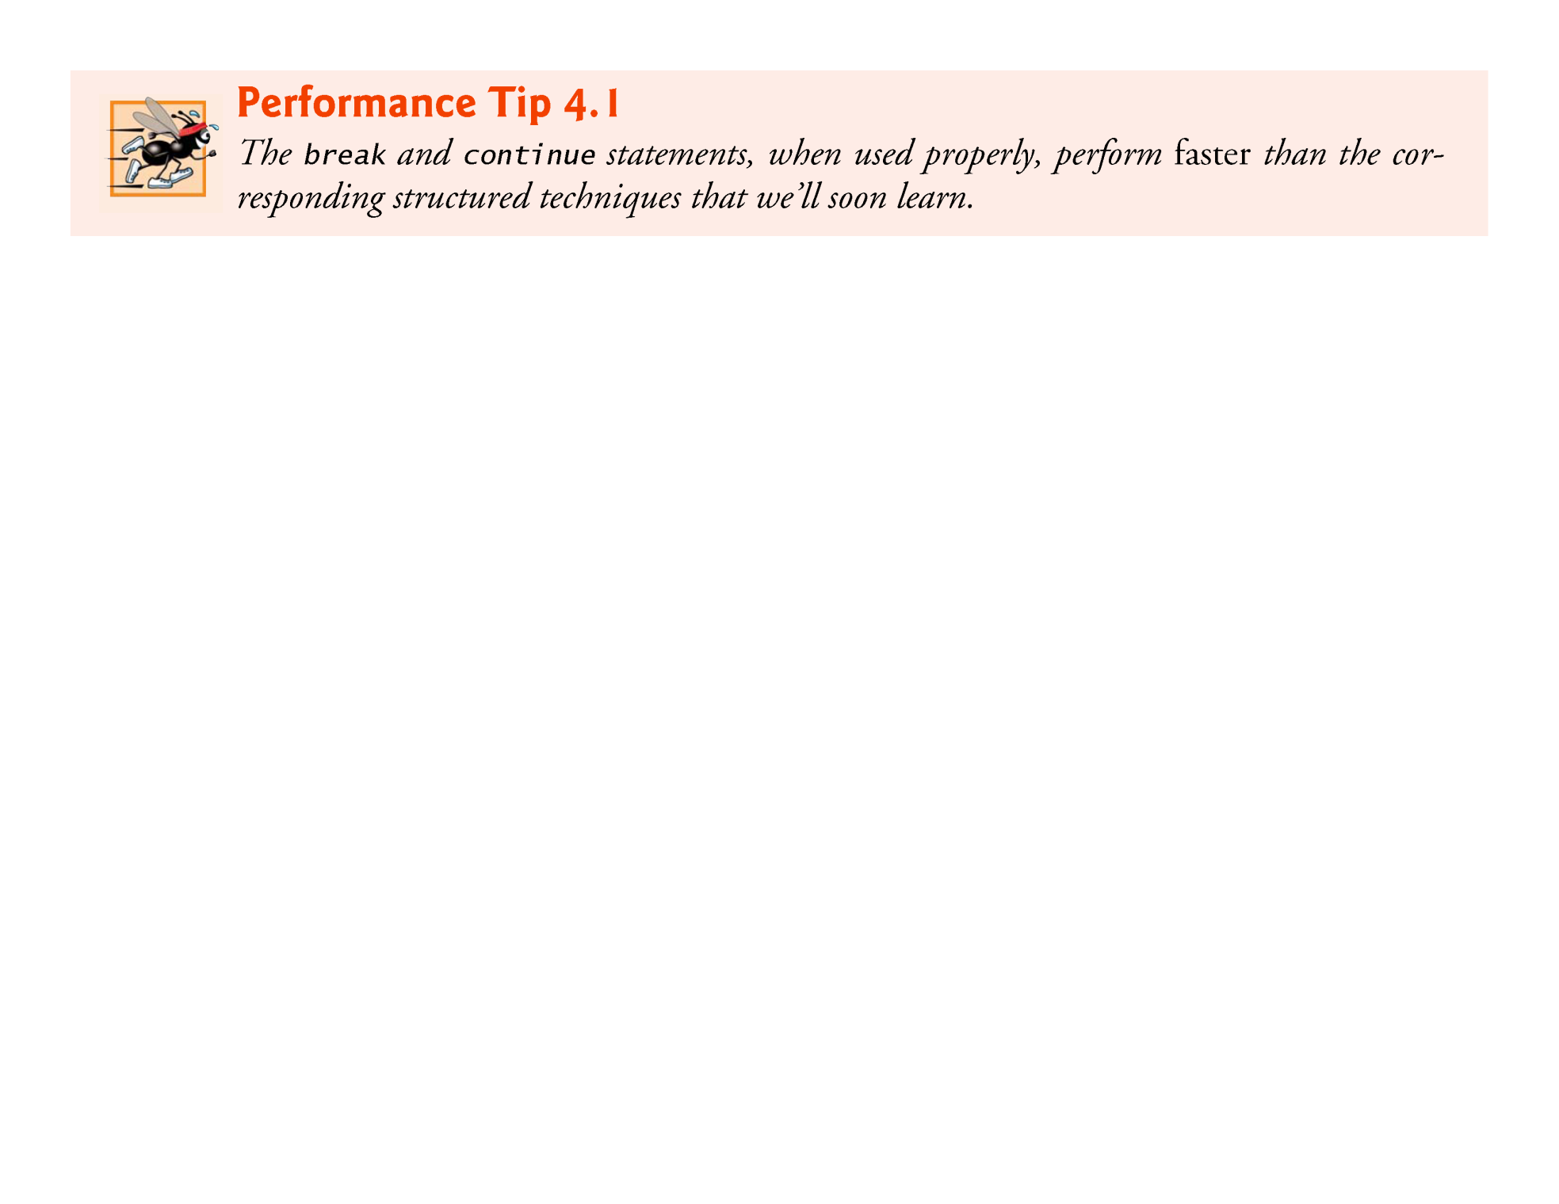

Slide 103
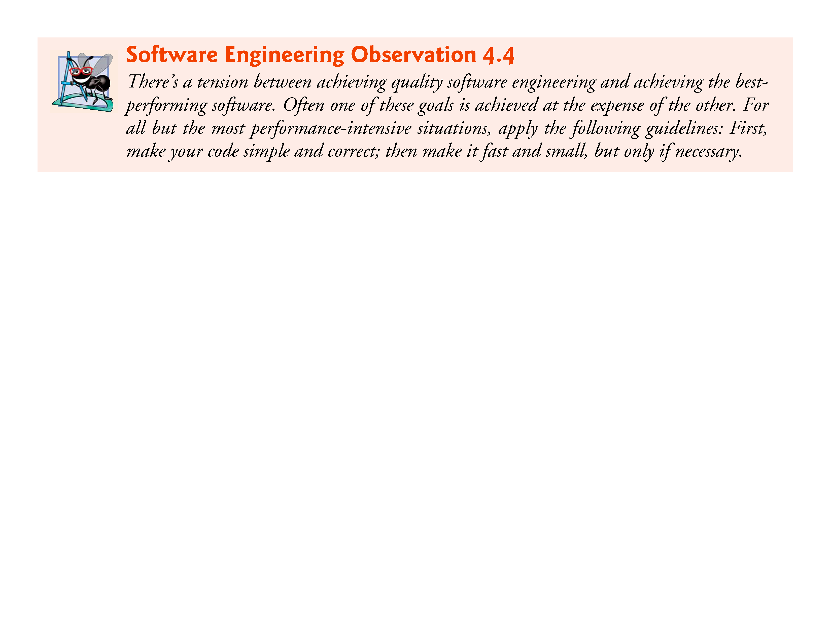

Slide 104
4.10 Logical Operators
C provides logical operators that may be used to form more complex conditions by combining simple conditions.
The logical operators are && (logical AND), || (logical OR) and ! (logical NOT also called logical negation).

Slide 105
4.10 Logical Operators (Cont.)
Logical AND (&&) Operator
Suppose we wish to ensure that two conditions are both true before we choose a certain path of execution.
In this case, we can use the logical operator && as follows:
if (gender == 1 && age >= 65) ++seniorFemales;
This if statement contains two simple conditions.
The condition gender == 1 might be evaluated, for example, to determine if a person is a female.
The condition age >= 65 is evaluated to determine whether a person is a senior citizen.
The two simple conditions are evaluated first because the precedences of == and >= are both higher than the precedence of &&.

Slide 106
4.10 Logical Operators (Cont.)
The if statement then considers the combined condition
gender == 1 && age >= 65
Which is true if and only if both of the simple conditions are true.
Finally, if this combined condition is true, then the count of seniorFemales is incremented by 1.
If either or both of the simple conditions are false, then the program skips the incrementing and proceeds to the statement following the if.
Figure 4.13 summarizes the && operator.

Slide 107
4.10 Logical Operators (Cont.)
The table shows all four possible combinations of zero (false) and nonzero (true) values for expression1 and expression2.
Such tables are often called truth tables.
C evaluates all expressions that include relational operators, equality operators, and/or logical operators to 0 or 1.
Although C sets a true value to 1, it accepts any nonzero value as true.

Slide 108
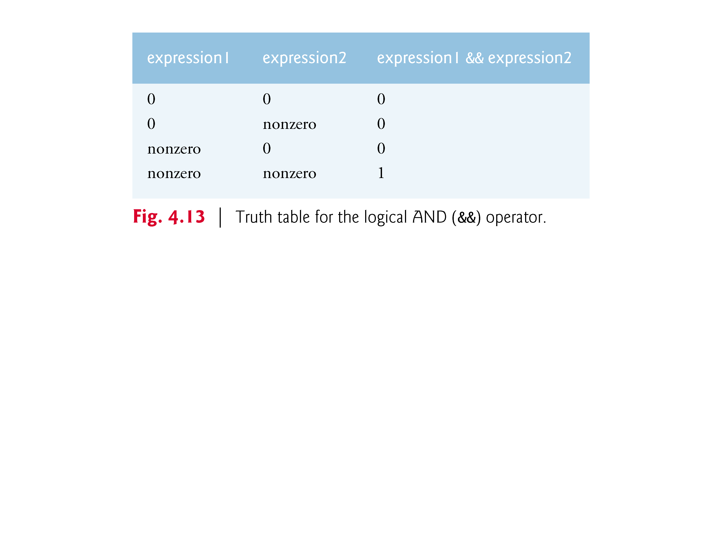

Slide 109
4.10 Logical Operators (Cont.)
Logical OR (||) Operator
Now let’s consider the || (logical OR) operator.
Suppose we wish to ensure at some point in a program that either or both of two conditions are true before we choose a certain path of execution.
In this case, we use the || operator as in the following program segment
if (semesterAverage >= 90 || finalExam >= 90) printf("Student grade is A");:
This statement also contains two simple conditions.
The condition semesterAverage >= 90 is evaluated to determine whether the student deserves an “A” in the course because of a solid performance throughout the semester.

Slide 110
4.10 Logical Operators (Cont.)
The condition finalExam >= 90 is evaluated to determine whether the student deserves an “A” in the course because of an outstanding performance on the final exam.
The if statement then considers the combined condition
semesterAverage >= 90 || finalExam >= 90
and awards the student an “A” if either or both of the simple conditions are true.
The message “Student grade is A” is not printed only when both of the simple conditions are false (zero).
Figure 4.14 is a truth table for the logical OR operator (||).

Slide 111
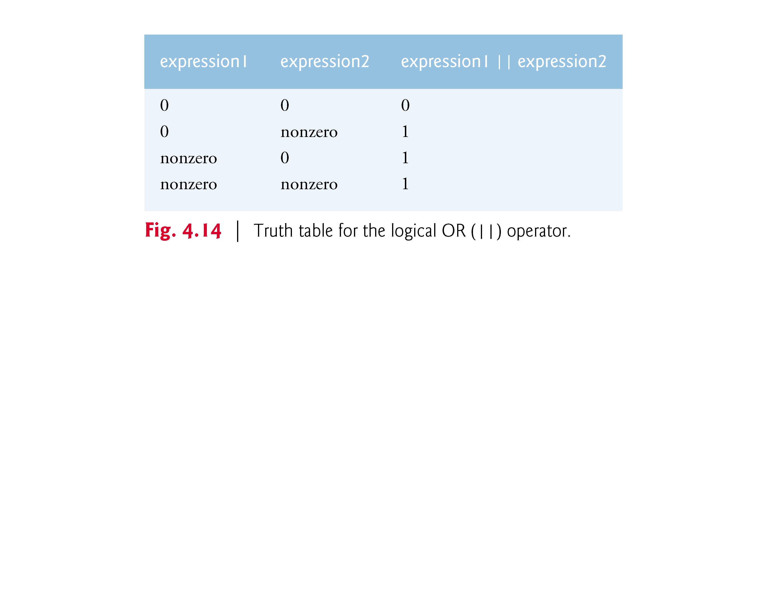

Slide 112
4.10 Logical Operators (Cont.)
The && operator has a higher precedence than ||.
Both operators associate from left to right.
An expression containing && or || operators is evaluated only until truth or falsehood is known.
Thus, evaluation of the condition
gender == 1 && age >= 65
will stop if gender is not equal to 1 (i.e., the entire expression is false), and continue if gender is equal to 1 (i.e., the entire expression could still be true if age >= 65).
This performance feature for the evaluation of logical AND and logical OR expressions is called short-circuit evaluation.

Slide 113
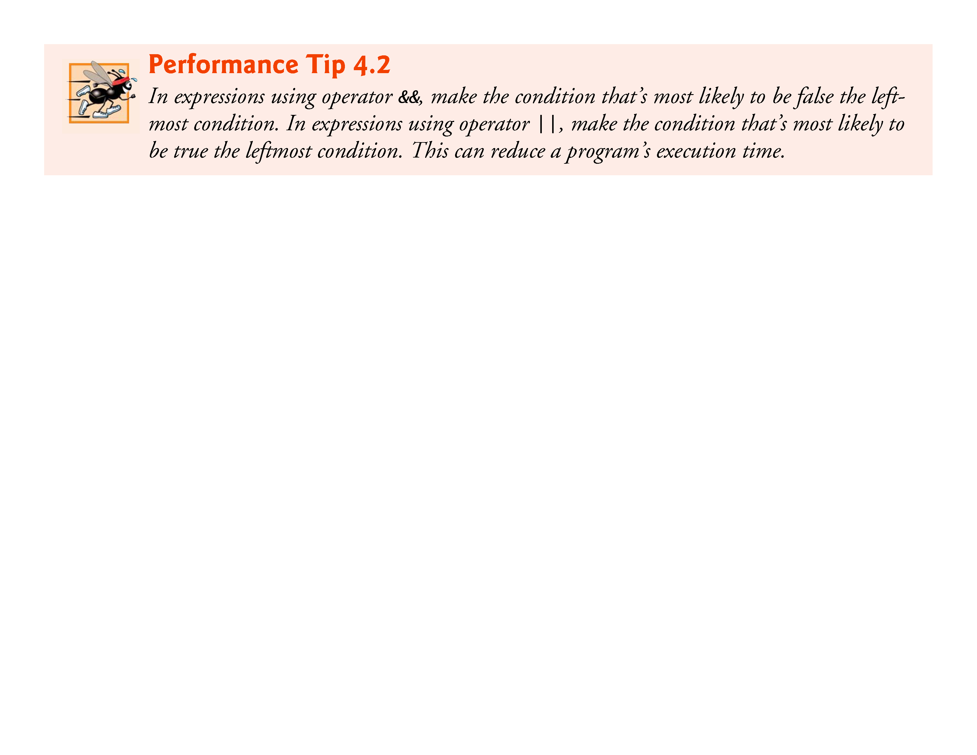

Slide 114
4.10 Logical Operators (Cont.)
Logical Negation (!) Operator
C provides ! (logical negation) to enable you to “reverse” the meaning of a condition.
The logical negation operator has only a single condition as an operand (and is therefore a unary operator).
Placed before a condition when we’re interested in choosing a path of execution if the original condition (without the logical negation operator) is false, such as in the following program segment:
if (!(grade == sentinelValue)) printf("The next grade is %f\n", grade);
The parentheses around the condition grade == sentinelValue are needed because the logical negation operator has a higher precedence than the equality operator.
Figure 4.15 is a truth table for the logical negation operator.

Slide 115
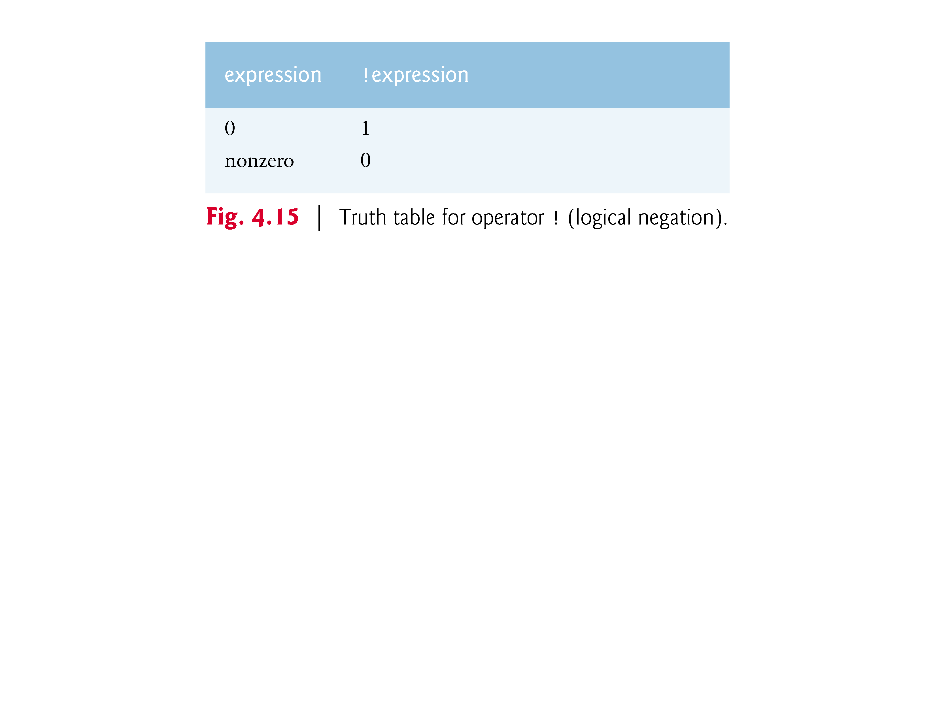

Slide 116
4.10 Logical Operators (Cont.)
In most cases, you can avoid using logical negation by expressing the condition differently with an appropriate relational operator.
For example, the preceding statement may also be written as follows:
if (grade != sentinelValue) printf("The next grade is %f\n", grade);

Slide 117
4.10 Logical Operators (Cont.)
Summary of Operator Precedence and Associativity
Figure 4.16 shows the precedence and associativity of the operators introduced to this point.
The operators are shown from top to bottom in decreasing order of precedence.

Slide 118
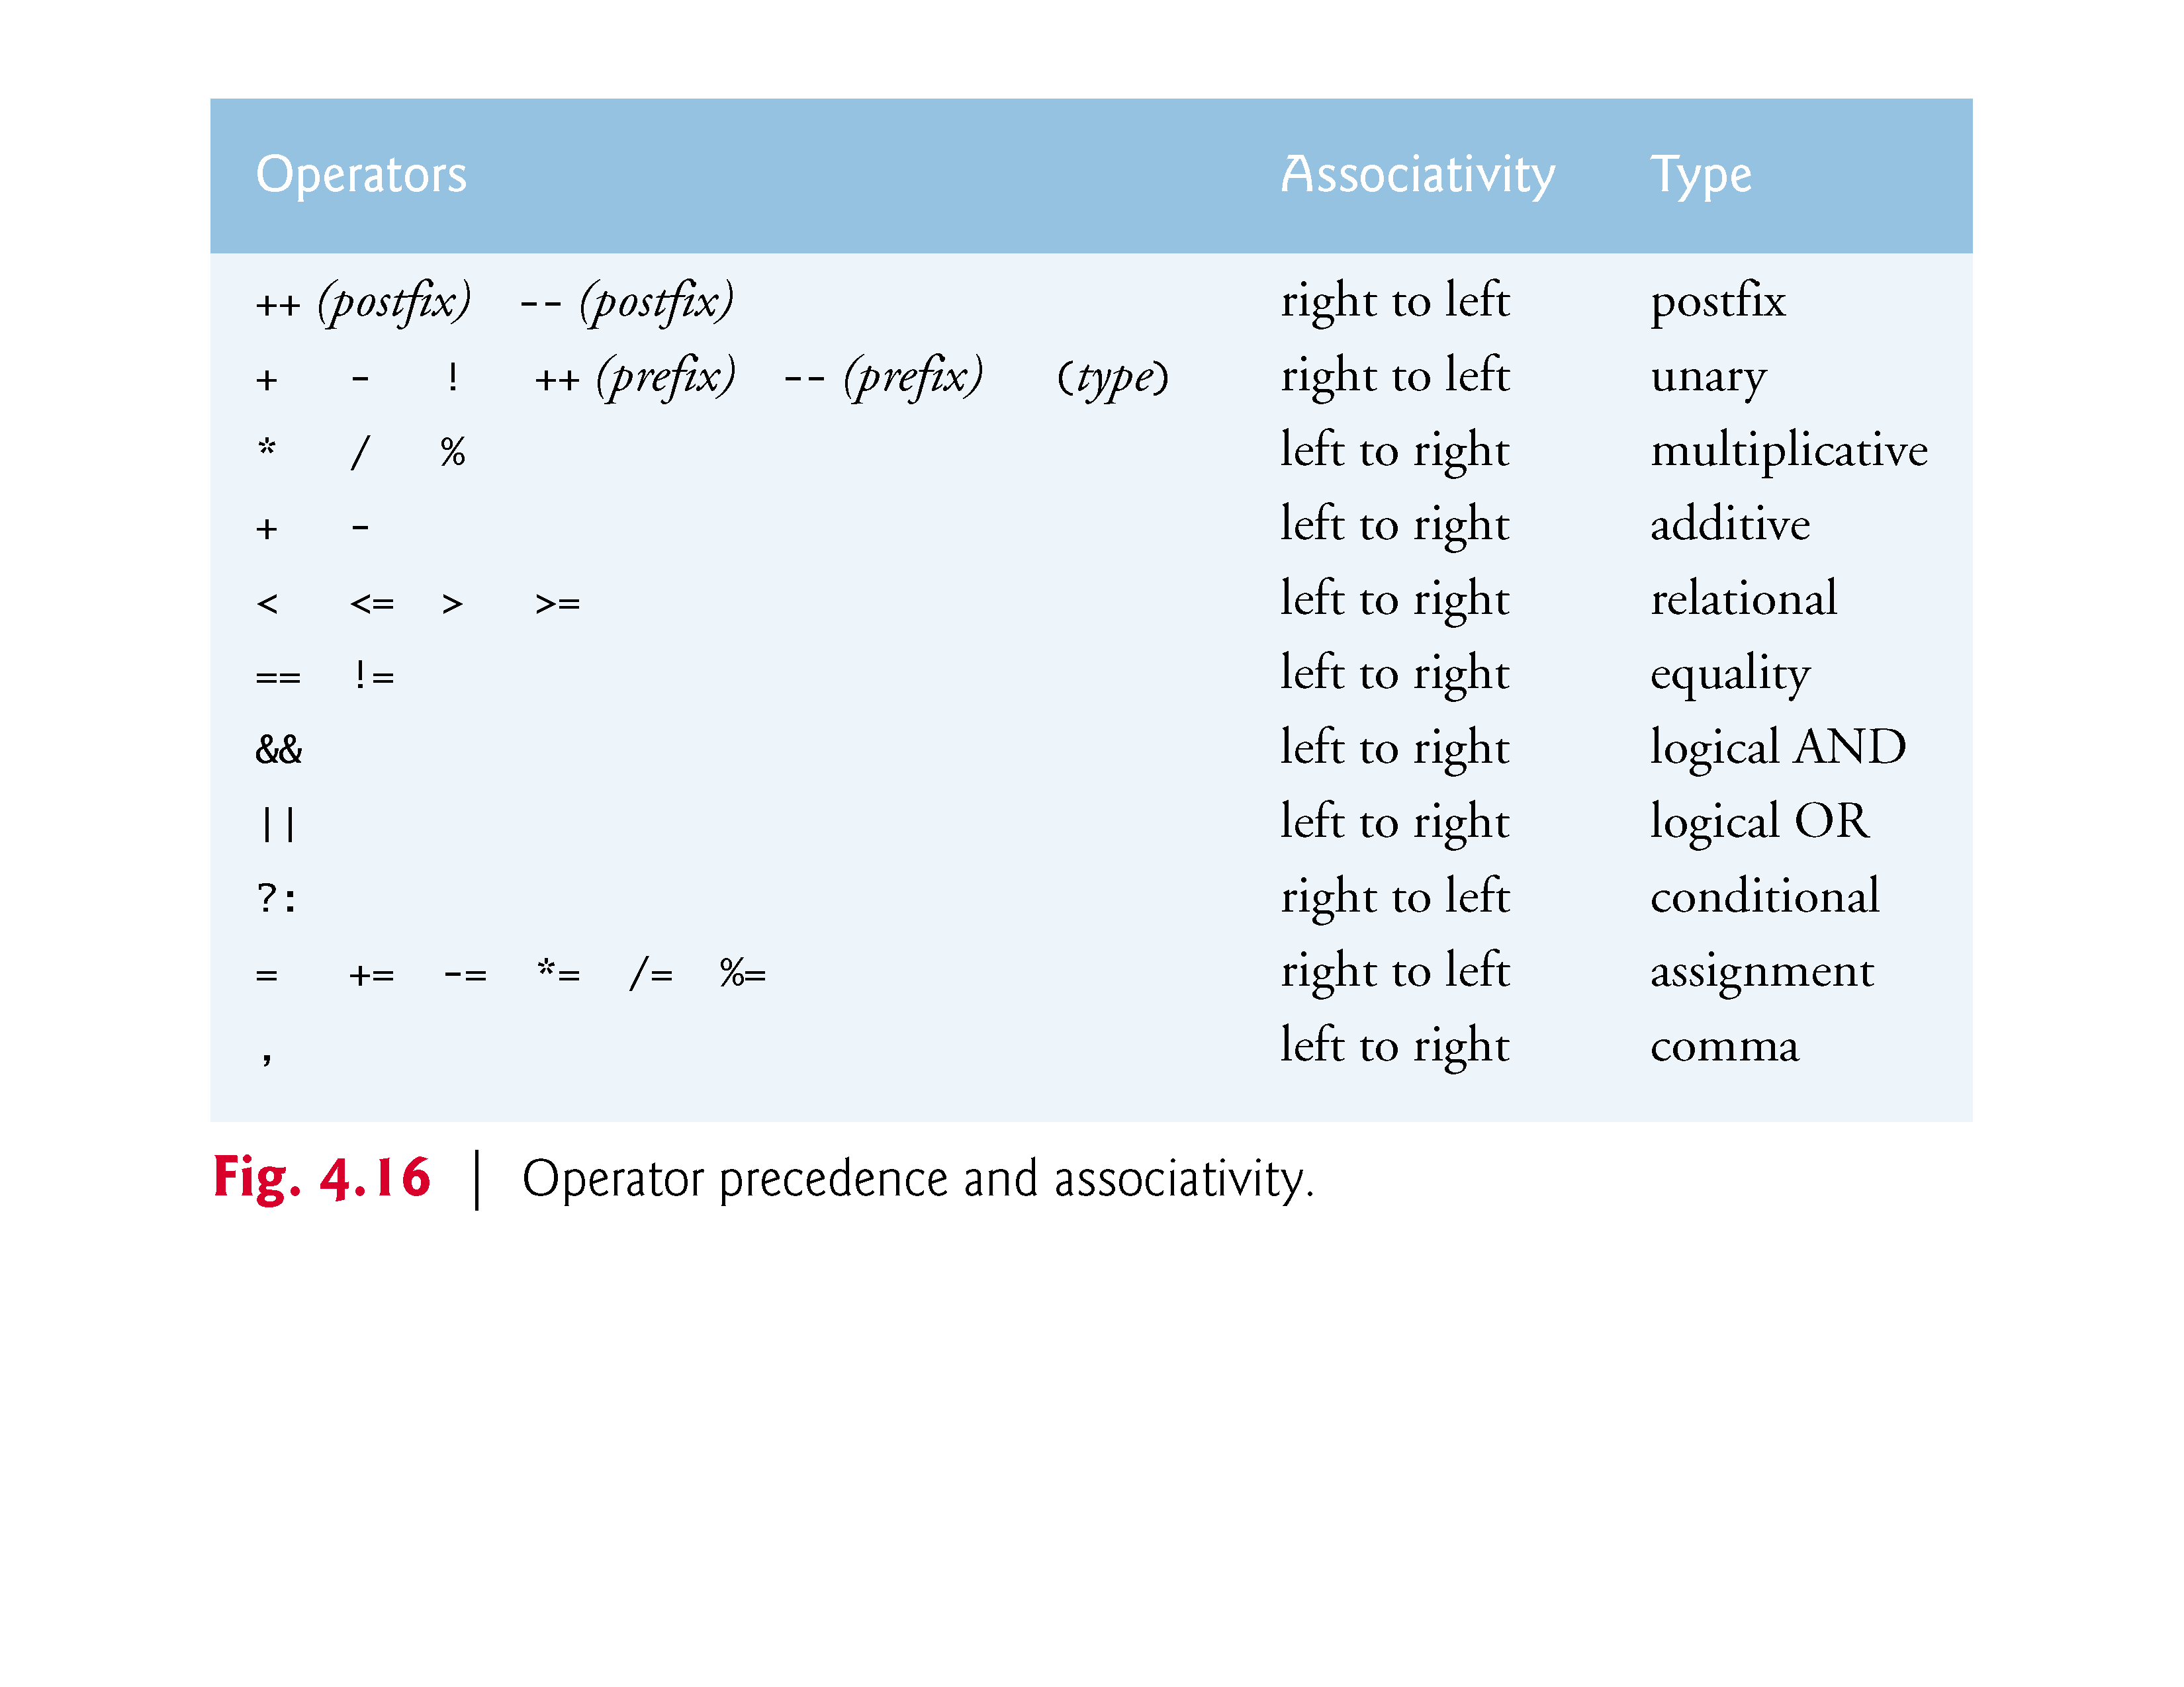

Slide 119
4.10 Logical Operators (Cont.)
The _Bool Data Type
The C standard includes a boolean type—represented by the keyword _Bool—which can hold only the values 0 or 1.
Recall C’s convention of using zero and nonzero values to represent false and true—the value 0 in a condition evaluates to false, while any nonzero value evaluates to true.
Assigning any non-zero value to a _Bool sets it to 1.
The standard also includes the <stdbool.h> header, which defines bool as a shorthand for the type _Bool, and true and false as named representations of 1 and 0, respectively.

Slide 120
4.10 Logical Operators (Cont.)
At preprocessor time, bool, true and false are replaced with _Bool, 1 and 0.
Section F.8 presents an example that uses bool, true and false.
The example uses a programmer-defined function, a concept we introduce in Chapter 5.
Microsoft Visual C++ does not implement the _Bool data type.

Slide 121
4.11 Confusing Equality (==) and Assignment (=) Operators
There’s one type of error that C programmers, no matter how experienced, tend to make so frequently that we felt it was worth a separate section.
That error is accidentally swapping the operators == (equality) and = (assignment).
What makes these swaps so damaging is the fact that they do not ordinarily cause compilation errors.
Rather, statements with these errors ordinarily compile correctly, allowing programs to run to completion while likely generating incorrect results through runtime logic errors.

Slide 122
4.11 Confusing Equality (==) and Assignment (=) Operators (Cont.)
Two aspects of C cause these problems.
One is that any expression in C that produces a value can be used in the decision portion of any control statement.
If the value is 0, it’s treated as false, and if the value is nonzero, it’s treated as true.
The second is that assignments in C produce a value, namely the value that’s assigned to the variable on the left side of the assignment operator.

Slide 123
4.11 Confusing Equality (==) and Assignment (=) Operators (Cont.)
For example, suppose we intend to write
if (payCode == 4) printf(“%s“, "You get a bonus!");
but we accidentally write
if (payCode = 4) printf(“%s“, "You get a bonus!");
The first if statement properly awards a bonus to the person whose paycode is equal to 4.
The second if statement—the one with the error—evaluates the assignment expression in the if condition.

Slide 124
4.11 Confusing Equality (==) and Assignment (=) Operators (Cont.)
This expression is a simple assignment whose value is the constant 4.
Because any nonzero value is interpreted as “true,” the condition in this if statement is always true, and not only is the value of payCode inadvertantly set to 4, but the person always receives a bonus regardless of what the actual paycode is!

Slide 125
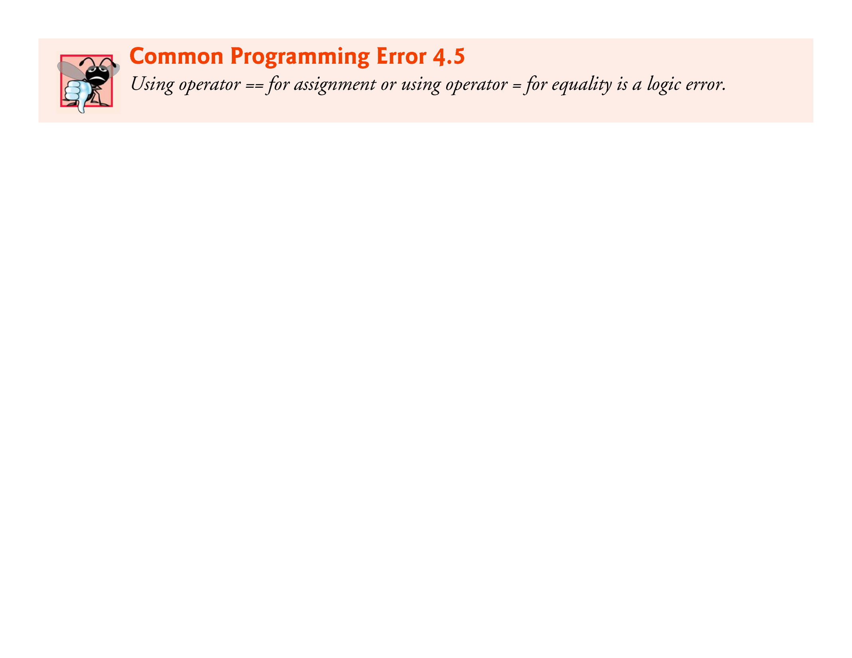

Slide 126
4.11 Confusing Equality (==) and Assignment (=) Operators (Cont.)
lvalues and rvalues
You’ll probably be inclined to write conditions such as x == 7 with the variable name on the left and the constant on the right.
By reversing these terms so that the constant is on the left and the variable name is on the right, as in 7 == x, then if you accidentally replace the == operator with =, you’ll be protected by the compiler.
The compiler will treat this as a syntax error, because only a variable name can be placed on the left-hand side of an assignment expression.
This will prevent the potential devastation of a runtime logic error.

Slide 127
4.11 Confusing Equality (==) and Assignment (=) Operators (Cont.)
Variable names are said to be lvalues (for “left values”) because they can be used on the left side of an assignment operator.
Constants are said to be rvalues (for “right values”) because they can be used on only the right side of an assignment operator.
lvalues can also be used as rvalues, but not vice versa.

Slide 128
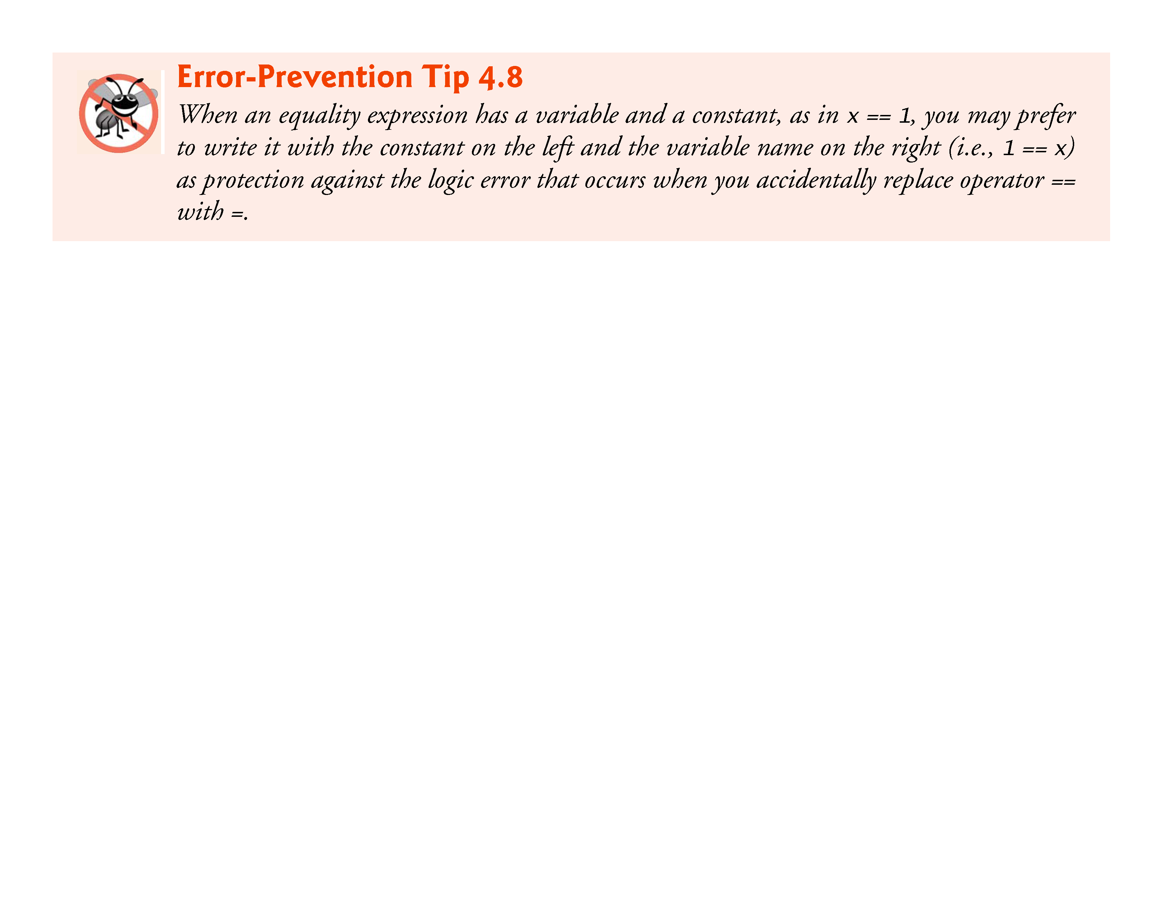

Slide 129
4.11 Confusing Equality (==) and Assignment (=) Operators (Cont.)
Confusing == and = in Standalone Statements
The other side of the coin can be equally unpleasant.
Suppose you want to assign a value to a variable with a simple statement such as
x = 1;
but instead write
x == 1;
Here, too, this is not a syntax error.
Rather the compiler simply evaluates the conditional expression.

Slide 130
4.11 Confusing Equality (==) and Assignment (=) Operators (Cont.)
If x is equal to 1, the condition is true and the expression returns the value 1.
If x is not equal to 1, the condition is false and the expression returns the value 0.
Regardless of what value is returned, there’s no assignment operator, so the value is simply lost, and the value of x remains unaltered, probably causing an execution-time logic error.
Unfortunately, we do not have a handy trick available to help you with this problem! Many compilers, however, will issue a warning on such a statement.

Slide 131
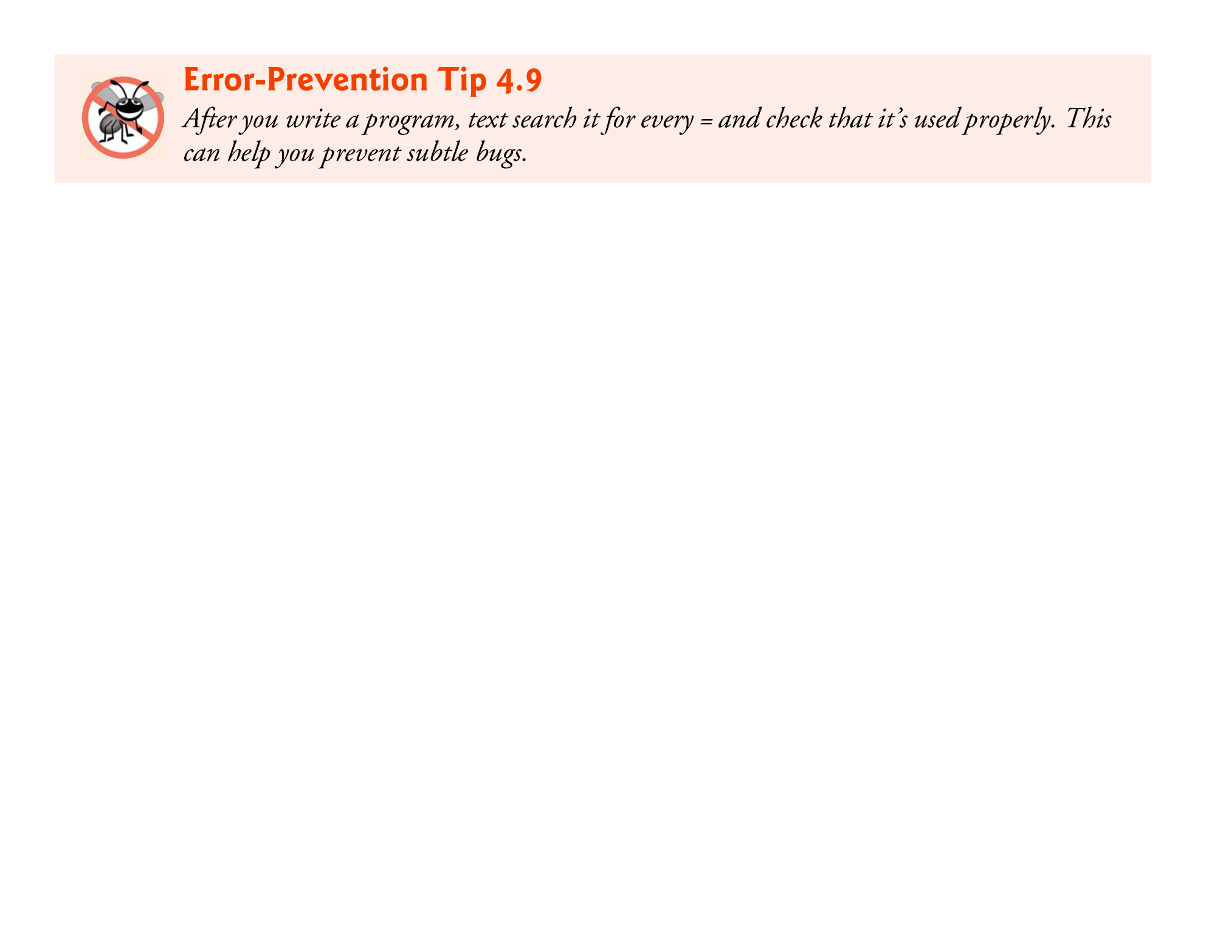

Slide 132
4.12 Structured Programming Summary
Figure 4.17 summarizes the control statements discussed in Chapters 3 and 4.
Small circles are used in the figure to indicate the single entry point and the single exit point of each statement.
Connecting individual flowchart symbols arbitrarily can lead to unstructured programs.
Therefore, the programming profession has chosen to combine flowchart symbols to form a limited set of control statements, and to build only structured programs by properly combining control statements in two simple ways.

Slide 133
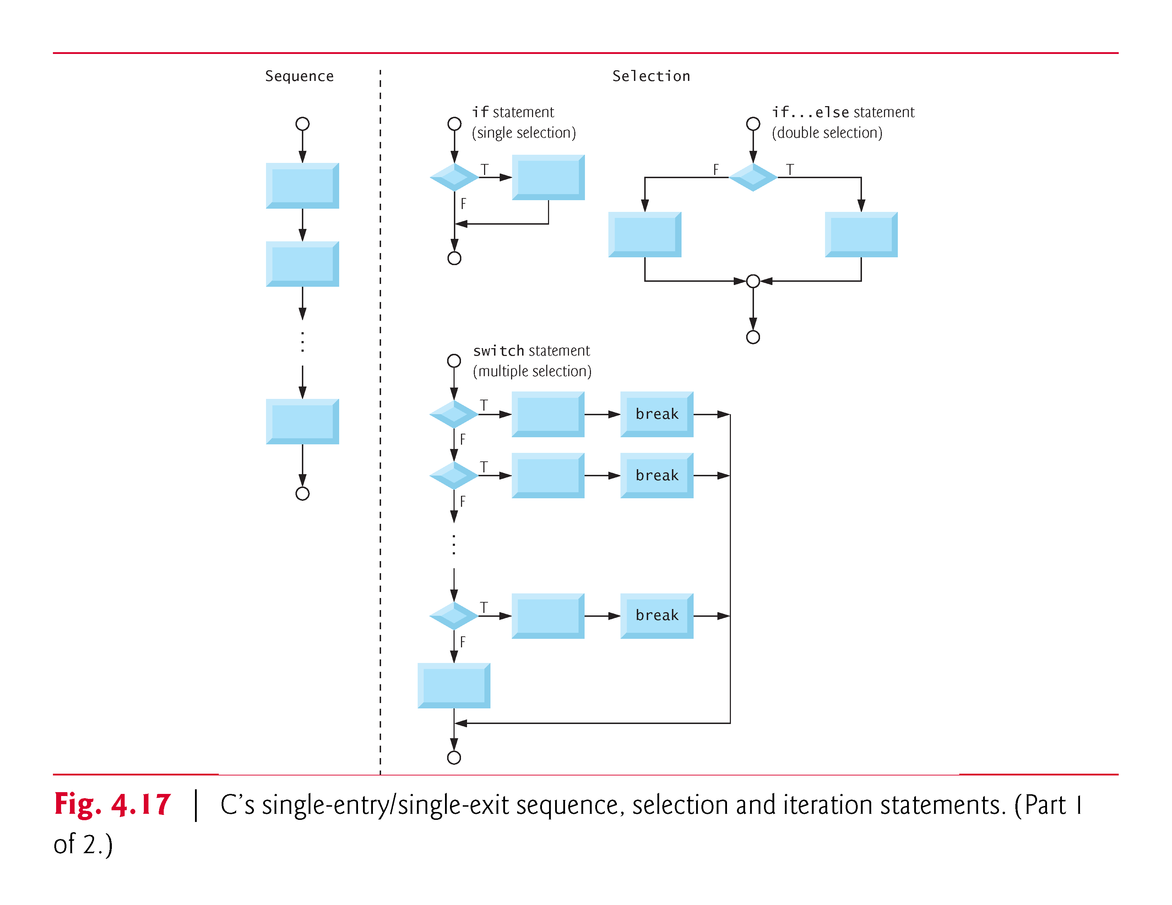

Slide 134
4.12 Structured Programming Summary (Cont.)
For simplicity, only single-entry/single-exit control statements are used—there’s only one way to enter and only one way to exit each control statement.
Connecting control statements in sequence to form structured programs is simple—the exit point of one control statement is connected directly to the entry point of the next, i.e., the control statements are simply placed one after another in a program—we’ve called this “control-statement stacking.”
The rules for forming structured programs also allow for control statements to be nested.

Slide 135
4.12 Structured Programming Summary (Cont.)
Figure 4.18 shows the rules for forming structured programs.
The rules assume that the rectangle flowchart symbol may be used to indicate any action including input/output.
Figure 4.19 shows the simplest flowchart.

Slide 136


Slide 137


Slide 138


Slide 139
4.12 Structured Programming Summary (Cont.)
Applying the rules of Fig. 4.18 always results in a structured flowchart with a neat, building-block appearance.
Repeatedly applying Rule 2 to the simplest flowchart (Fig. 4.19) results in a structured flowchart containing many rectangles in sequence (Fig. 4.20).
Rule 2 generates a stack of control statements; so we call Rule 2 the stacking rule.

Slide 140


Slide 141
4.12 Structured Programming Summary (Cont.)
Rule 3 is called the nesting rule.
Repeatedly applying Rule 3 to the simplest flowchart results in a flowchart with neatly nested control statements.
For example, in Fig. 4.21, the rectangle in the simplest flowchart is first replaced with a double-selection (if…else) statement.
Then Rule 3 is applied again to both of the rectangles in the double-selection statement, replacing each of these rectangles with double-selection statements.
The dashed box around each of the double-selection statements represents the rectangle that was replaced in the original flowchart.

Slide 142


Slide 143
4.12 Structured Programming Summary (Cont.)
Rule 4 generates larger, more involved, and more deeply nested structures.
The flowcharts that emerge from applying the rules in Fig. 4.18 constitute the set of all possible structured flowcharts and hence the set of all possible structured programs.
It’s because of the elimination of the goto statement that these building blocks never overlap one another.
The beauty of the structured approach is that we use only a small number of simple single-entry/single-exit pieces, and we assemble them in only two simple ways.

Slide 144
4.12 Structured Programming Summary (Cont.)
Figure 4.22 shows the kinds of stacked building blocks that emerge from applying Rule 2 and the kinds of nested building blocks that emerge from applying Rule 3.
The figure also shows the kind of overlapped building blocks that cannot appear in structured flowcharts (because of the elimination of the goto statement).

Slide 145


Slide 146
4.12 Structured Programming Summary (Cont.)
If the rules in Fig. 4.18 are followed, an unstructured flowchart (such as that in Fig. 4.23) cannot be created.
If you’re uncertain whether a particular flowchart is structured, apply the rules of Fig. 4.18 in reverse to try to reduce the flowchart to the simplest flowchart.
If you succeed, the original flowchart is structured; otherwise, it’s not.
Structured programming promotes simplicity.
Bohm and Jacopini showed that only three forms of control are needed:
Sequence
Selection
Iteration

Slide 147


Slide 148
4.12 Structured Programming Summary (Cont.)
Sequence is straighforward.
Selection is implemented in one of three ways:
if statement (single selection)
if…else statement (double selection)
switch statement (multiple selection)
In fact, it’s straightforward to prove that the simple if statement is sufficient to provide any form of selection—everything that can be done with the if…else statement and the switch statement can be implemented with one or more if statements.

Slide 149
4.12 Structured Programming Summary (Cont.)
Iteration is implemented in one of three ways:
while statement
do…while statement
for statement
It’s straightforward to prove that the while statement is sufficient to provide any form of iteration.
Everything that can be done with the do…while statement and the for statement can be done with the while statement.

Slide 150
4.12 Structured Programming Summary (Cont.)
Combining these results illustrates that any form of control ever needed in a C program can be expressed in terms of only three forms of control:
sequence
if statement (selection)
while statement (iteration)
And these control statements can be combined in only two ways—stacking and nesting.
Indeed, structured programming promotes simplicity.

Slide 151
4.12 Structured Programming Summary (Cont.)
In Chapters 3 and 4, we discussed how to compose programs from control statements containing actions and decisions.
In Chapter 5, we introduce another program structuring unit called the function.
We’ll learn to compose large programs by combining functions, which, in turn, are composed of control statements.
We’ll also discuss how using functions promotes software reusability.

Slide 152
4.13 Secure C Programming
Checking Function scanf’s Return Value
Figure 4.6 used the math library function pow, which calculates the value of its first argument raised to the power of its second argument and returns the result as a double value.
The calculation’s result was then used in the statement that called pow.

Slide 153
4.13 Secure C Programming (Cont.)
Many functions return values indicating whether they executed successfully.
For example, function scanf returns an int indicating whether the input operation was successful.
If an input failure occurs, scanf returns the value EOF (defined in <stdio.h>); otherwise, it returns the number of items that were read.
If this value does not match the number you intended to read, then scanf was unable to complete the input operation.

Slide 154
4.13 Secure C Programming (Cont.)
Consider the following statement from Fig. 3.6
scanf("%d", &grade); // read grade from user
which expects to read one int value.
If the user enters an integer, scanf returns 1 indicating that one value was indeed read.
If the user enters a string, such as "hello", scanf returns 0 indicating that it was unable to read the input as an integer.
In this case, the variable grade does not receive a value.

Slide 155
4.13 Secure C Programming (Cont.)
Function scanf can read multiple inputs, as in
scanf("%d%d", &number1, &number2); // read two integers
If the input is successful, scanf will return 2 indicating that two values were read.
If the user enters a string for the first value, scanf will return 0 and neither number1 nor number2 will receive values.
If the user enters an integer followed by a string, scanf will return 1 and only number1 will receive a value.

Slide 156
4.13 Secure C Programming (Cont.)
To make your input processing more robust, check scanf’s return value to ensure that the number of inputs read matches the number of inputs expected.
Otherwise, your program will use the values of the variables as if scanf completed successfully.
This could lead to logic errors, program crashes or even attacks.

Slide 157
4.13 Secure C Programming (Cont.)
Range Checking
Even if a scanf operates successfully, the values read might still be invalid.
For example, grades are typically integers in the range 0–100. In a program that inputs such grades, you should validate the grades by using range checking to ensure that they are values from 0 to 100.
You can then ask the user to reenter any value that’s out of range.

Slide 158
4.13 Secure C Programming (Cont.)
If a program requires inputs from a specific set of values (e.g., non-sequential product codes), you can ensure that each input matches a value in the set.

Slide 159


